Slide 1
Transfer to Secondary School Process and useful information
Jim Britton
St John’s CE Primary
09 Sept 2019

Slide 2
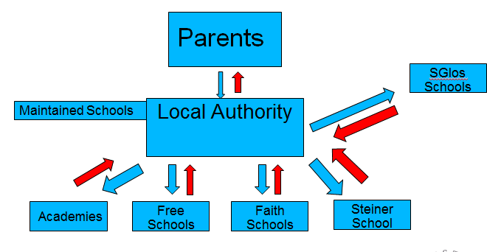
Introduction
Not connected to any School or Academy Trust
Coordinating role
Contact me at james.britton@bristol.gov.uk

Slide 3
Key Points
You cannot apply until 12th Sept 2019.
Apply on time before midnight 31st Oct 2019
Read the Admission Criteria
Check if you need to complete a SIF
Check if you need to attend a test
Use all 3 preferences if you can
Use the tools on the BCC website
Contact Jim if you have any questions

Slide 4
Admissions Criteria – How they decide who gets the places
Academies, Faith Schools etc. can set their own Admissions Criteria
Some use Catchment Areas
Some prioritise FSM recipients
Some have Social/Medical grounds
Others have faith criteria
Some use random allocation

Slide 5
1. Children in care or previously in care
Children in care co-ordinated by LA
Definition of previously in care:
‘Children who were looked after but ceased to be so because they were adopted (or became subject to a residence order or special guardianship order)’

Slide 6
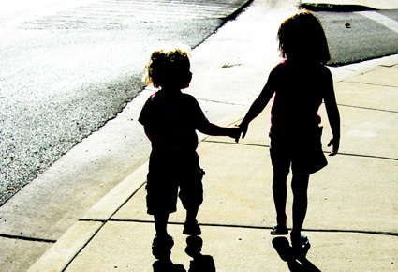
2. Siblings
Brother, sister, half brother or sister, step brother or sister or child of parent/carer’s partner where the child for whom the place is sought is living in the same family unit at the same address as that sibling.
Only applies when the sibling is in attendance

Slide 7
3. Geography
APAs, Parish Boundaries
Home to school distance
As the crow flies
Home address is where the child spends the majority of the time
May need to request evidence eg. tenancy agreement or letter from solicitor
Consequences of using a false address

Slide 8
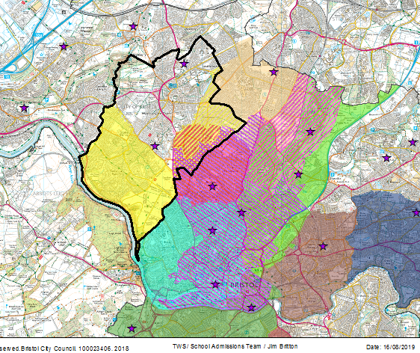
Admissions Priority Areas
Use the My Neighbourhoods Tool

Slide 9
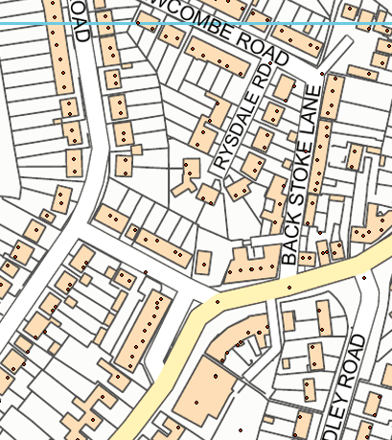
LPG Points & Distance Calculation

Slide 10
Case Study
Jenny lives at 21 Anglesea Place
Parents check ‘My Neighbourhood’ and they live in Cotham’s ‘Area’
Parent visits all the schools and does a lot of research
Lives close to Cotham and RGS but would prefer Bristol Cathedral Choir because Mum works next door and best friend will be going there as has a sibling. Also likes Colston’s Girls.

Slide 11
Scenario 1 – Just one preference
“I really want Bristol Cathedral Choir School. I feel it is the perfect school for Jenny. I am going to put it down as my one and only preference so that the council can’t fob me off with something else”
1st Pref – Bristol Cathedral Choir
2nd Pref – None
3rd Pref - None

Slide 12
Scenario 1 - Outcome
Jenny’s application is considered under BCCS random allocation. A draw takes place and Jenny’s name is drawn 897th . A place cannot be offered.
No other schools are listed as preferences
At the end of the process Jim looks at a list of all those children yet to be offered a school, puts them on a map and offers them the nearest school with a place available which is 6km away.

Slide 13
Scenario 2 – Three Preferences
“I really want Bristol Cathedral Choir School. I feel it is the perfect school for Jenny. I am going to put it down as my 1st preference. I realise that there is a strong possibility that I may not get it, so I will add Colston’s Girls as my 2nd preference and Cotham as my 3rd.
1st Pref – Bristol Cathedral Choir
2nd Pref – Colston’s Girls
3rd Pref – Cotham

Slide 14
Scenario 2 - Outcome
Jenny’s application is considered under BCCS random allocation. A draw takes place and Jenny’s name is drawn 523rd . A place cannot be offered.
Jenny also misses out on a place at Colston’s Girls.
She qualifies for a place at Cotham the fact that it is a 3rd preference makes no difference. Her 3rd preference ranks higher than a 1st preference who lives further away.
Jenny can still go on a waiting list for BCCS or appeal and the place at Cotham will be saved while she waits.

Slide 15
Rounds of Allocation
1st Round – 31st March 2020
2nd Round – Late May 2020
Subsequent Rounds as and when up until September 2020

Slide 16
Waiting List or Appeal?
Both treated the same by me
Appeals worth a try
Very fair transparent process
Appeals take place May – July 2020

Slide 17
What Happened Last Year?
Health Warning
Things will be different this year
More Pupils in Year 6
CST Trinity is open and is an option
Colston’s Girls taking 28 fewer pupils

Slide 18
What happened last year?
Redland Green
1st Round – In Area within 1km
End of Process – In Area with 1.2km
There are applicants living outside the APA with siblings who missed out

Slide 19
What happened last year?
Cotham
1st Round – Everybody within a 2.146km radius
End of Process – Everybody within a 2.33km radius
Bristol Free
1st Round – Everybody within the APA
End of Process –
Everybody within a 921m radius of the school
Everybody within a 2.7km radius of the measure point

Slide 20
What happened last year?
BCCS
Only 54 places left for random allocation
Over 1300 applications!
CGS
Only 107 places left for random allocation
Over 800 applications!
28 fewer places this year.

Slide 21
What happened last year?
Fairfield
1st Round – Outside Area as far as 1.11km radius
End of Process – Outside Area as far as 927m radius
StMRT & St Bede’s
Talk to School
Orchard & Oasis Brightstowe
Both breached to take extra pupils
Both were having to turn away pupils come the end

Slide 22
Where did last year’s Yr. 6 St John’s pupils end up going?
Independent School Offers – Not included

Slide 23
Myths
“I am only putting down one preference and then they will have to give it to me”
I don’t need to apply as I have a sibling already there
St Mary Redcliffe & Temple know I want a place as I have filled in a ‘Faith Form’
My Primary School is a feeder for Redland Green
The Council holds back places for people moving into the area
My child has dyslexia so gets priority

Slide 24
Any questions?
Contacts
JIM
james.britton@bristol.gov.uk

