Slide 1
Alternative Spelling Strategies

Slide 2
See it, shape it, love it

Slide 3
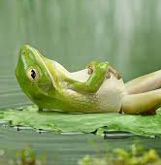
First sound and the rest

Slide 4
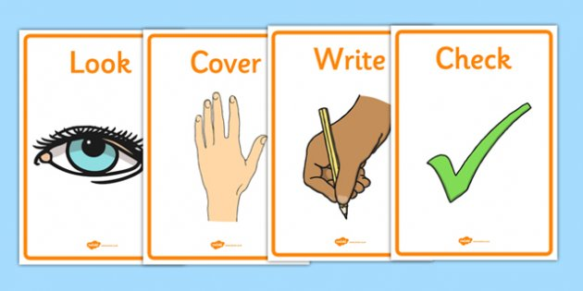
Look Cover Write Check

Slide 5
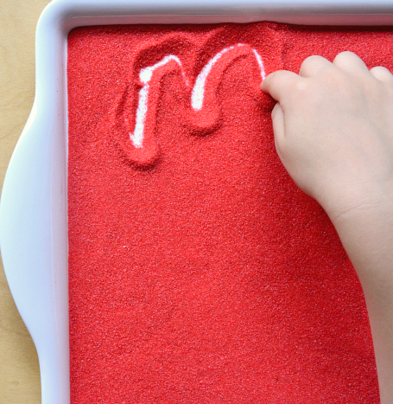
Trace it

Slide 6
Record it

Slide 8
Draw it

Slide 9
Funny Phrase it

