Slide 1
ghoti
Welcome to the St John’s Spelling Curriculum Session
What does this say?

Slide 2
fish
gh as in laugh (‘ff’ sound)
o as in women (‘i’ sound).
ti as in station (‘sh’ sound).
Notes:
Just a little taste of the challenges that spelling presents!

Slide 3
How do we structure our spelling lessons?
At the beginning of the Year, children were assessed on all Year 1 and 2 red words, Year 1 and 2 spelling patterns, and Year 3/4 spelling patterns. Based on this they were put into groups.
On a Monday, the children are in spelling groups for 45 minutes and have a spelling input to introduce a new spelling pattern or red words.
Phonics group – focussing on securing sounds this group is predominantly EAL children who are new to English.
Yellow group – focus on securing Year 1 and 2 red words, and Year 1 spelling patterns
Red group – Year 2 spelling patterns
Blue group – Year 3/4 spelling patterns
The focus of each group is then practised throughout the week during 25 minute sessions to embed the pattern.

Slide 4
YELLOW GROUP
Terms 1 and 2 – Initially a Year 1 red word focus with a new strategy introduced every couple of weeks
Putting the words into sentences to embed them into writing
Writing the words on each others backs

Slide 5
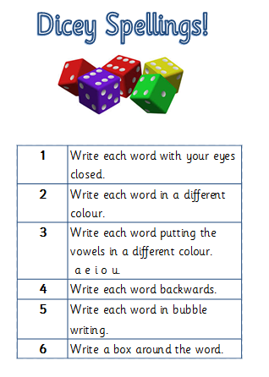
Making cards each week, the children use their spelling words for this activity.

Slide 6
***SPELLING STRATEGY PICS

Slide 8
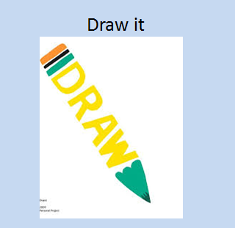

Slide 9
YELLOW GROUP
Current focus
Year 1 spelling rules so far we have done ff,ss, ll, ch sound as tch, words with more than one syllable.
Lots of this is games from Nessy.
We will do one rule a week then move onto the Year 2 red words.

Slide 10
RED and BLUE GROUPS
Follow Oxford Owl Read Write Inc.
RED group – consolidating Year 2 patterns
BLUE group – learning Year 3/4 patterns

Slide 11
SPEED SPELL VIDEO

Slide 12
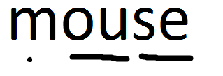
Dots and dashes
These are the same as sound buttons which your children will have used in KS1.
A digraph is two letters making one sound and shown with a line underneath.
A trigraph is three letters making one sound and is also shown with a line underneath all 3 letters.
Split digraphs a –e o –e
Notes:
To support children with spelling the children are taught to put dots and dashes on the words to show the sounds in the word.

Slide 15
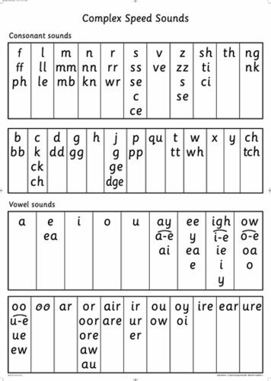
Complex Speed Sound Chart
Can you use the complex speed sound chart to write this word in as many different ways as possible?

Slide 16
Did you get these?
mmouse
mbouse
mbowc
mbowce
mowse
mouse
mous
Notes:
When getting children to spell , make sure they sound out the word and have a go at using their phonics. We praise effort at correct phonics but would correct misspelt words. Complex speed sounds charts are on the tables for use when they are writing.

Slide 17
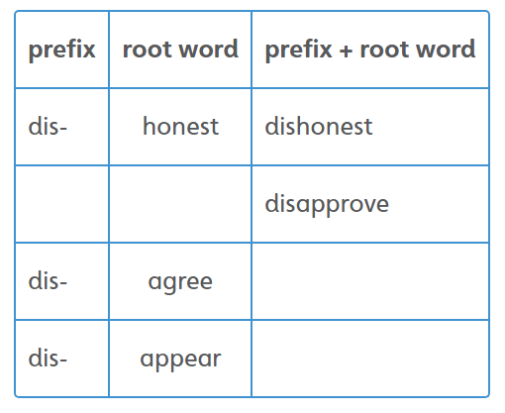

Slide 18
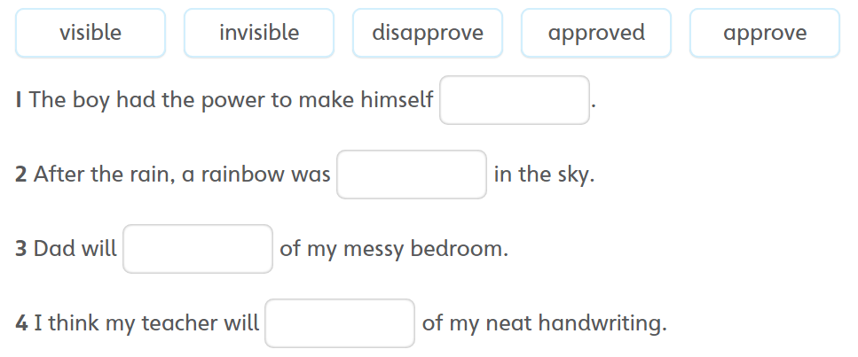

Slide 19
How else do we support spellings?
Interactive spelling display
PSDs
Dictionaries
Complex speed sound charts

Slide 20
How can you help?
It’s all on the website!
Check for your child’s pattern
Encourage them to sound out their spellings – use a complex speed sound chart at home?
Try the alternative spelling strategies

