Slide 1
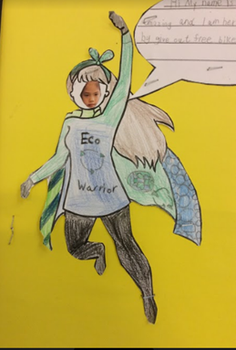
AGENTS OF CHANGE
ST. JOHN’S PRIMARY SCHOOL
Anya, Sephina and Kirpan

Slide 2
AGENTS OF CHANGE NW24 ECO PROJECT 8 schools : One Mission!
Cotham Secondary
Henleaze Junior School
Westbury On Trym
Blaise
St Bons
Horfield
Christchurch
And……….
us

Slide 3
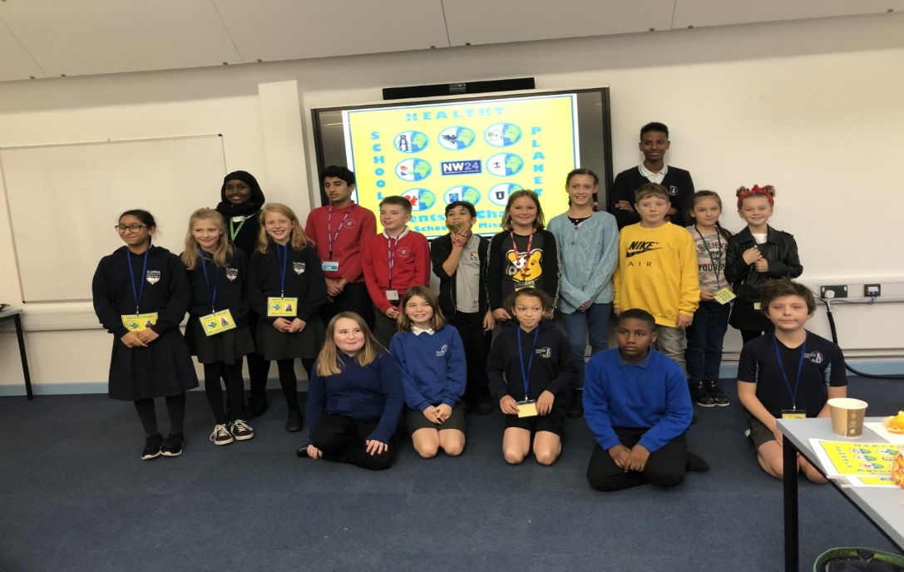
ABOUT THE PROJECT
Schools chose 2 or 3 representatives from their schools.
Here are the reps from these schools
Kirpan, Sephina and Anya!

Slide 4
What We had to do
The reps had to find out what eco or healthy projects are happening in their school and also had to make a power point presentation.
All the agents of change met at Cotham school and shared their ideas and presentations.

Slide 5
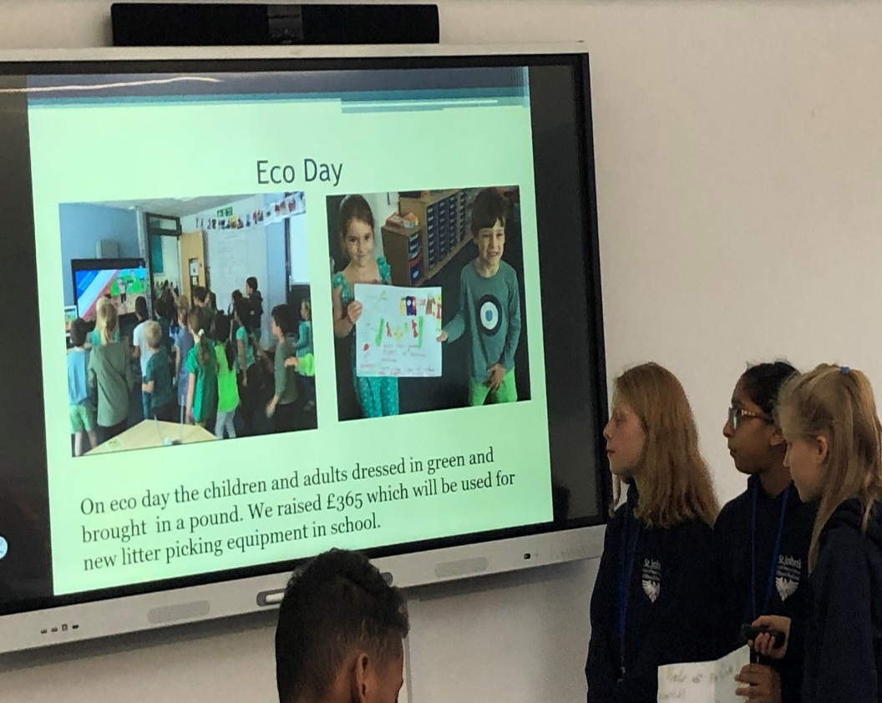
Here we are at Cotham presenting our powerpoint

Slide 6
They will now share with you what they
presented to the other schools

Slide 7
OUR PRESENTATION
Our Eco Team.
Facts and figures about plastic pollution.
What we’ve done so far.
Our aims and next steps.

Slide 8
ST. JOHN’S ECO TEAM
They meet weekly.
They have 10 members from Y3 to Y6 .
They discuss and act how to help the environment in school
and raise awareness.

Slide 9
3 FACTS ABOUT SINGLE USE PLASTIC BAGS
Plastic bags start out as fossil fuels and end up in land fills and the ocean.
Birds often mistake shredded plastic bags for food, filling their stomachs with toxic debris.
For hungry sea turtles, it’s nearly impossible to distinguish between jellyfish and floating plastic shopping bags.

Slide 10
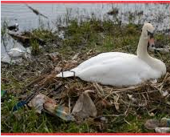
WHY WE SHOULD REDUCE PLASTIC
Globally, it is estimated that over 100,000,000 marine animals are killed each year due to plastic waste.
According to a study from Plymouth University plastic pollution affects at least 700 marine species.
Up to 80% of ocean plastic pollution enters the ocean from land. At least 267 different species have been affected by plastic pollution in the ocean.

Slide 11
REDUCE PLASTIC USE
As a school our Reception children have stopped using plastic straws and containers and as a result of this, there are fewer plastic straws in landfill and our environment .

Slide 12
How Did we do This?
We wrote to our Headteacher
Notes:
Sephina will read letter
Anya : Mr Hoye, our Head teacher advised us to write to the dairy and we successfully stopped using plastic straws and cartons.

Slide 13
NO MORE PLASTIC MILK CARTONS AND STRAWS!!!
THE CHILDREN WASH UP THEIR CUPS AND REUSE THEM EVERY DAY AT ST. JOHN’S.
Notes:
Kirpan read

Slide 14
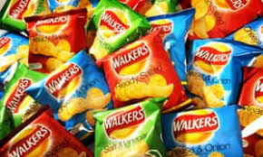
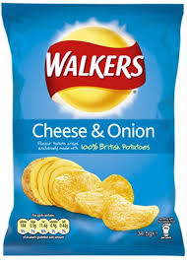
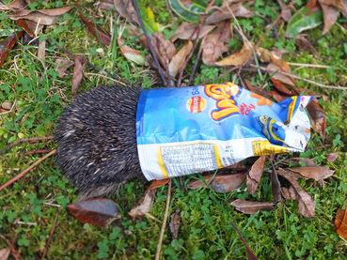
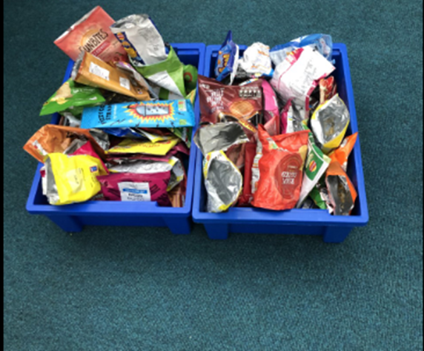
CRISP PACKETS
SAY NO TO ME!!
Notes:
At St. John’s the eco team are encouraging children and staff to place their empty crisp packets into boxes which we send back to the companies and we hope that they will recycle them.

Slide 15
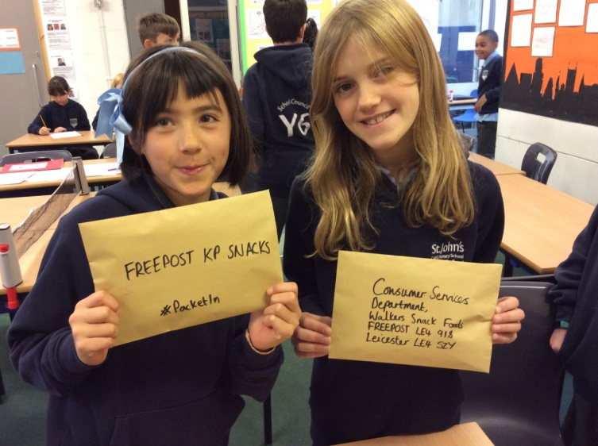
School Council wrote letters and sent back our used crisp packets to the companies to raise awareness about Plastic Pollution.

Slide 16
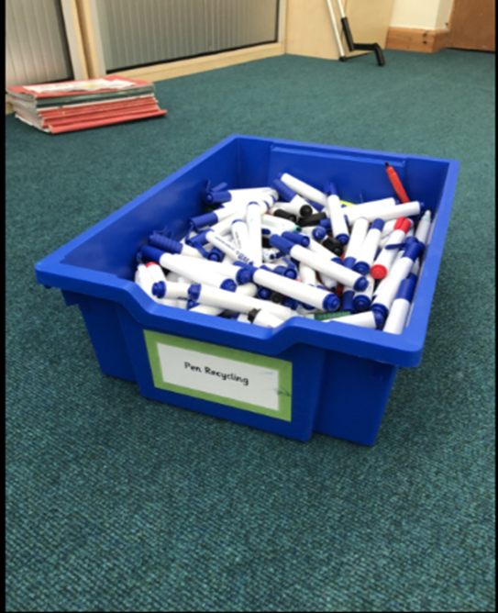
Ryman’s Pens
At our school every time one of our pens run out, we put them in one of the blue boxes in our classrooms and because of this, there are fewer plastic pens in the ocean and in animal’s stomachs.
Rymans pen company have a great recycling attitude

Slide 17
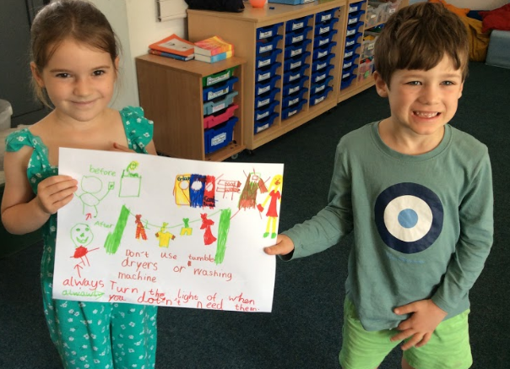
Eco Day
On eco day the children and adults dressed in green and brought in a pound. We raised £365 which will be used for new litter picking equipment in school.

Slide 18
Award!!!
Notes:
We aim to achieve , then ..

Slide 19
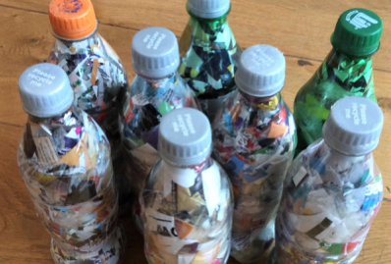
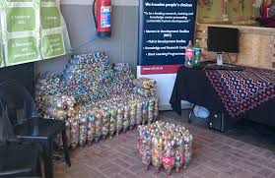
Here are some of the great ideas we picked up from the other schools
Meat free Mondays!
Make and create something
with eco bricks

Slide 20
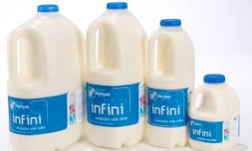
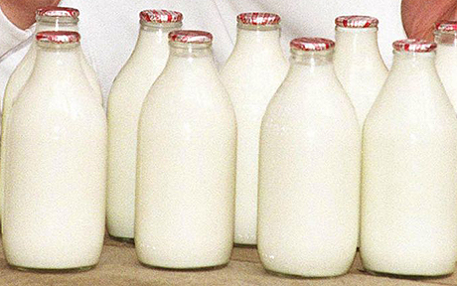
More Ideas
Use glass milk bottles not plastic

Slide 21
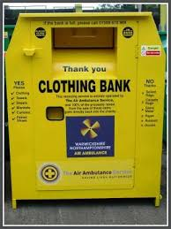
And..
Get a clothes recycling bank at school

Slide 22
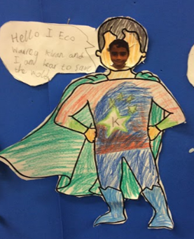
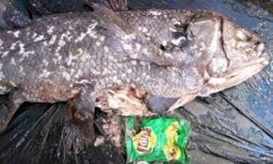
Thank you for listening!
Any questions?

Slide 23
Let Us Pray

Slide 24
Time to Sing!

Slide 25
By doing all we can to care for our wonderful planet and the living things in it.
Reduce, Reuse, Recycle!

