Slide 1
End of Key Stage 1 (Y2) Assessments
Together, Fly High Like an Eagle

Slide 2
Don’t Panic!!

Slide 3
General information about assessments
Children will be assessed in Reading, Writing,
Maths and SPAG.
Tests must take place in May (Reading and Maths are compulsory. SPAG is optional).
Tests are pieces of the puzzle.
Papers will be marked by class teacher and children will receive a raw score.
DFE will release a conversion chart in June which will then allow the raw score to be transferred into a standardised score.

Slide 4
Reading
Two papers
1st paper will be combined reading and questions in one booklet
2nd paper will be separate reading and questions and is much harder than paper 1
Papers used together with the framework
Key things- decoding and understanding of vocabulary
Reported as working towards expected standard, working at expected standard,
working at greater depth within expected standard

Slide 5
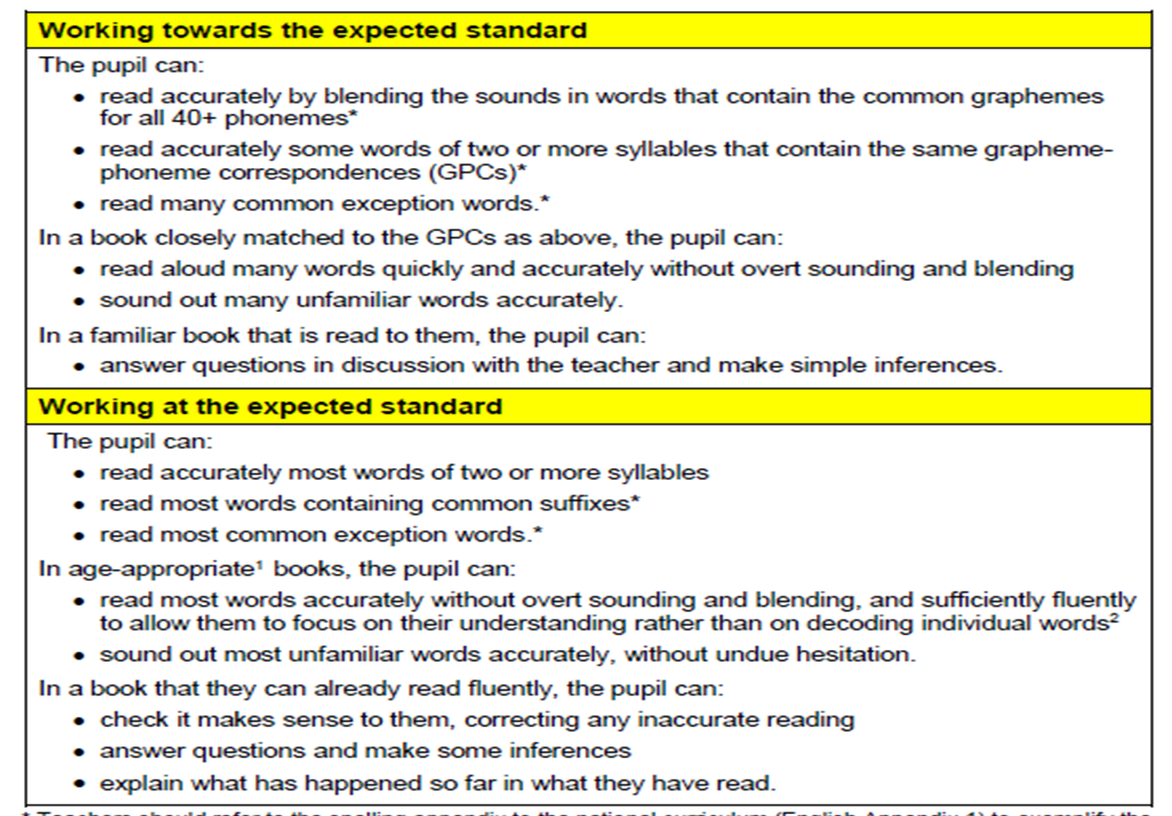

Slide 6
Writing
SPAG paper 1- multiple choice questions OPITIONAL
Spelling paper – 20 contextualised words OPTIONAL
Writing - Teacher Assessed based on the framework provided.
Key things- HANDWRITING AND SPELLING OF RED words.
Reported as working towards expected standard, working at expected standard, working at greater depth within expected standard.

Slide 8
Maths
Paper 1- Arithmetic e.g. 15 x 4 =
Paper 2- Reasoning e.g. contextualised questions
Time limits (although they do not have to be timed!)
Children can have people reading the questions
Reported as working towards expected standard, working at expected standard, working at greater depth within expected standard.

Slide 10
Pre Key stage
If a child is working below the objectives of the key stage they can be assessed as ‘pre key stage foundations’
Towards IS A standard

Slide 11
Organisation
Papers will take place in the classroom and group rooms- children will be split into small groups dependant on needs. Done by the class teacher
Reporting results- DFE/LA will be told if the child is Working Towards, Working At, Working with Greater Depth

Slide 12
Any Questions?

