Slide 1
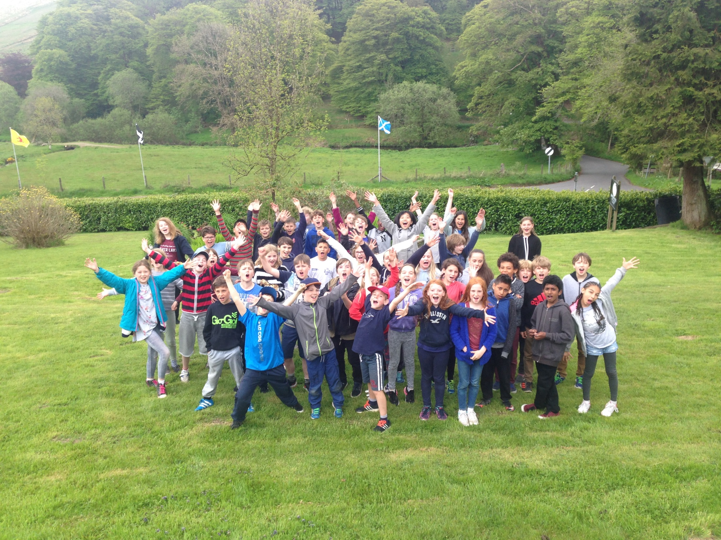
Y6 Camp 2023
22nd – 26th May
Simonsbath, Exmoor

Slide 3
Tuesday | Cereals, Yoghurt or Fruit Salad Sausages, Baked Beans & Hash Browns Toast & Jam Orange Juice Tea | Sandwich Choice: Variety of Fillings Crisps Piece of Fruit Cake/Biscuit Drink | Spaghetti Bolognaise Sweet and Sour Chicken Spinach & Ricotta Cannelloni Jacket Potato, Cheese or Tuna Mayo & Salad Chocolate Sponge & Custard Fruit Salad in Jelly or Yoghurt
Wednesday | Cereals, Yoghurt or Fruit Salad Scrambled Eggs or Spaghetti Hoops on Toast Toast & Jam Orange Juice Tea | Sandwich Choice: Variety of Fillings Crisps Piece of Fruit Cake/Biscuit Drink | Fish, Chips and Peas Traditional Lasagne Jacket Potato, Cheese & Beans Cheese & Tomato Quiche & Salad Cheese Cake, Yoghurt or Jam Doughnut

Slide 4
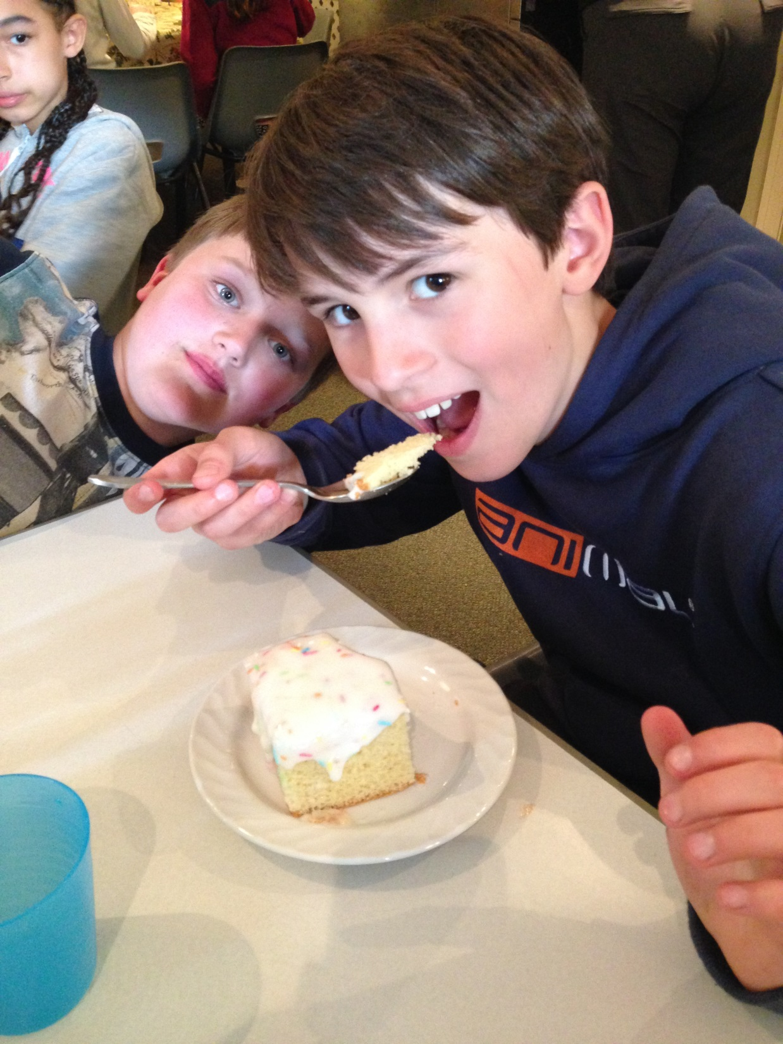

Slide 5
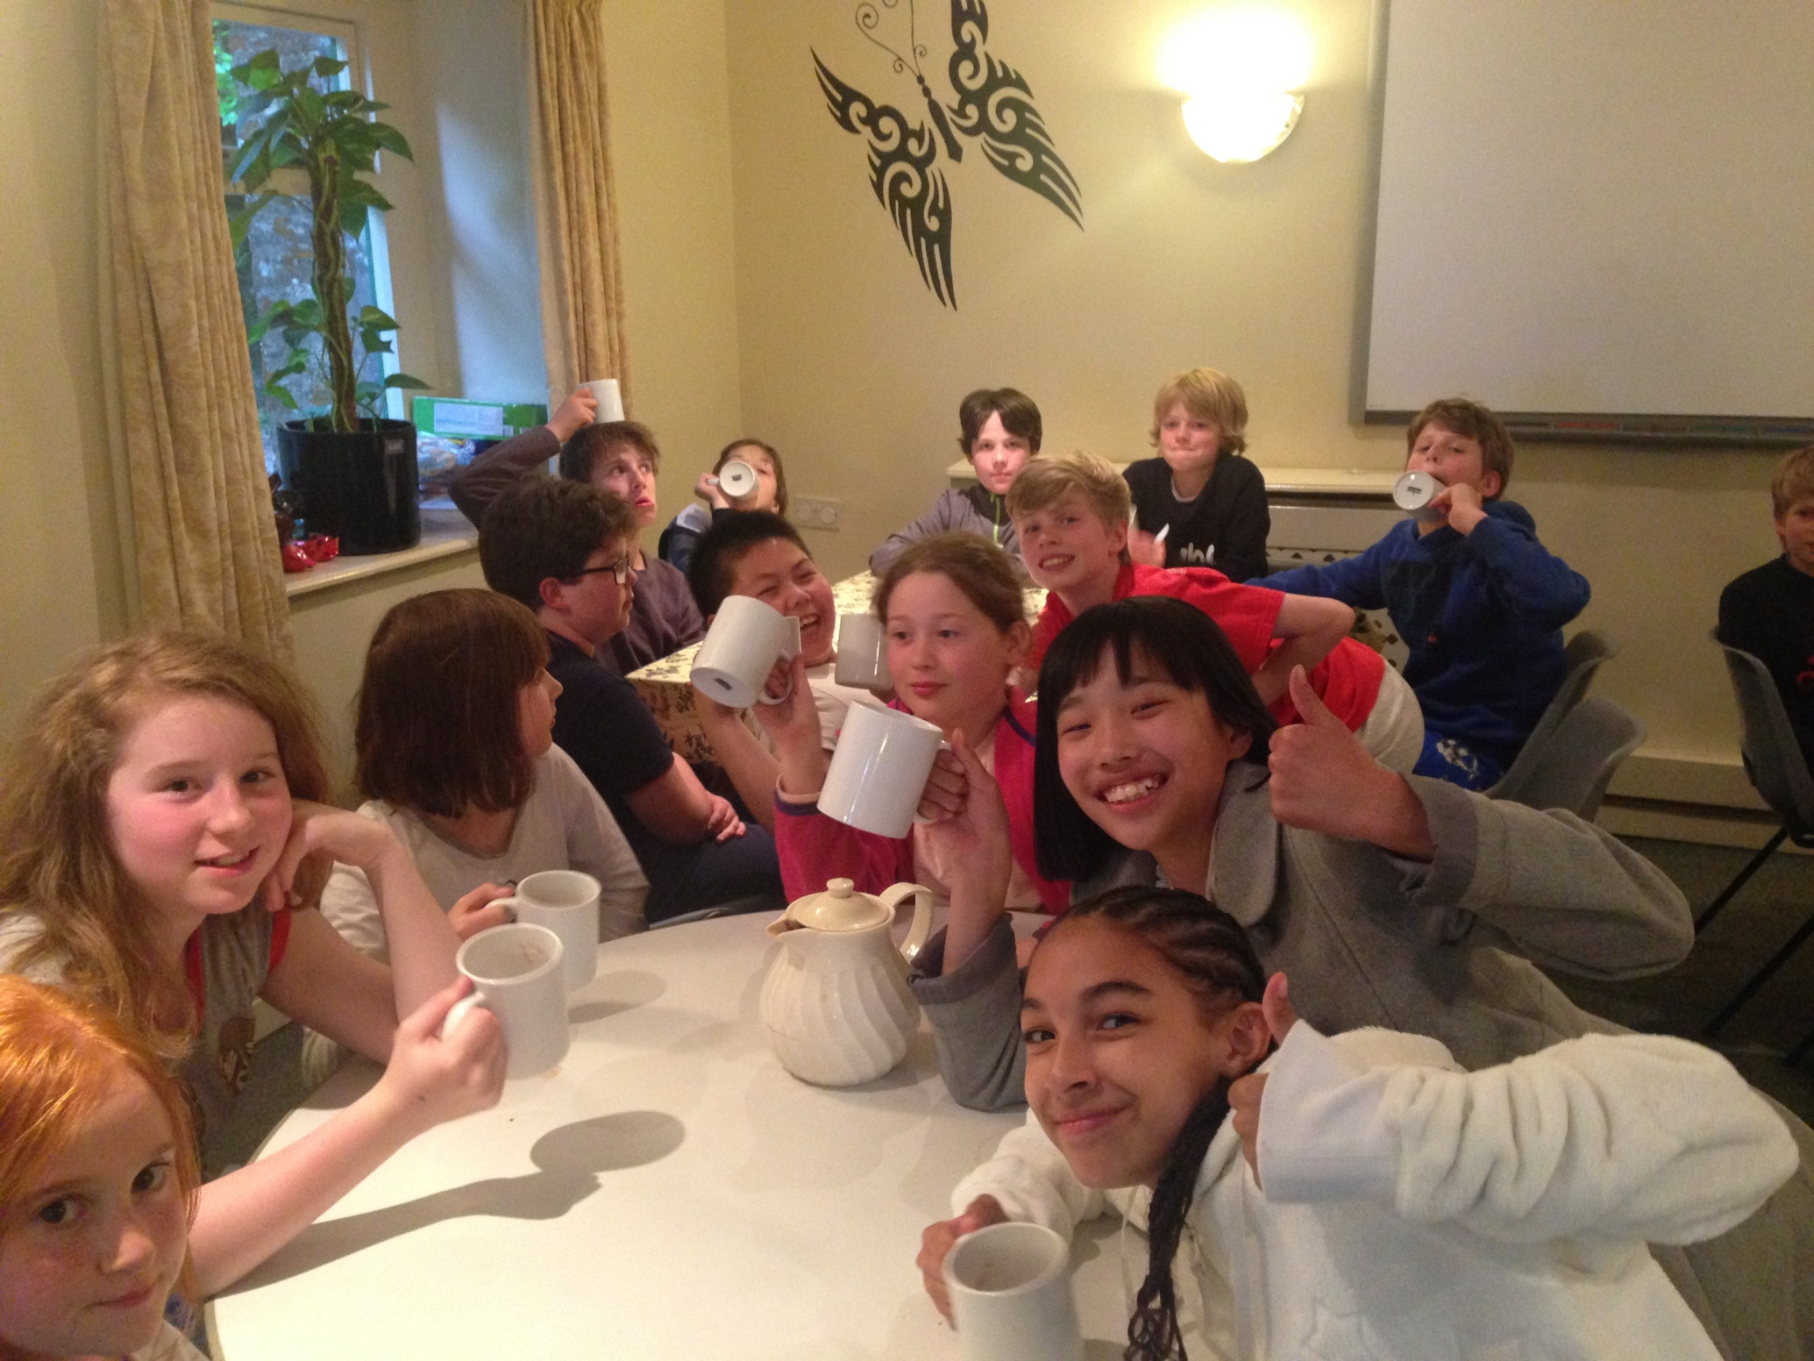

Slide 6
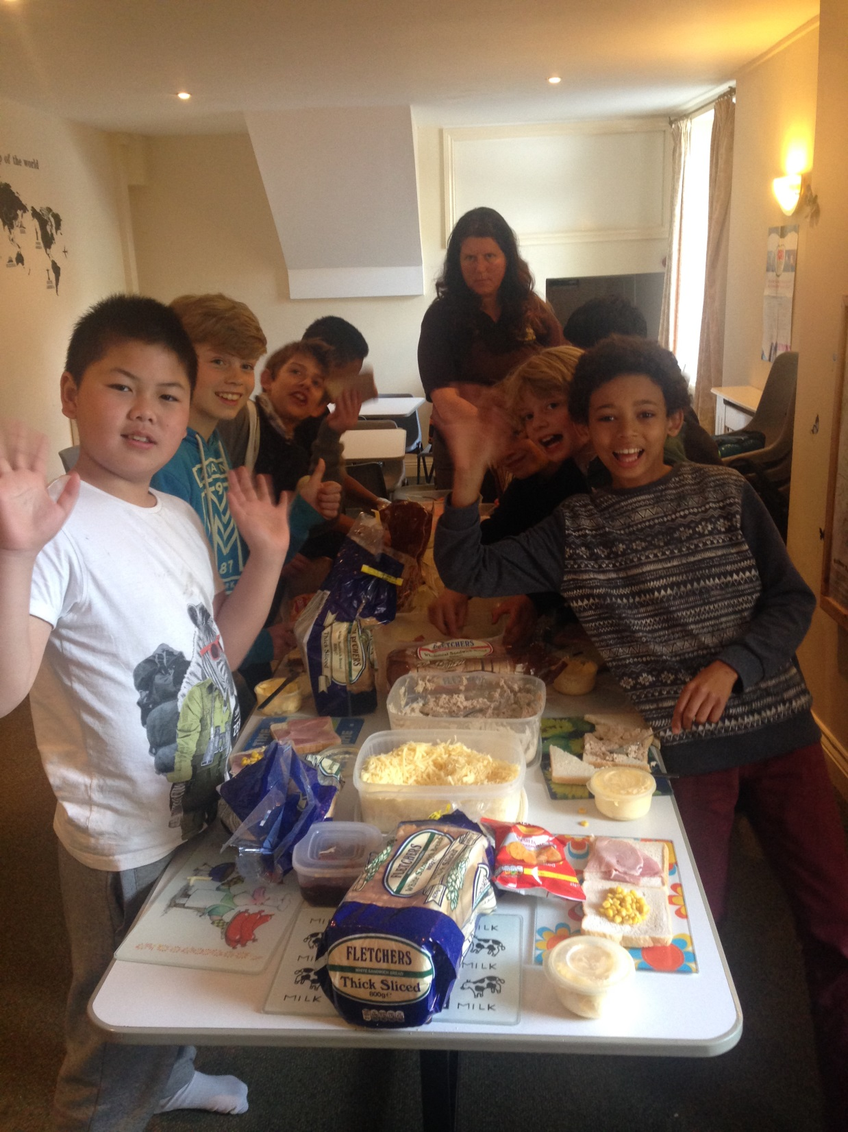

Slide 7
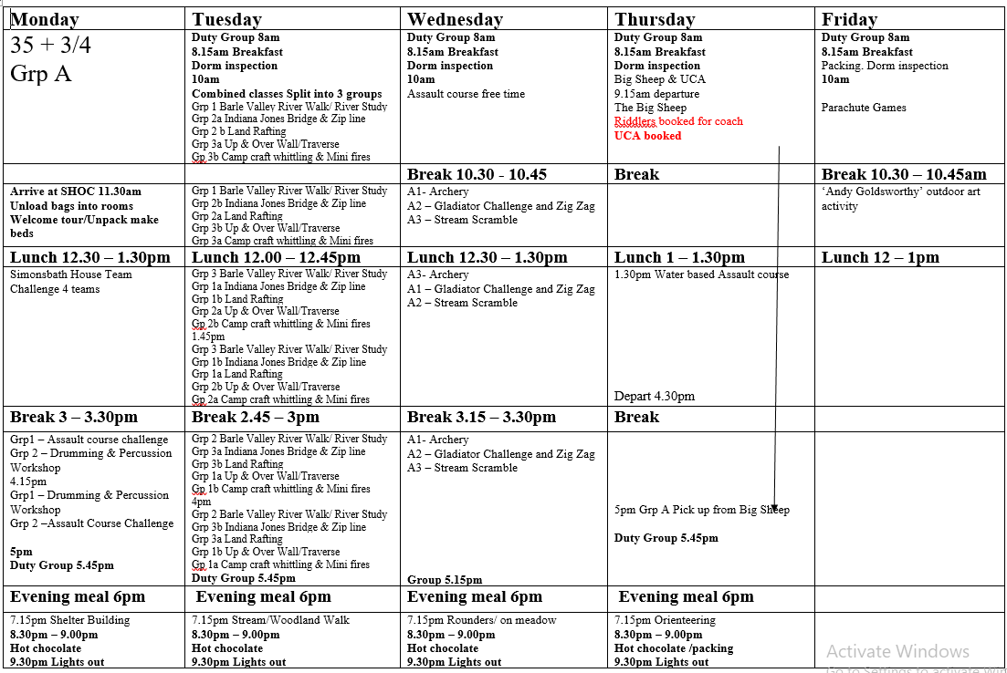

Slide 8
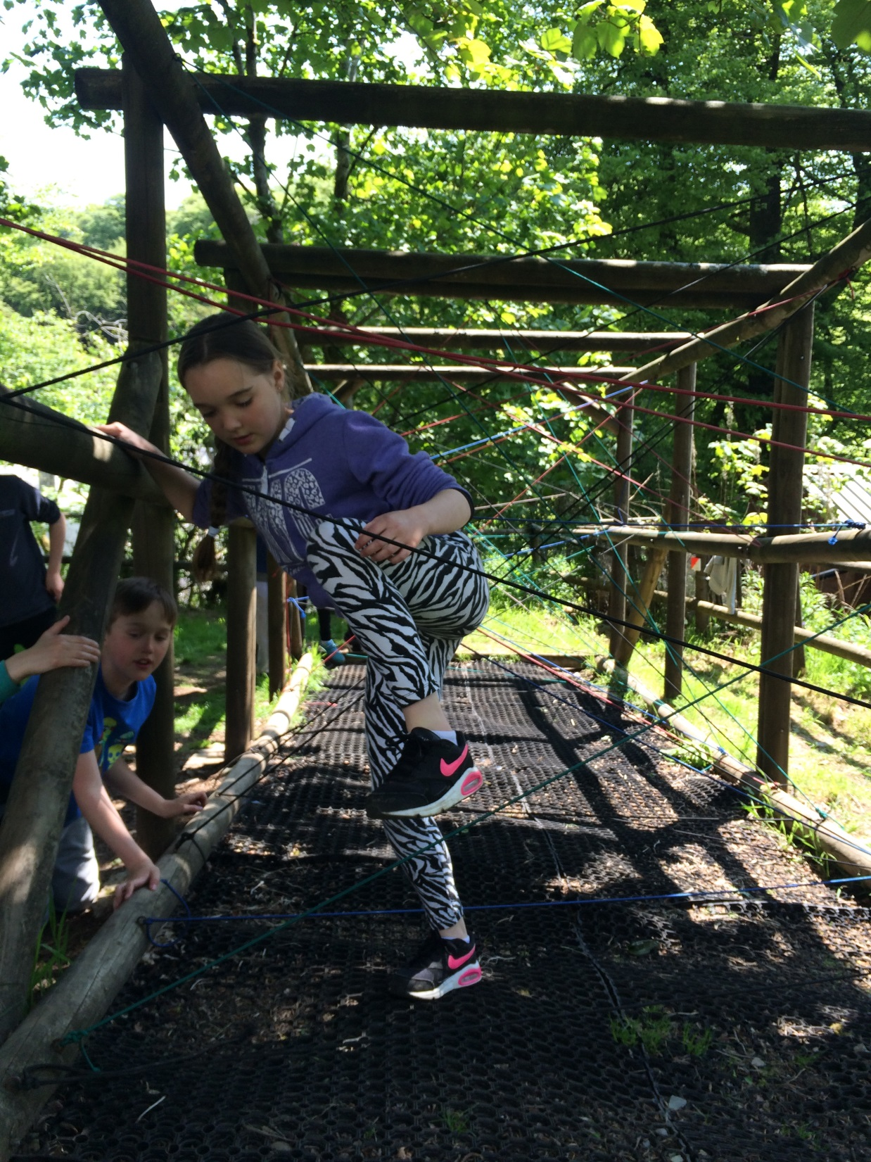
Simonsbath house team challenge

Slide 9
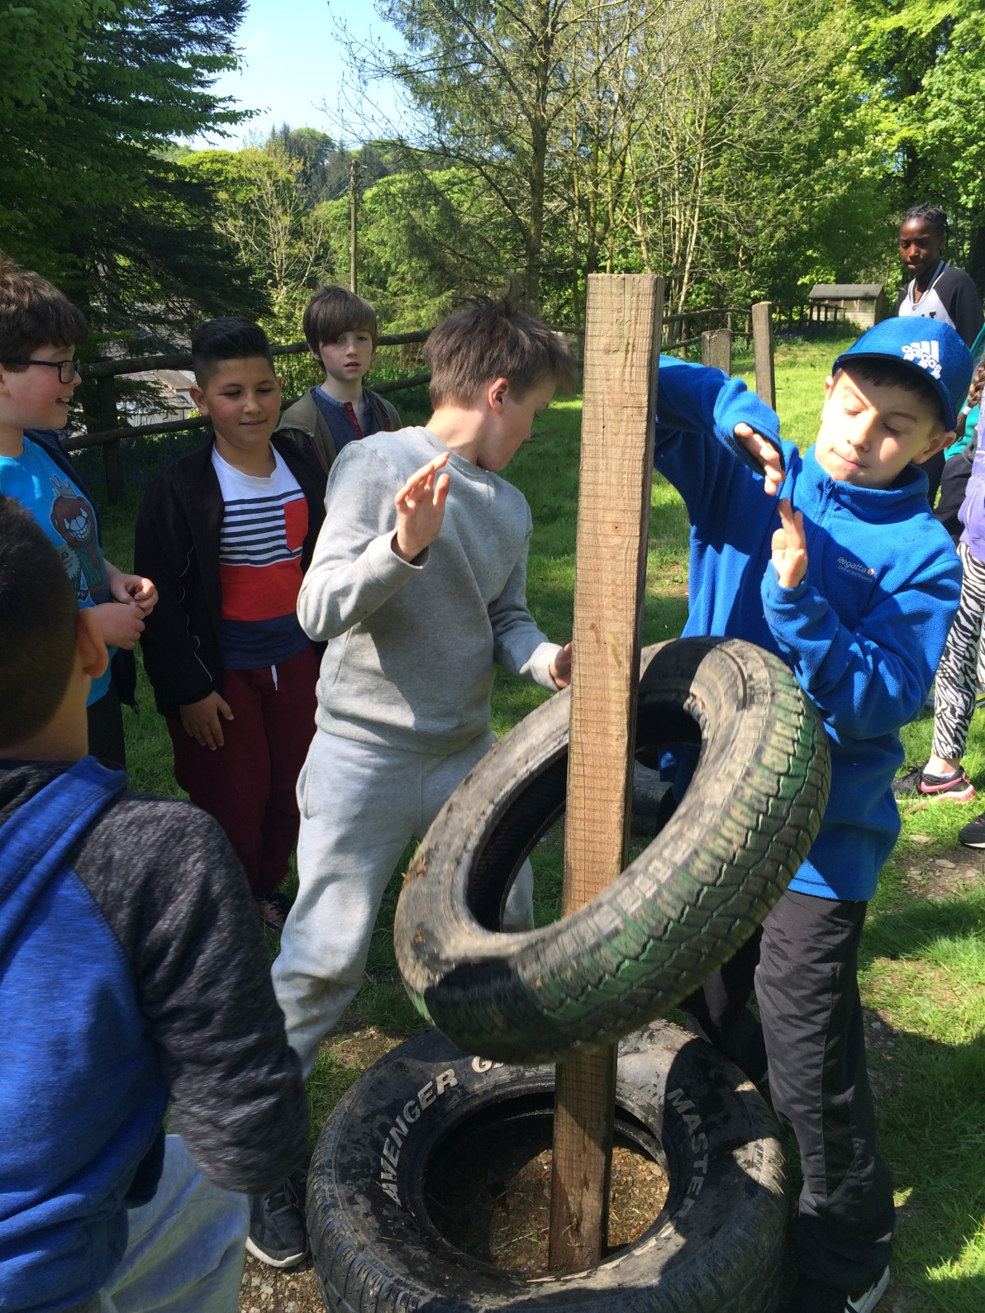

Slide 10
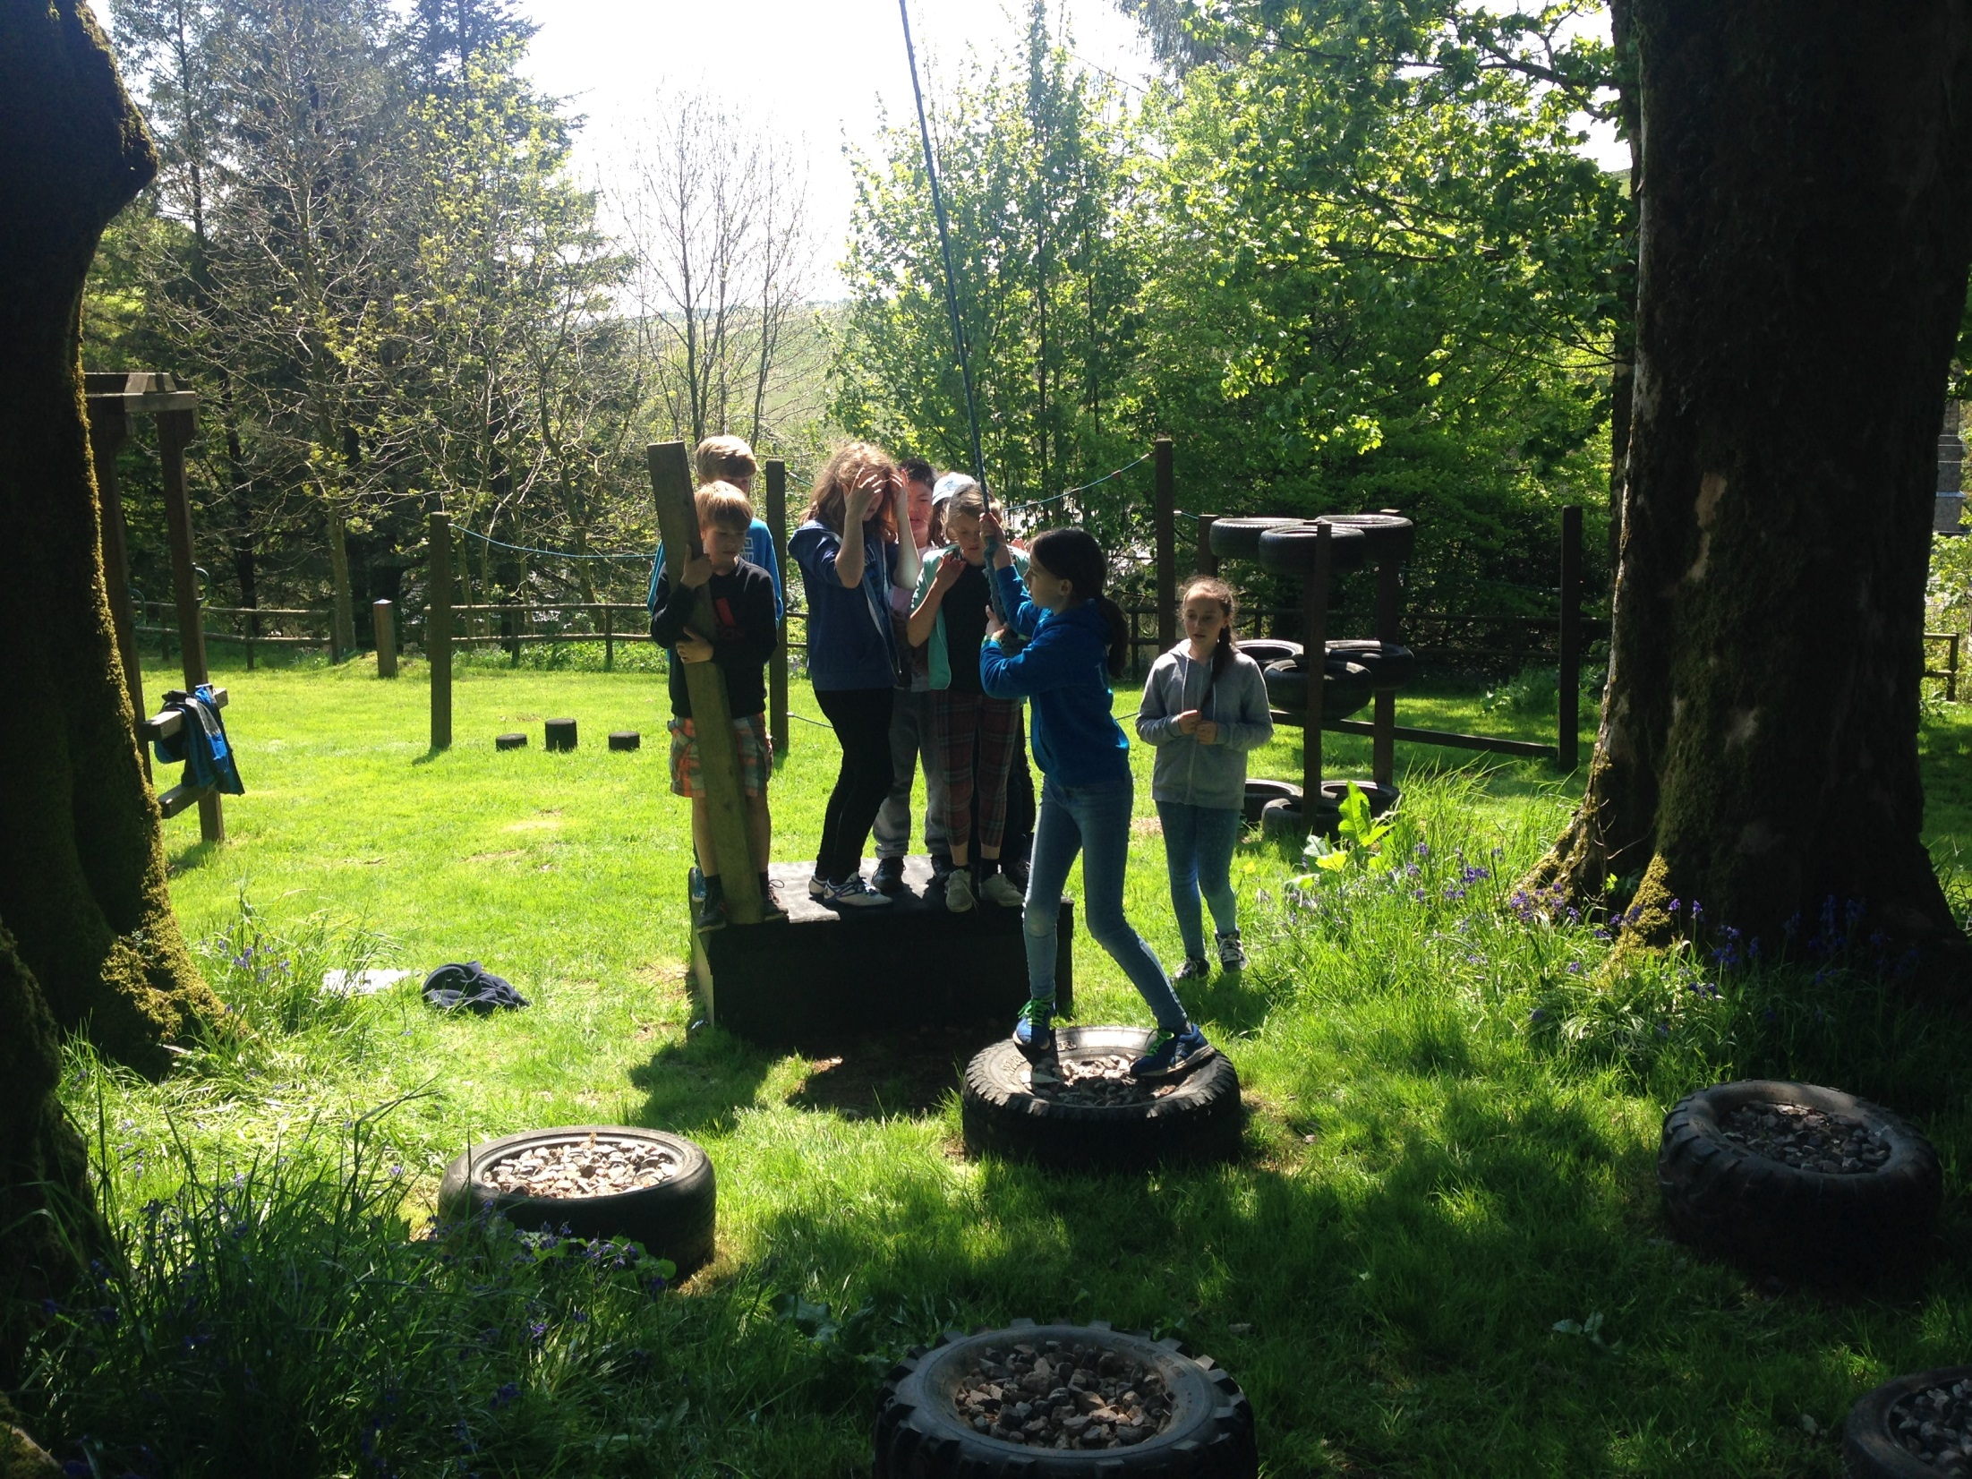

Slide 11
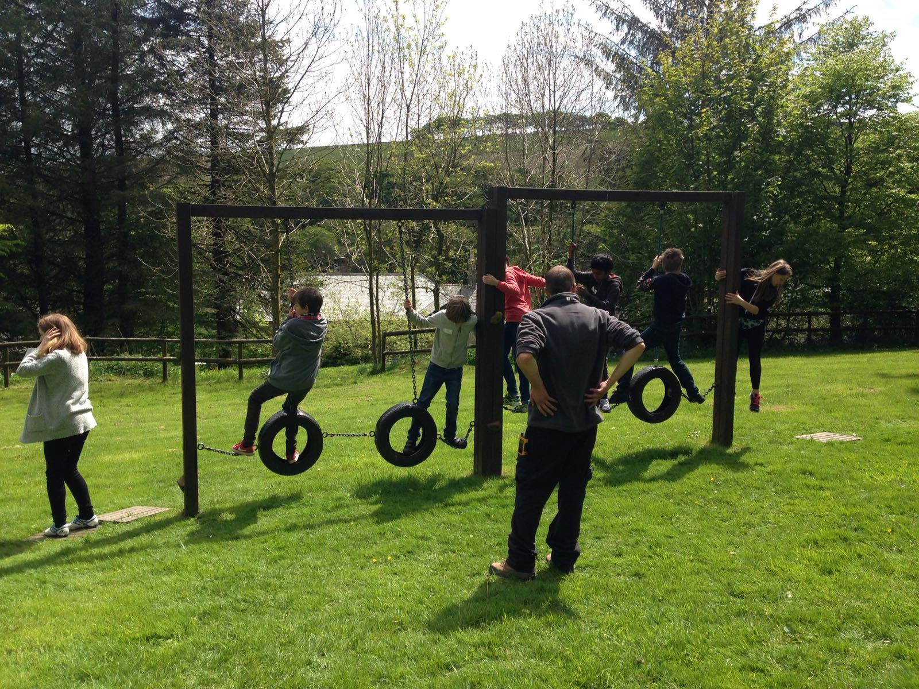

Slide 12
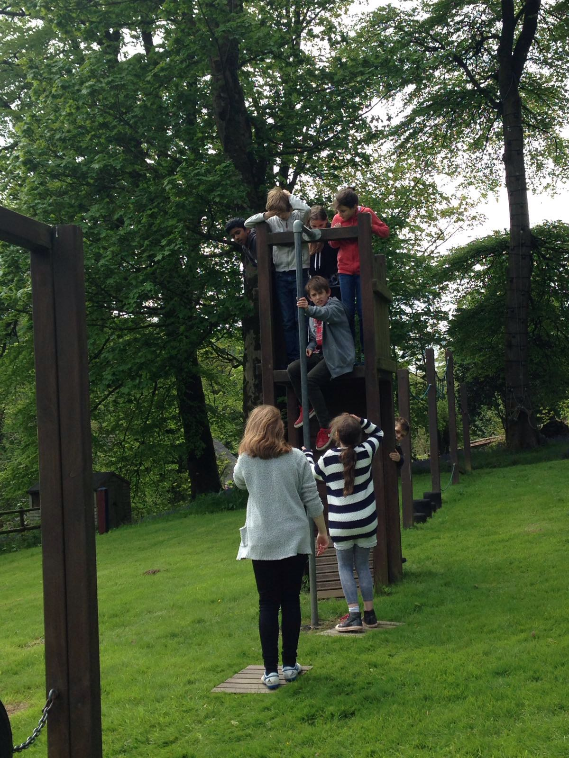
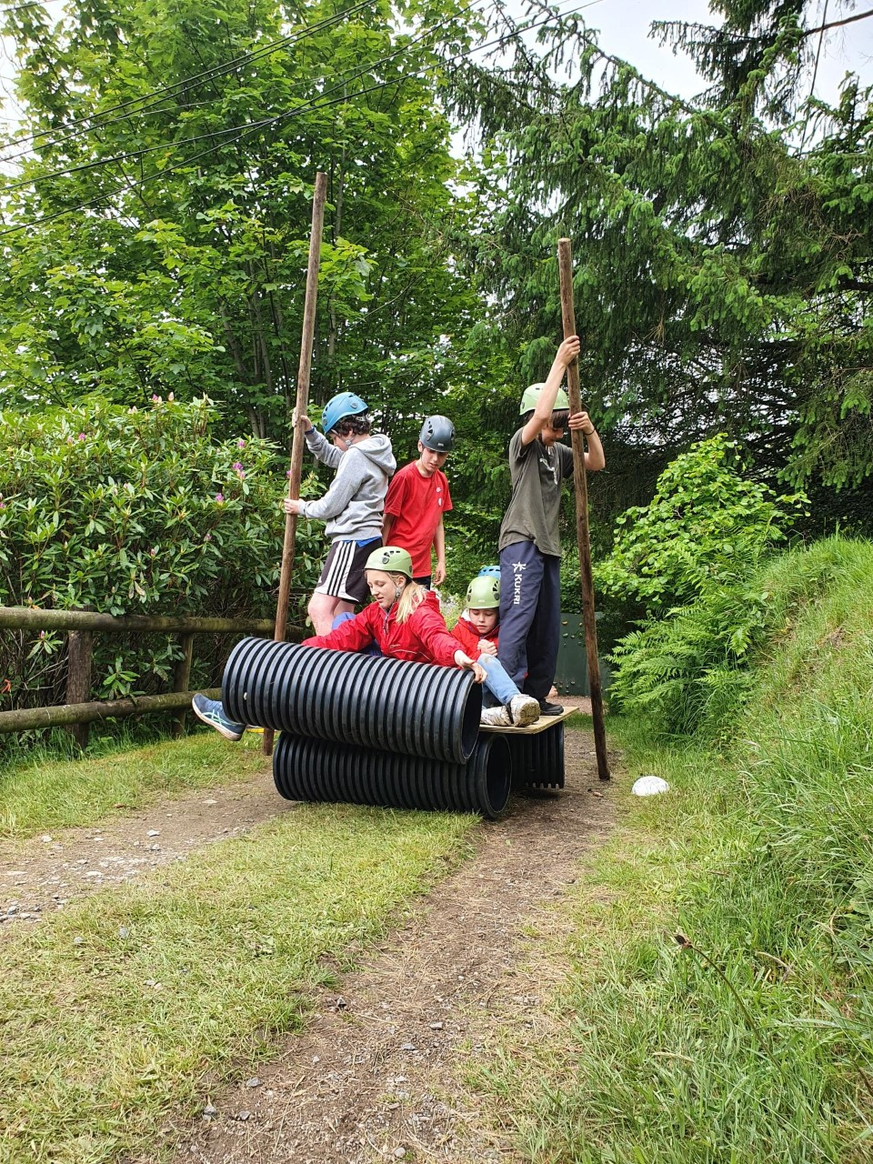
Assault course
Land rafting

Slide 13
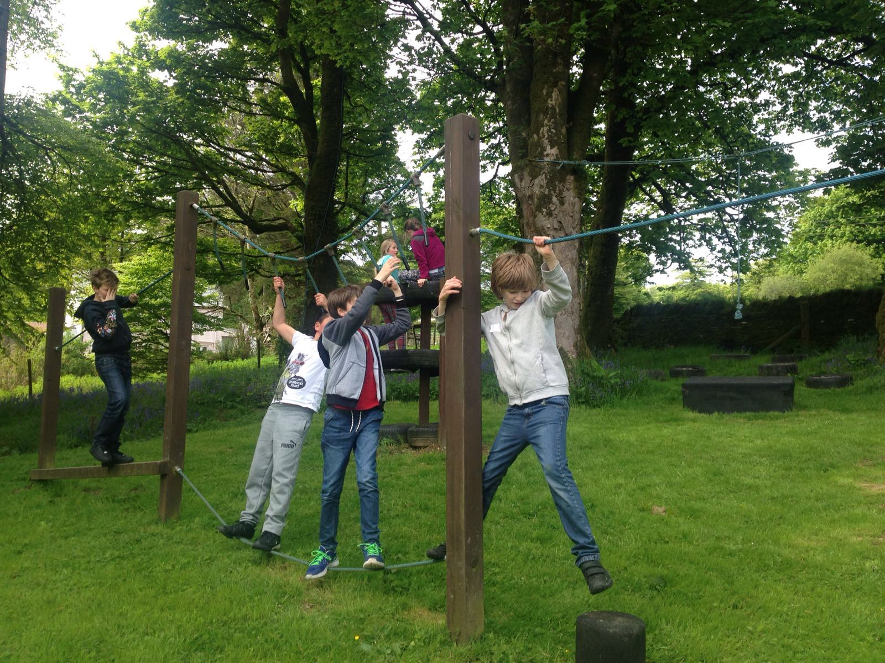

Slide 14
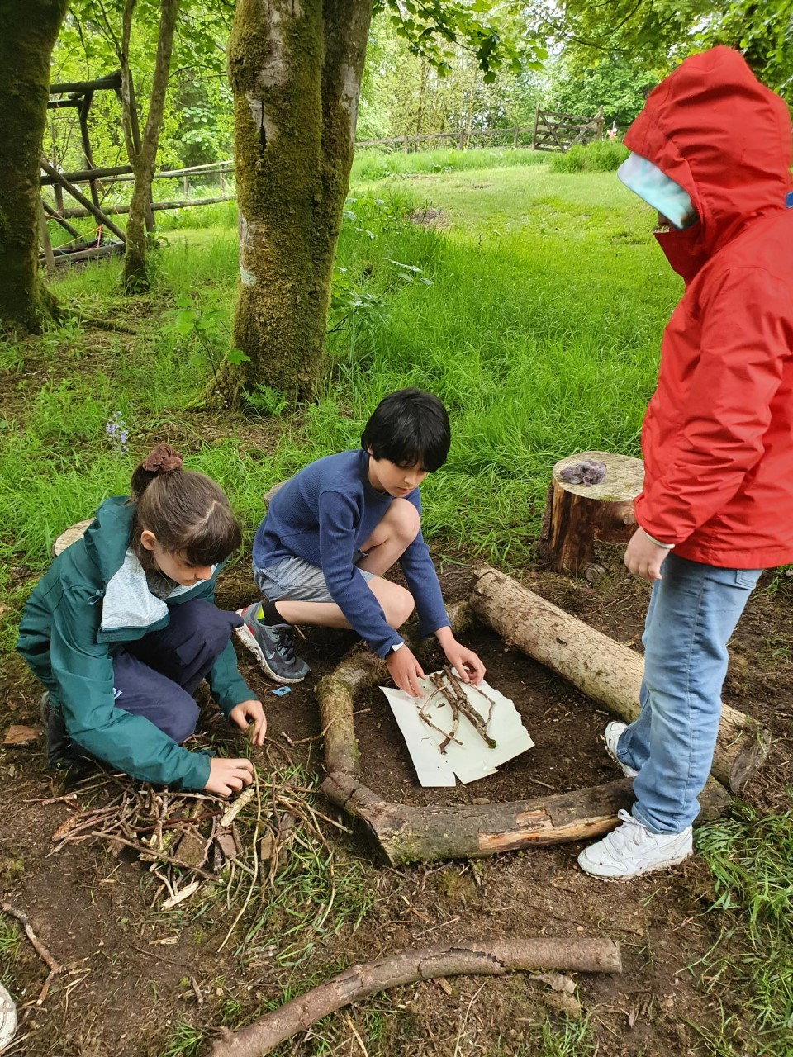
Camp craft

Slide 15
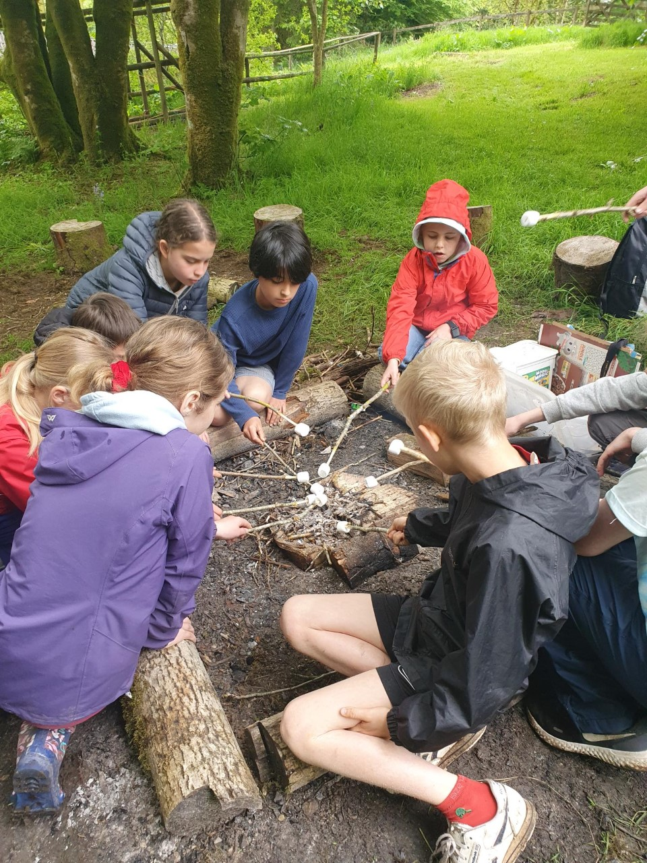

Slide 17
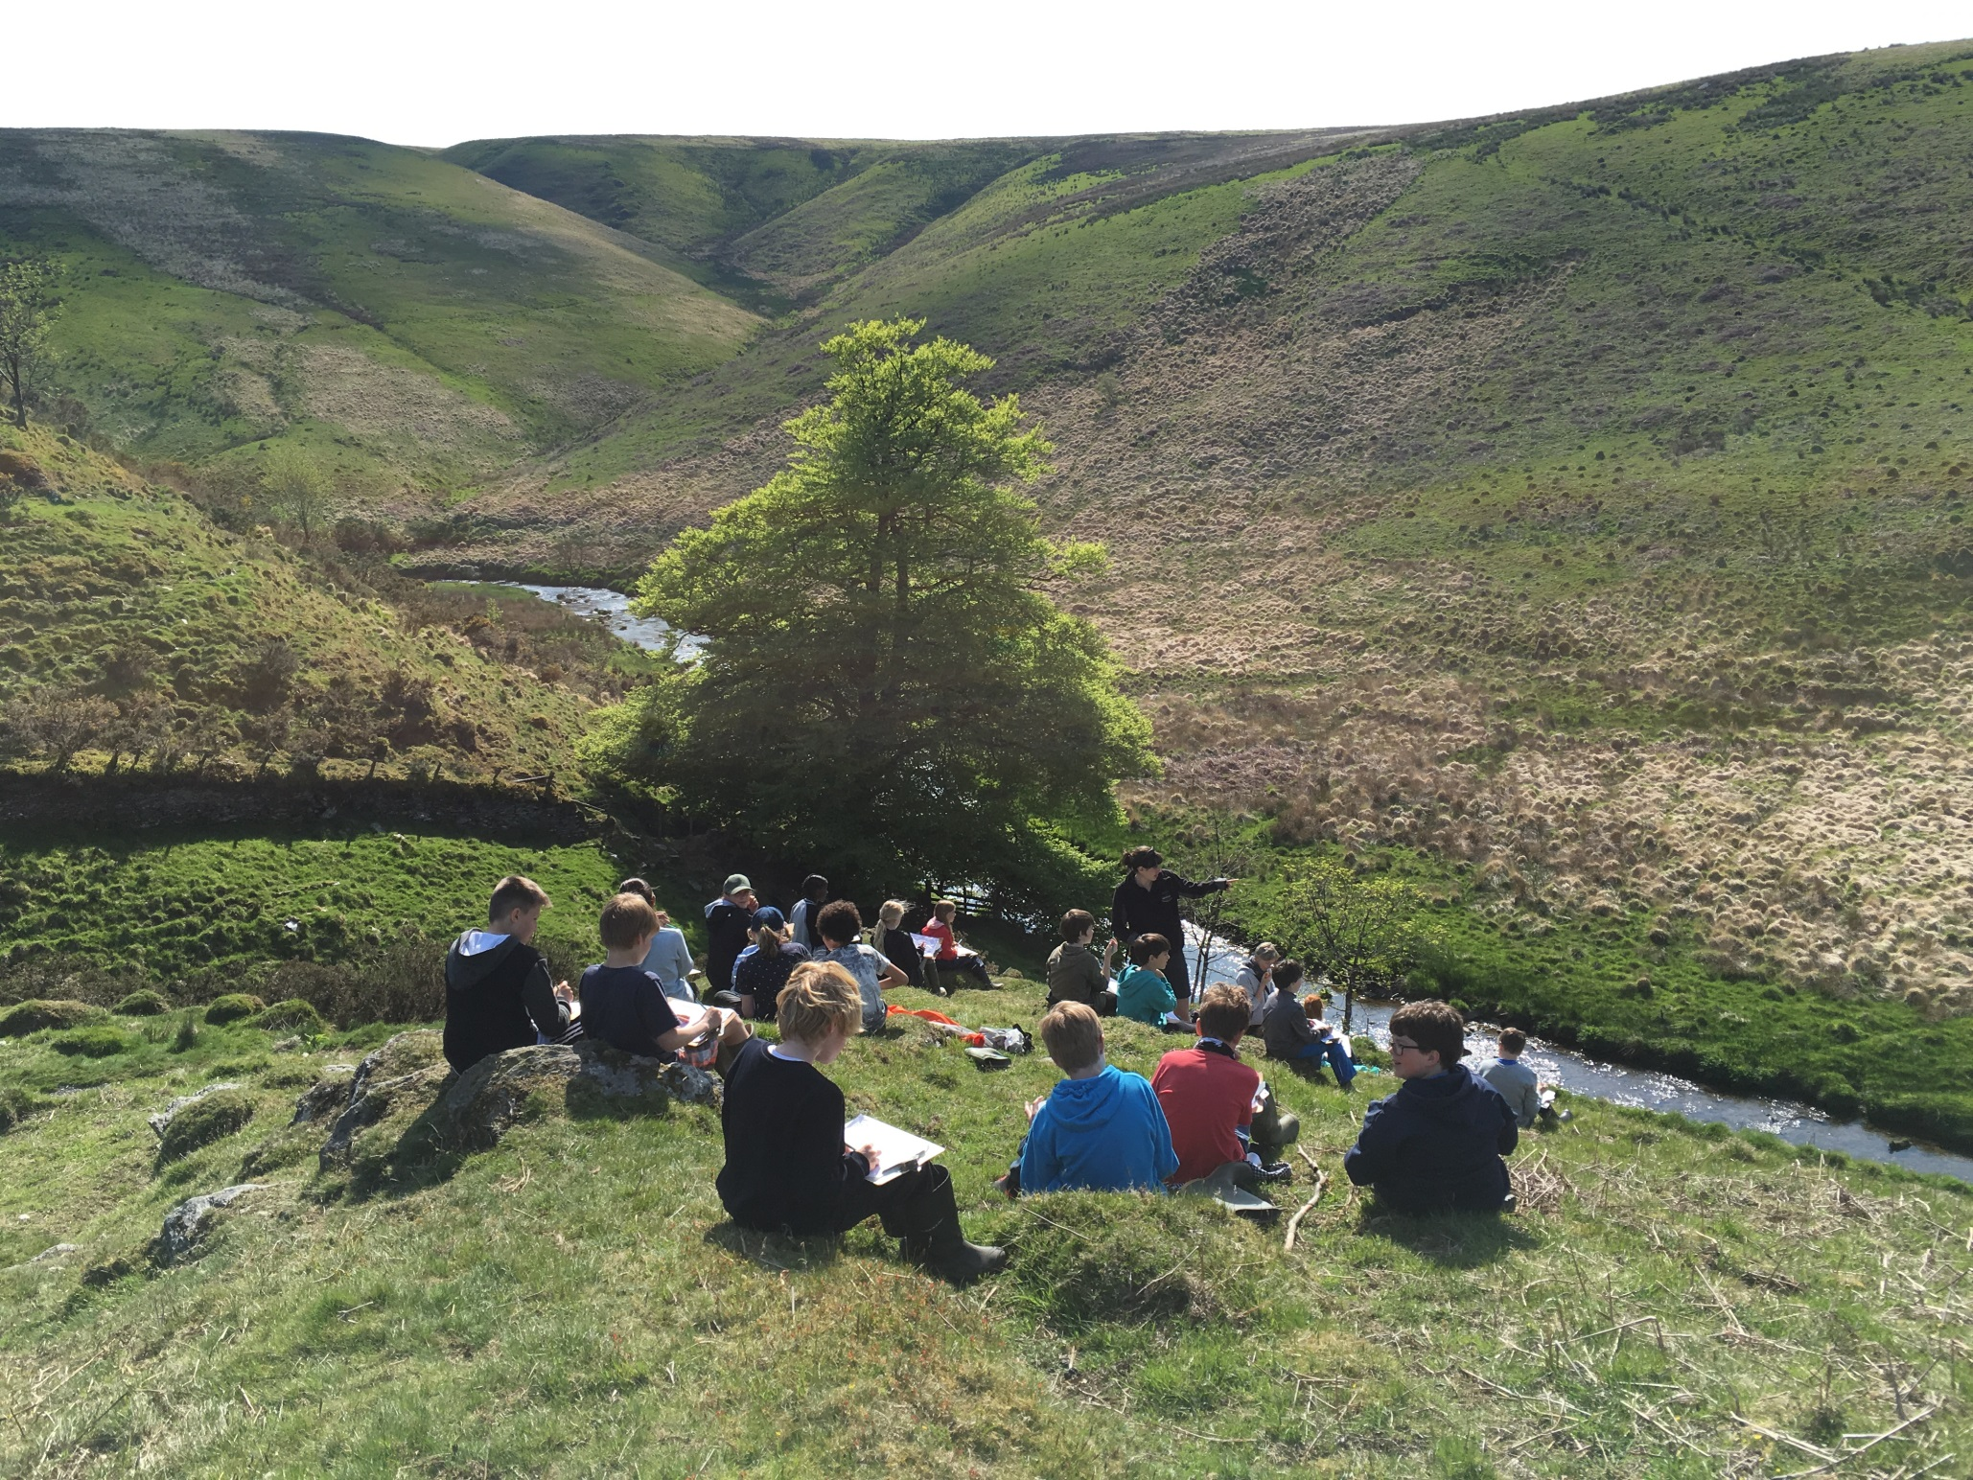

Slide 18
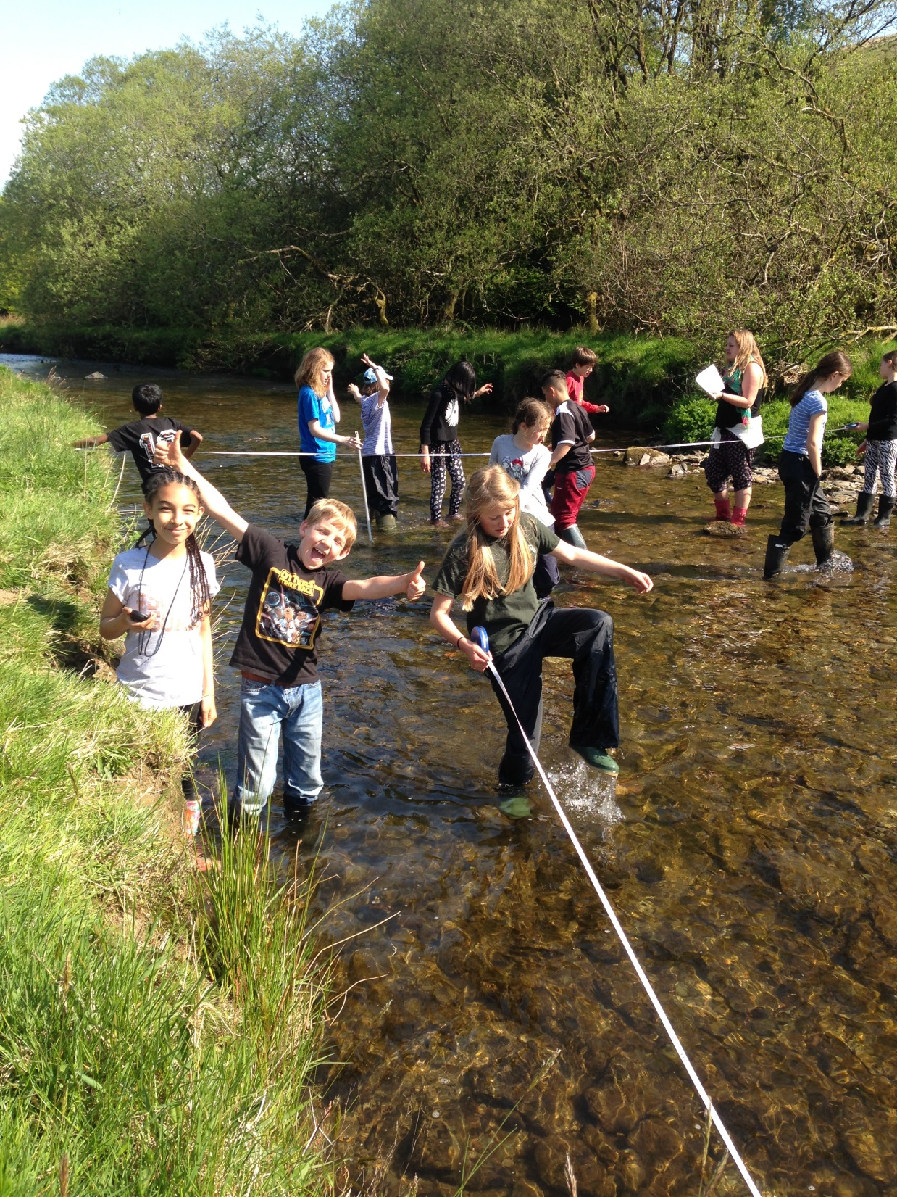

Slide 19
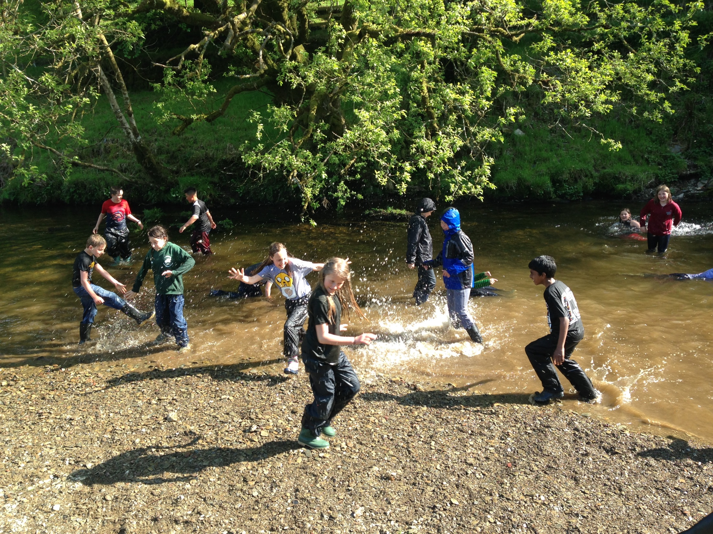

Slide 20
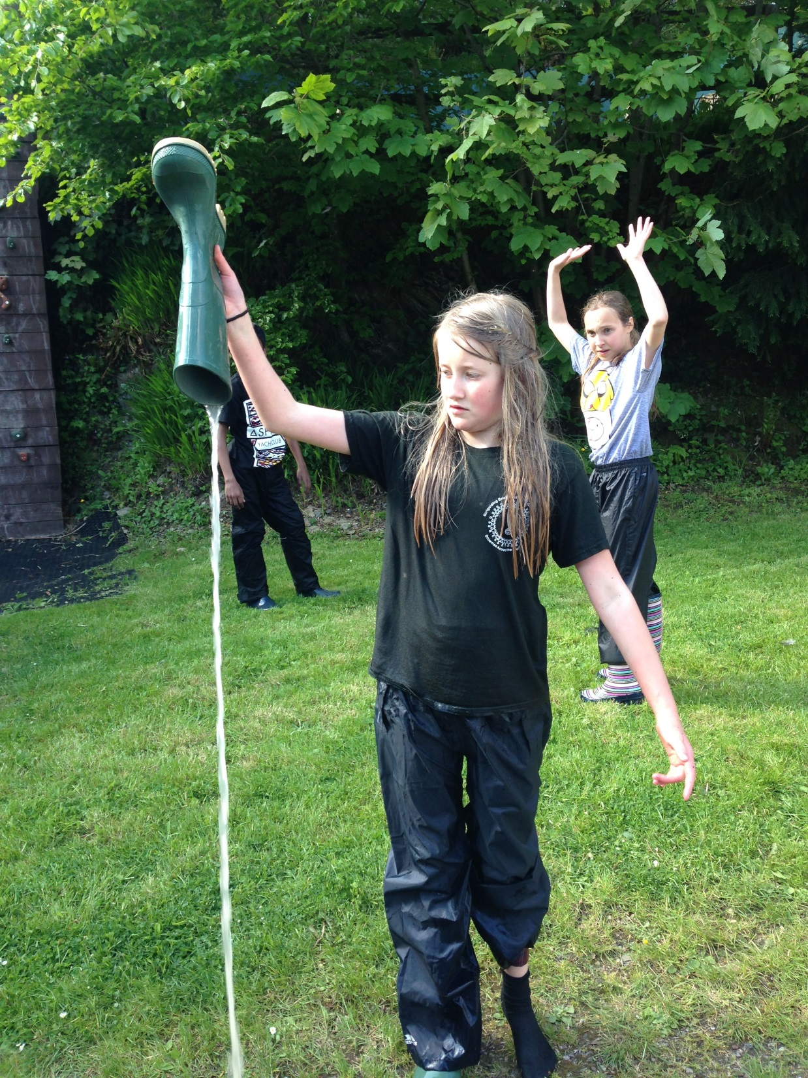

Slide 21
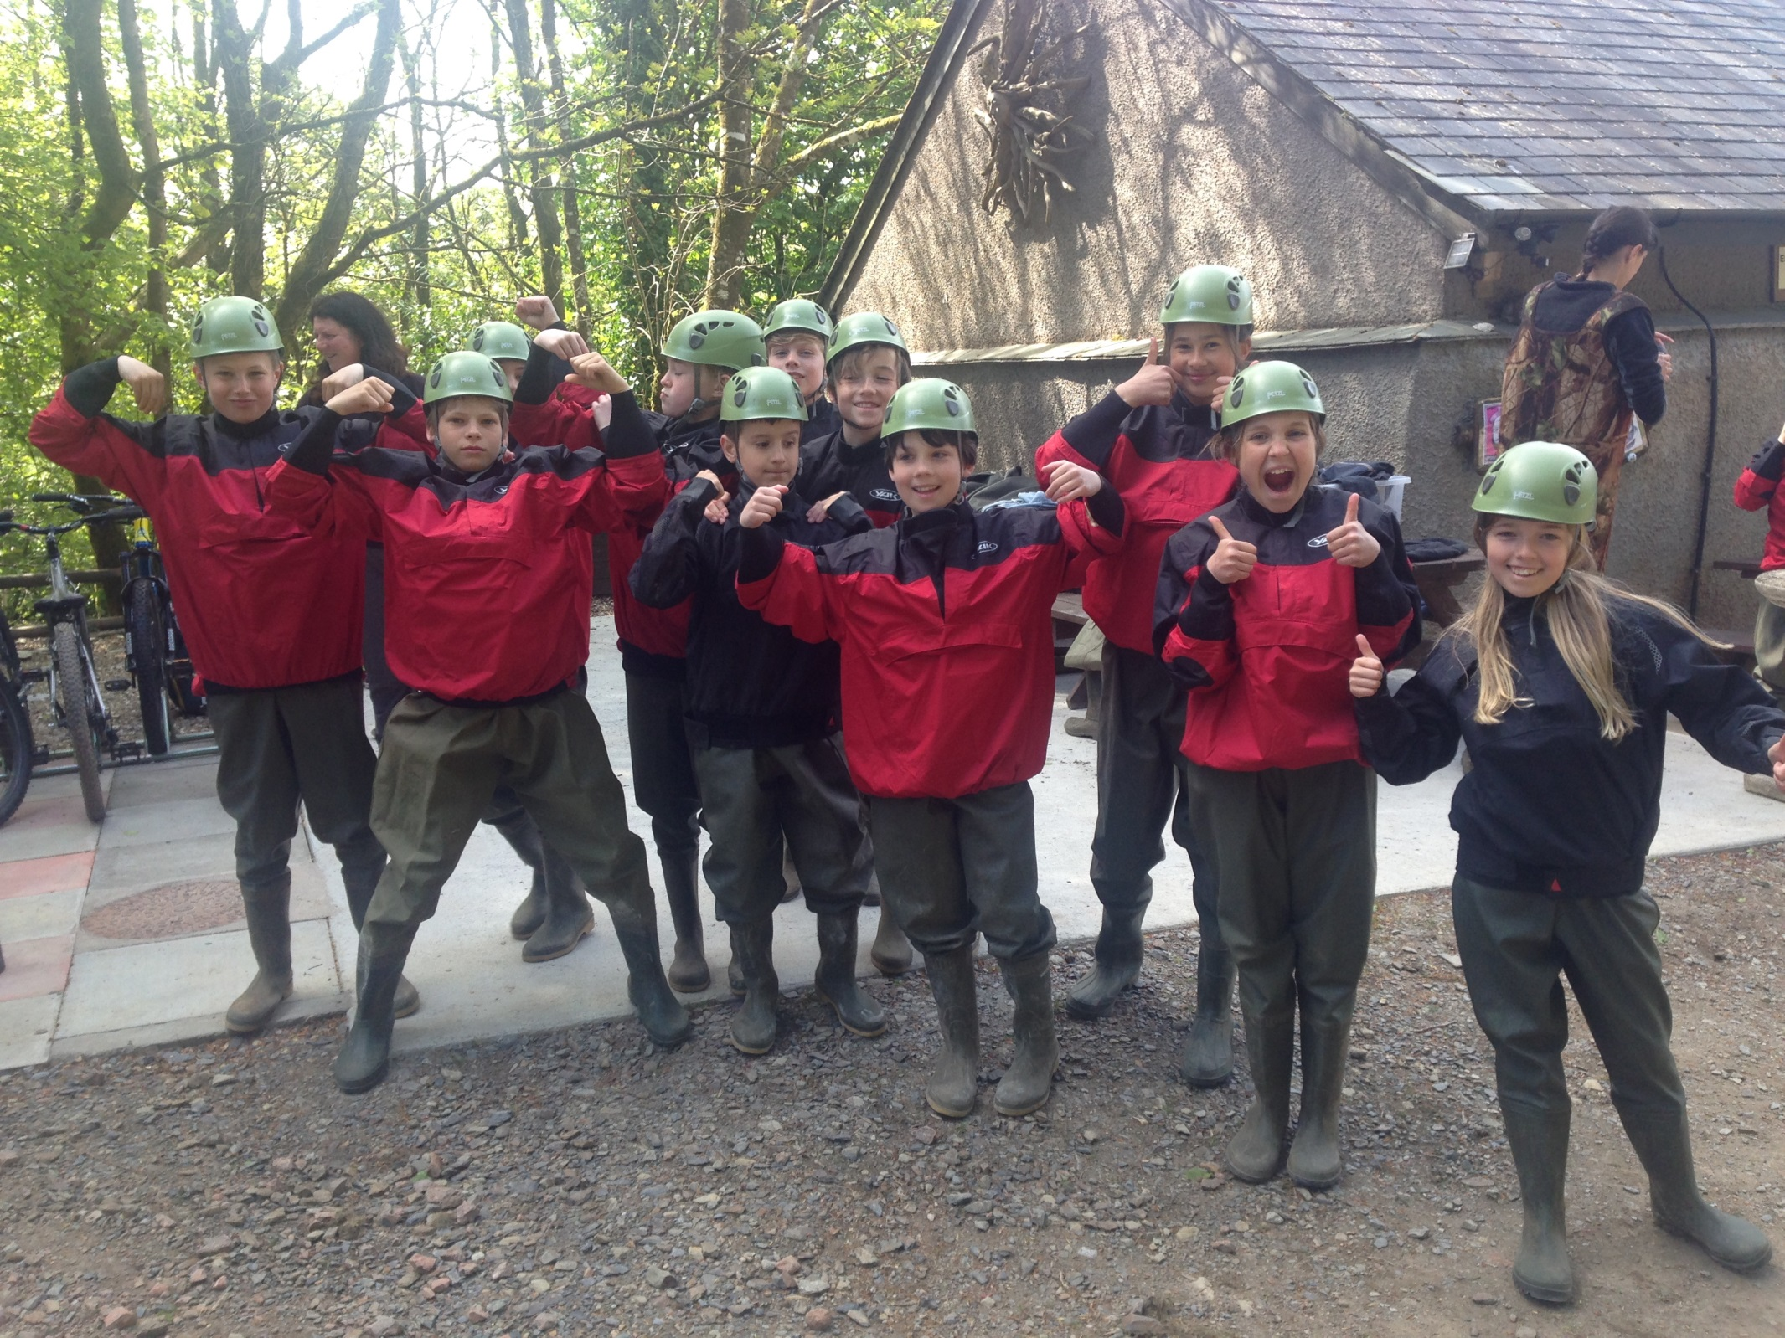
Stream scramble

Slide 24
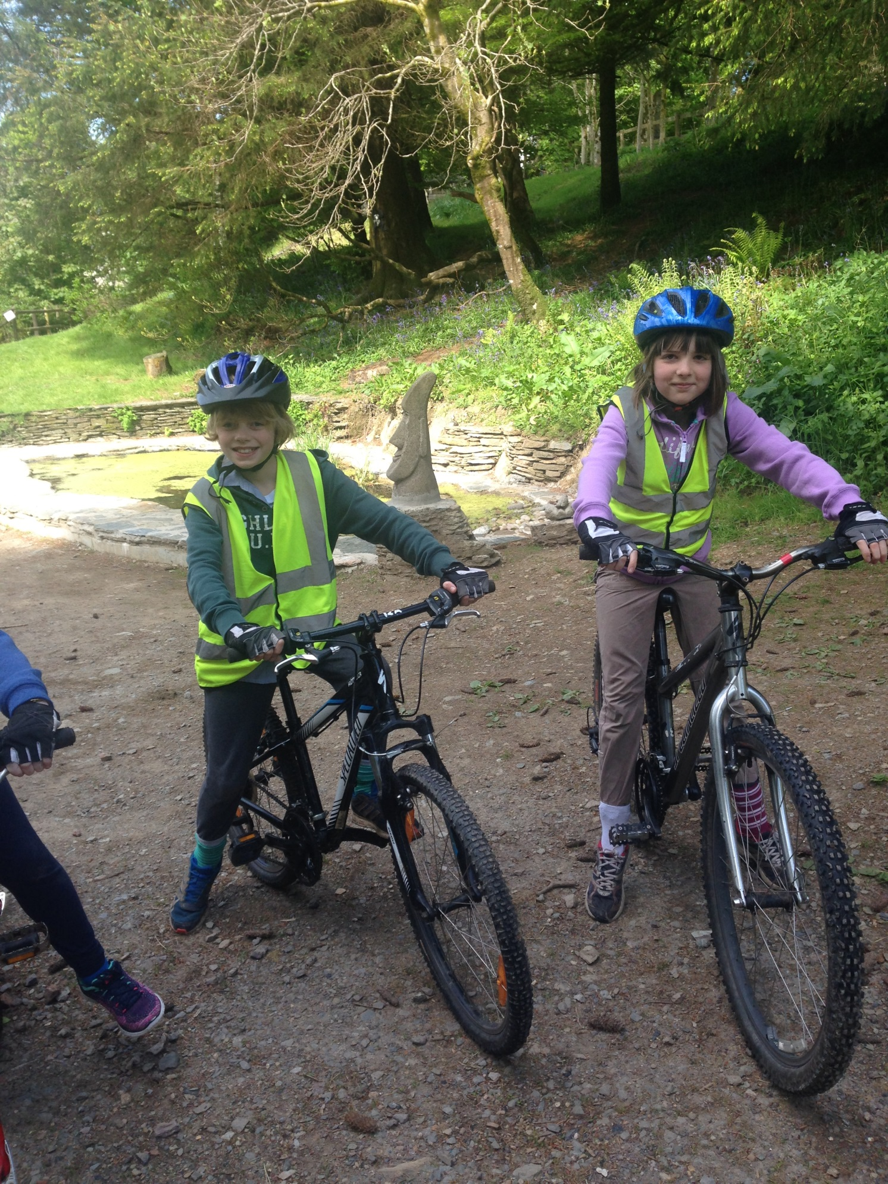

Slide 26
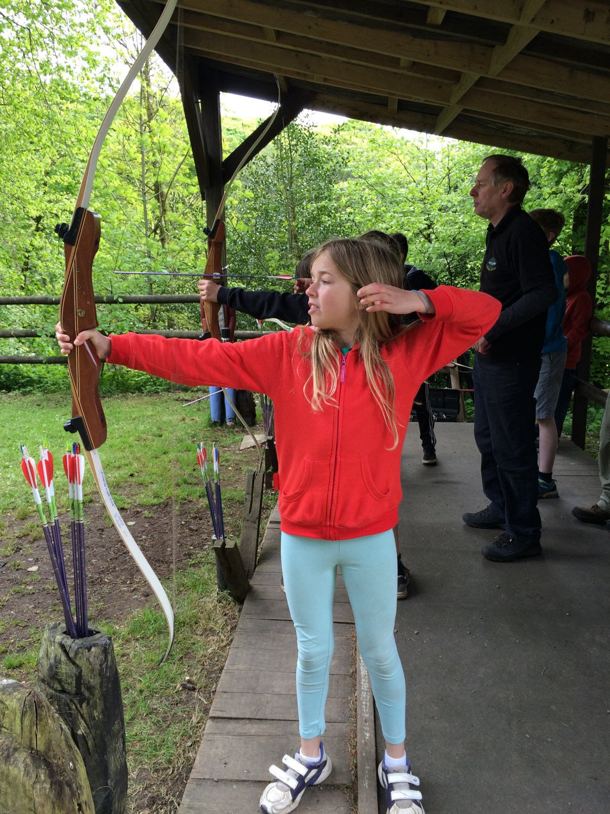

Slide 27
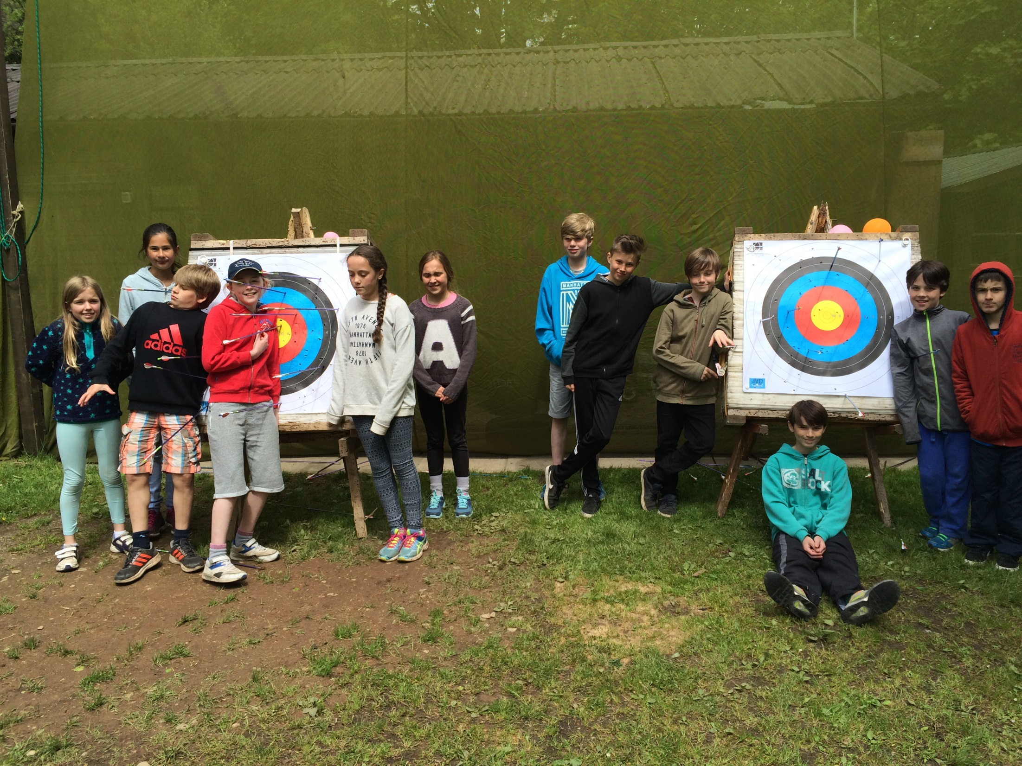

Slide 28
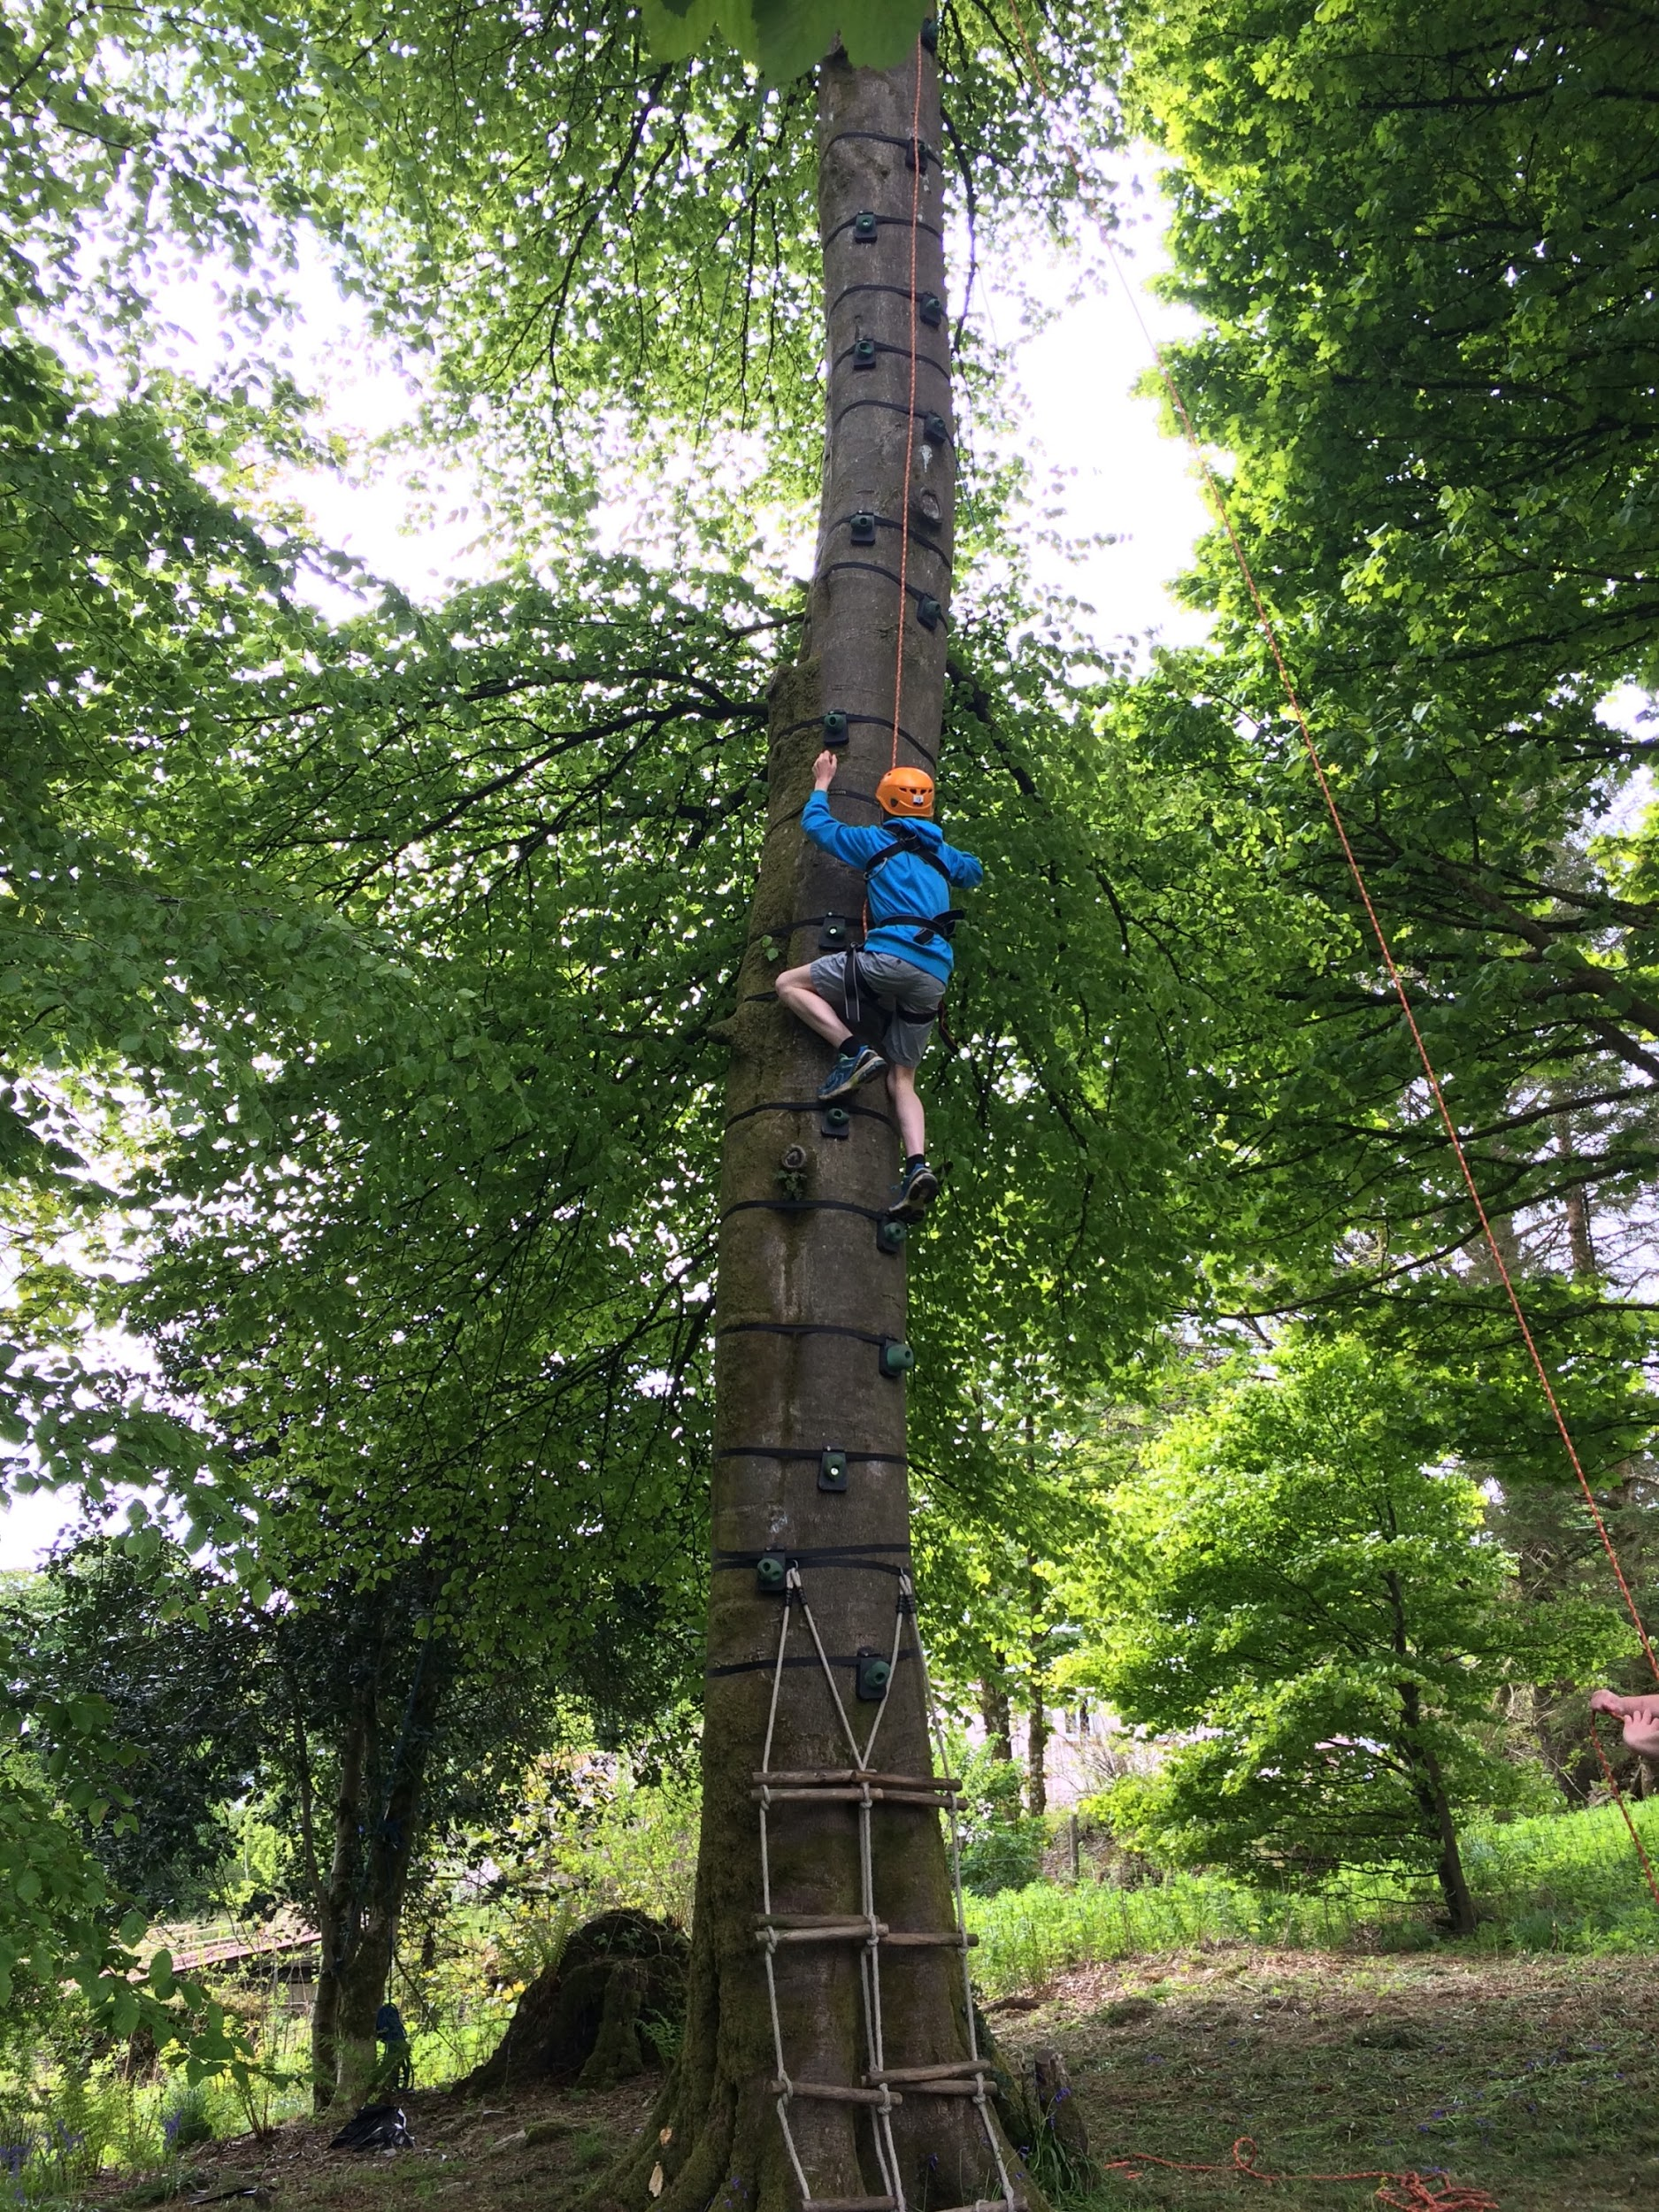
Gladiator challenge

Slide 29
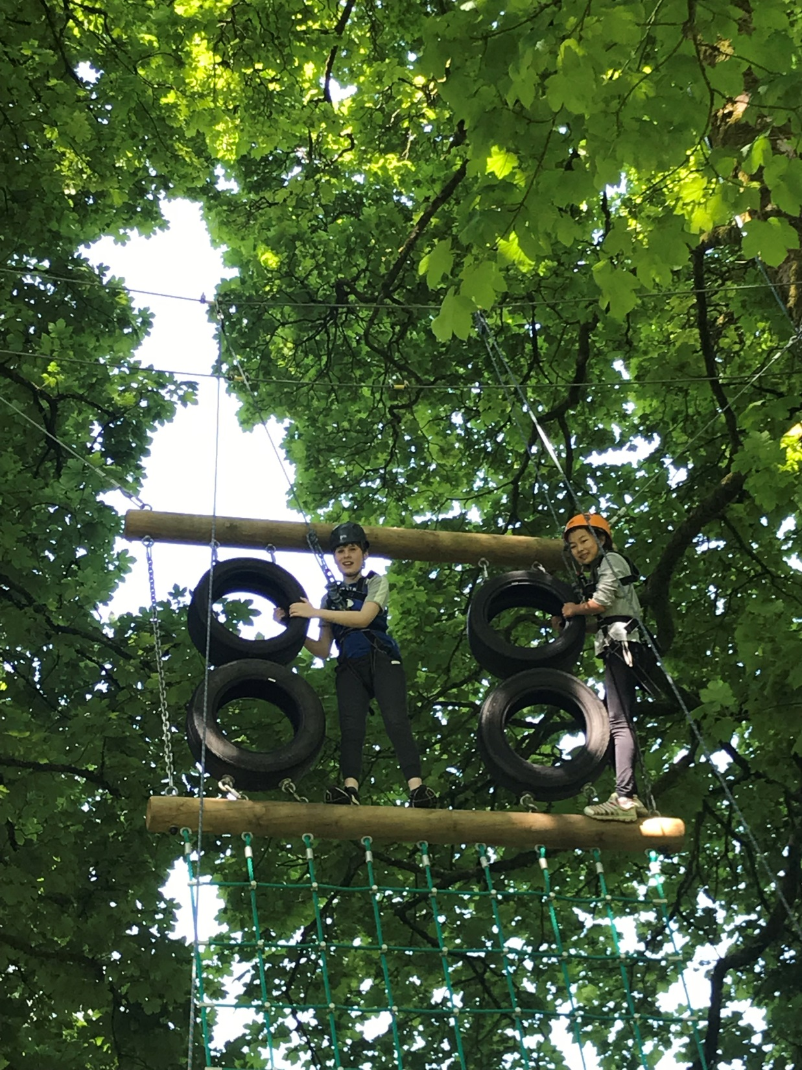

Slide 30
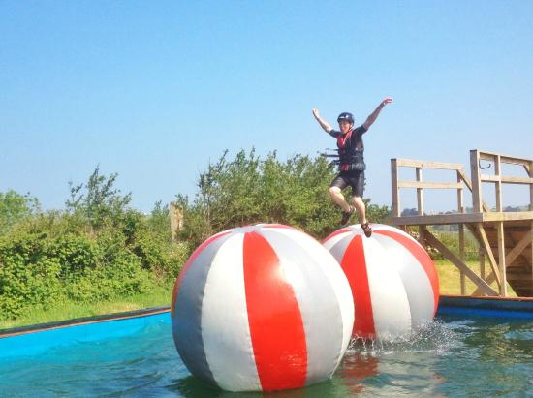
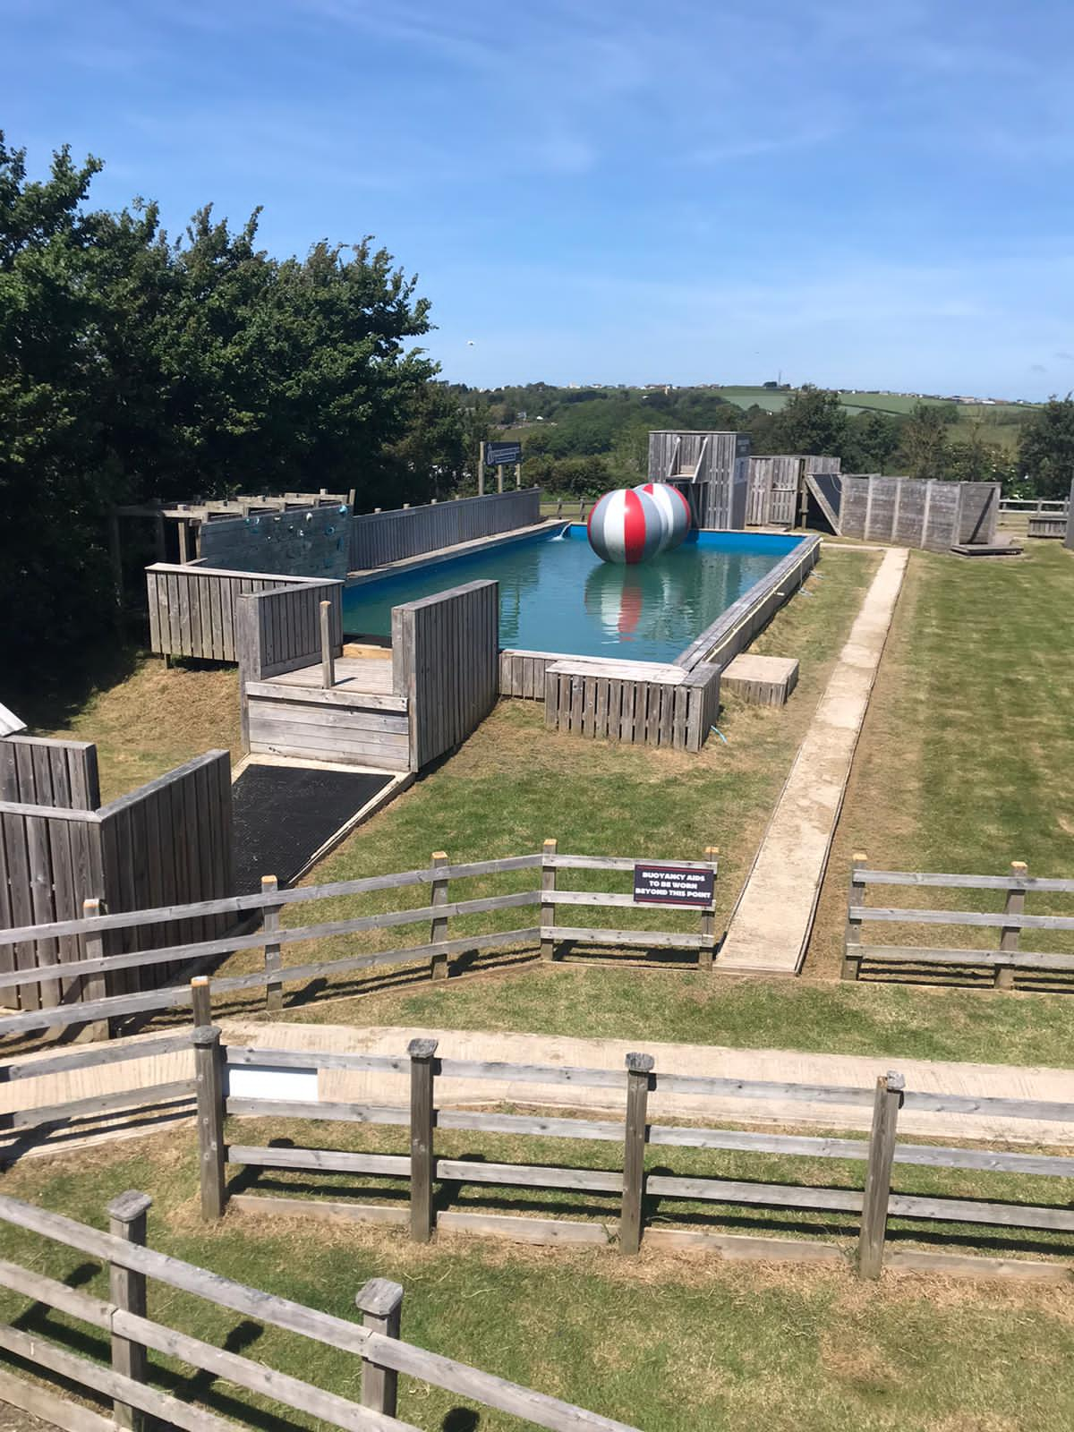
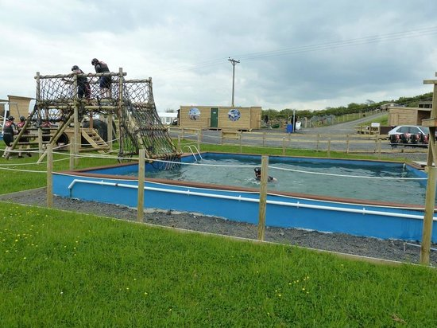
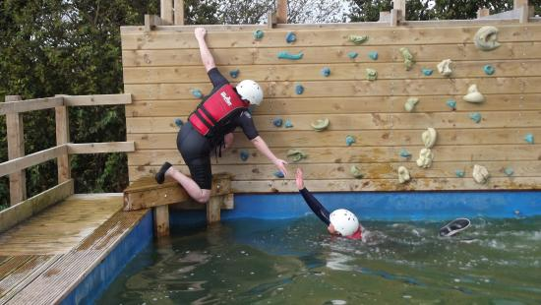

Slide 31
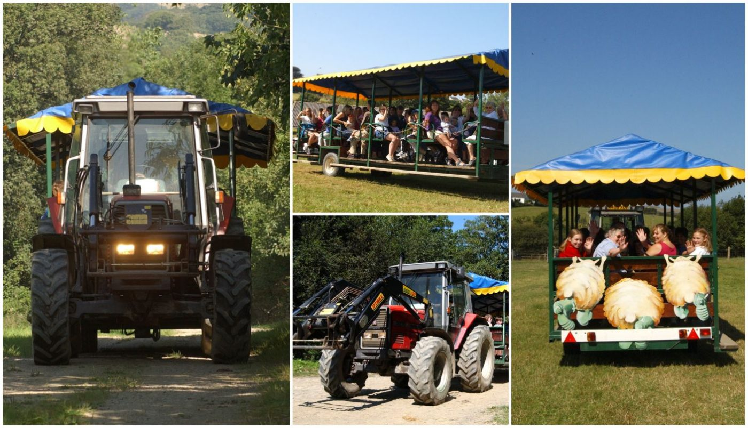

Slide 32
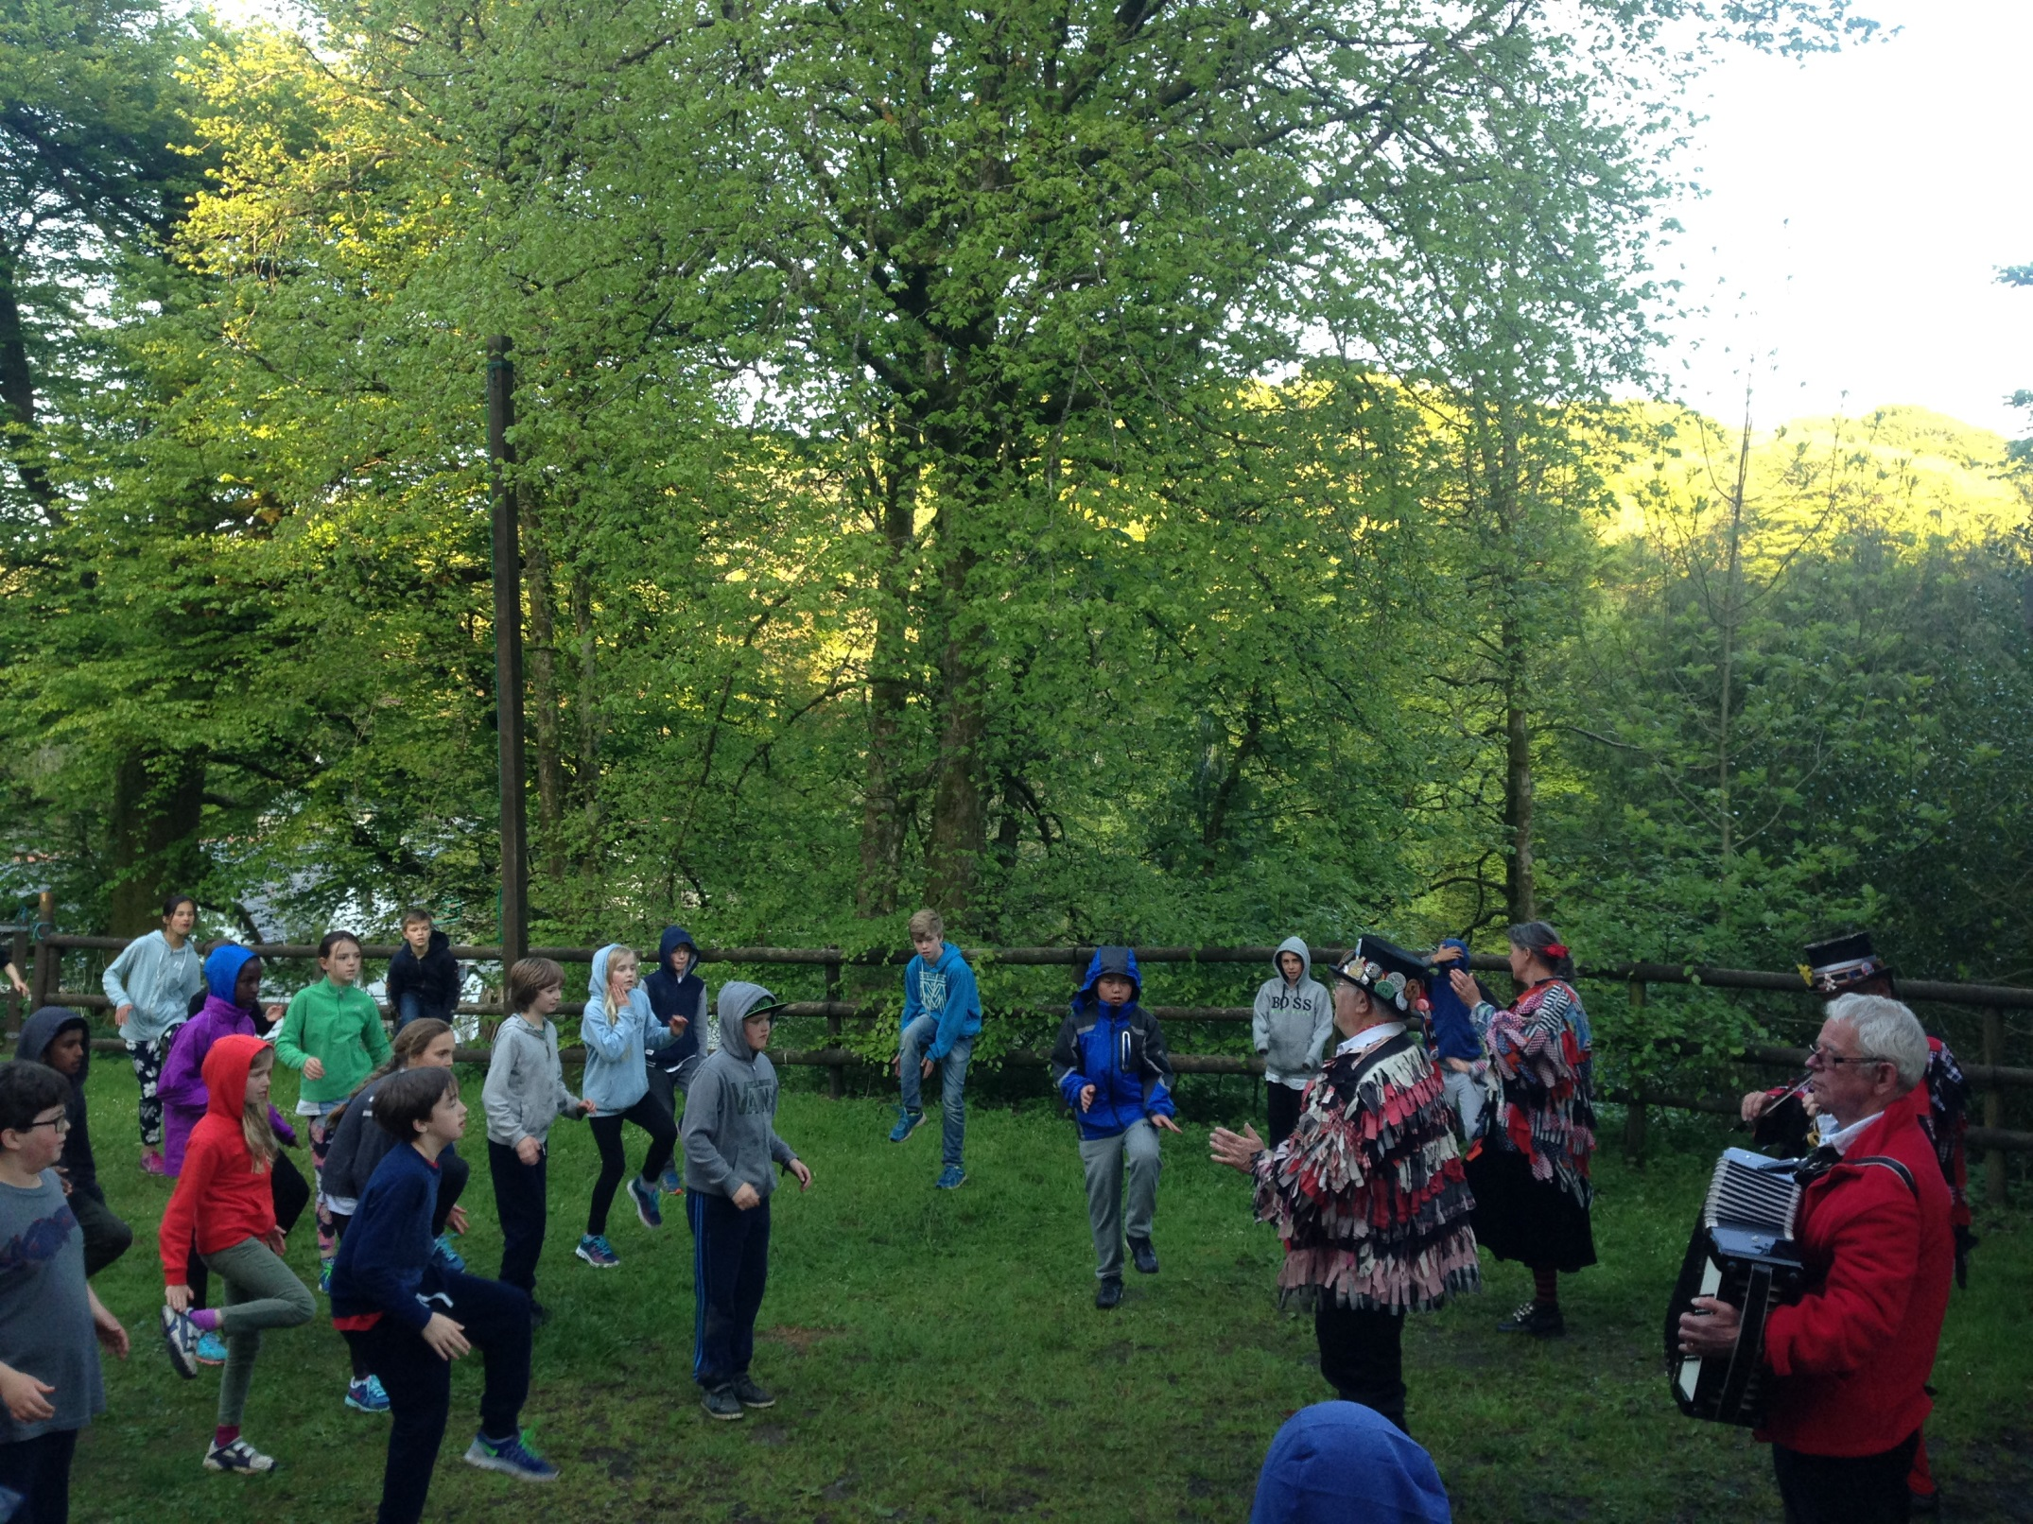

Slide 33
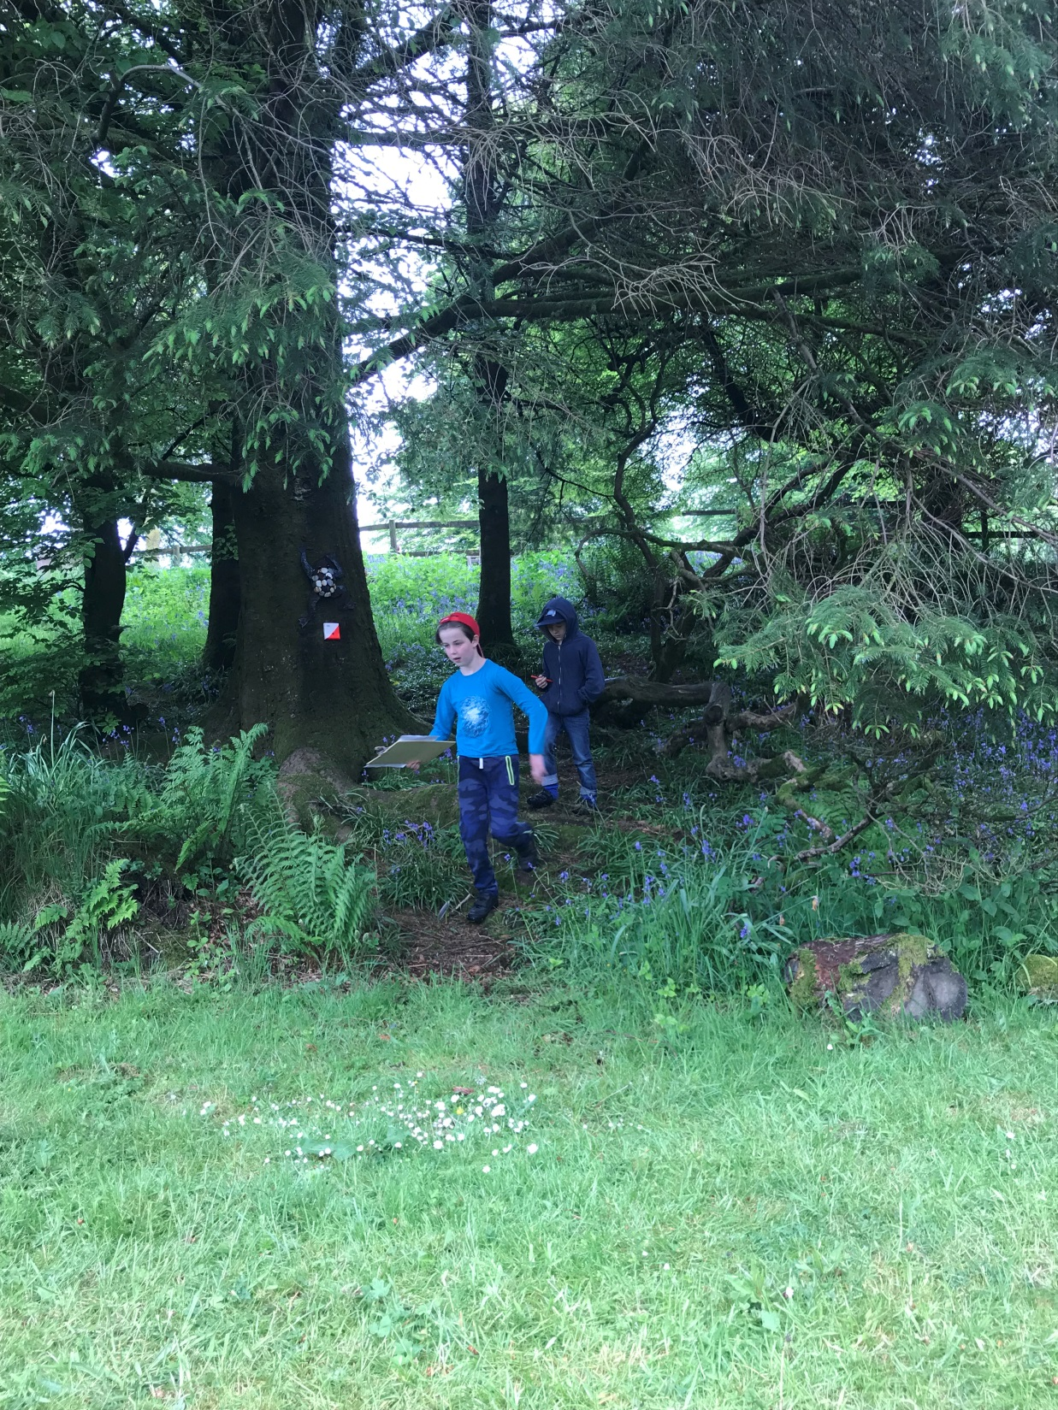

Slide 34
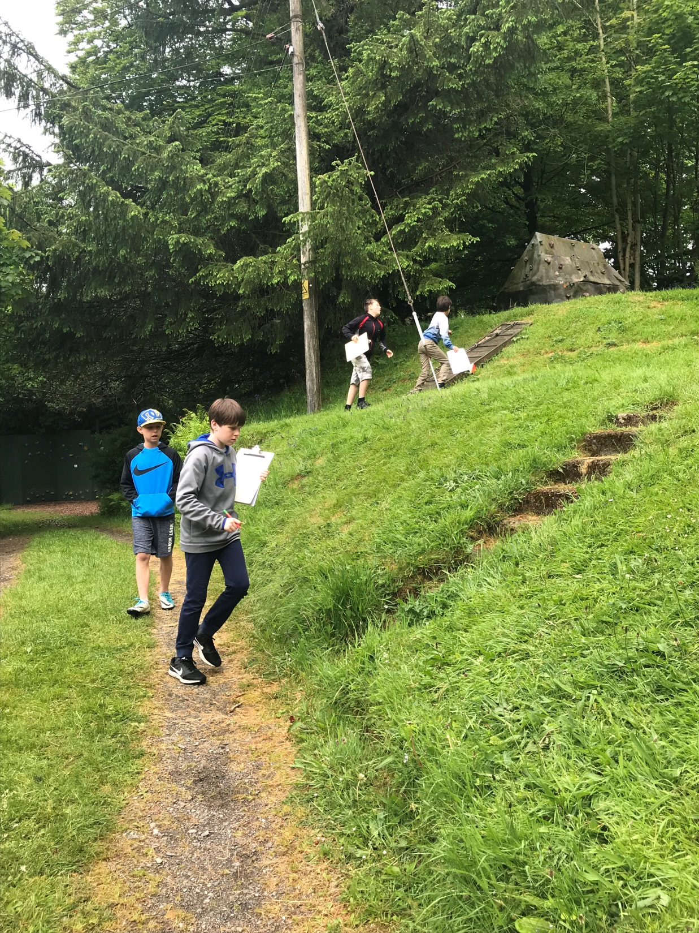

Slide 35
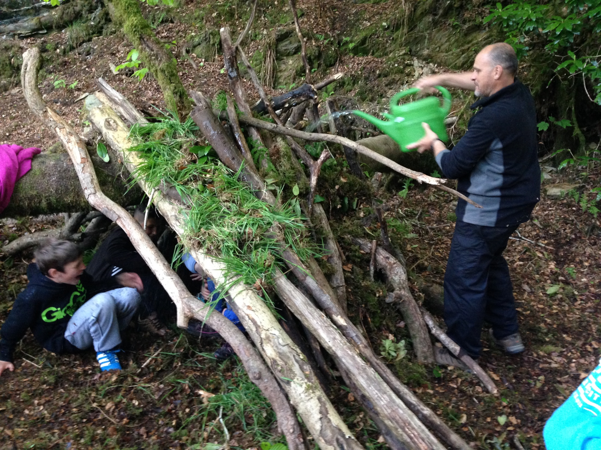
Shelter building

Slide 36
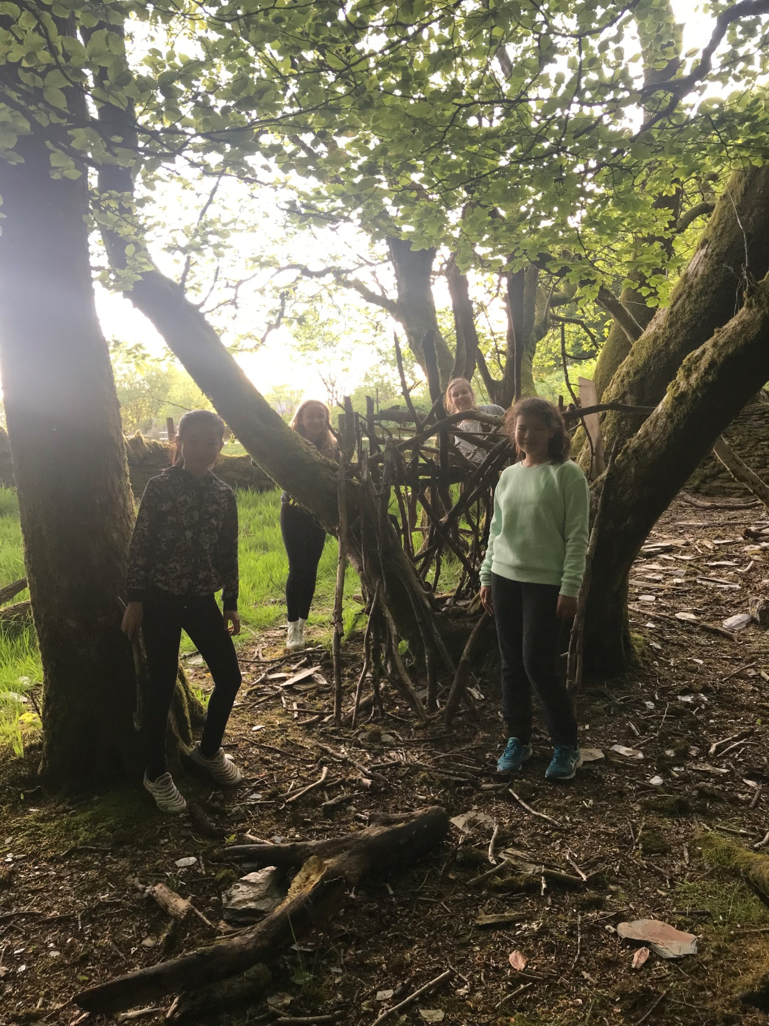

Slide 37
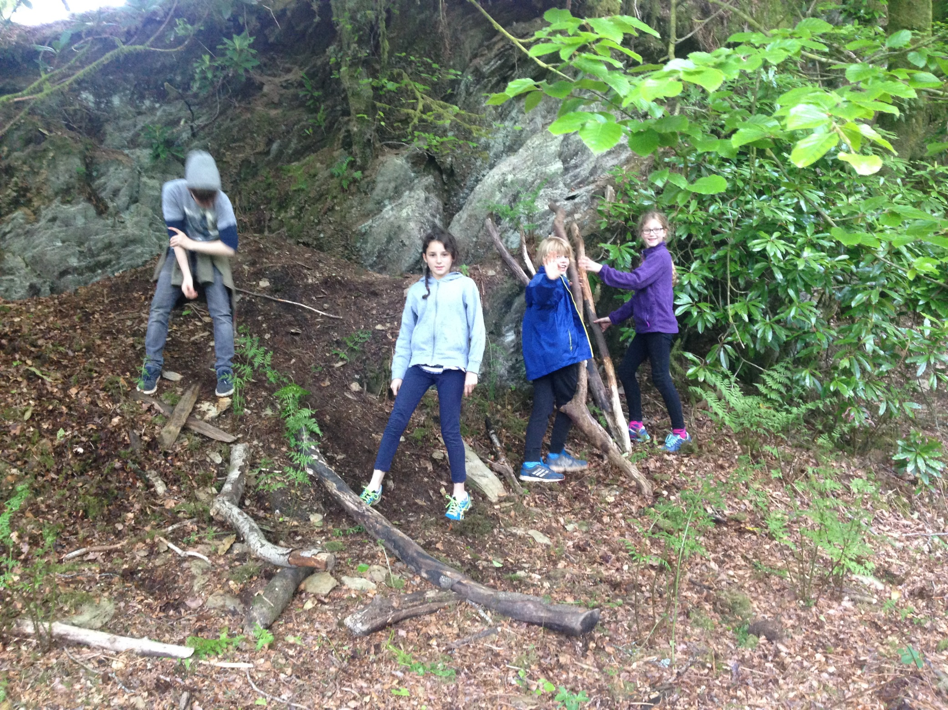

Slide 39
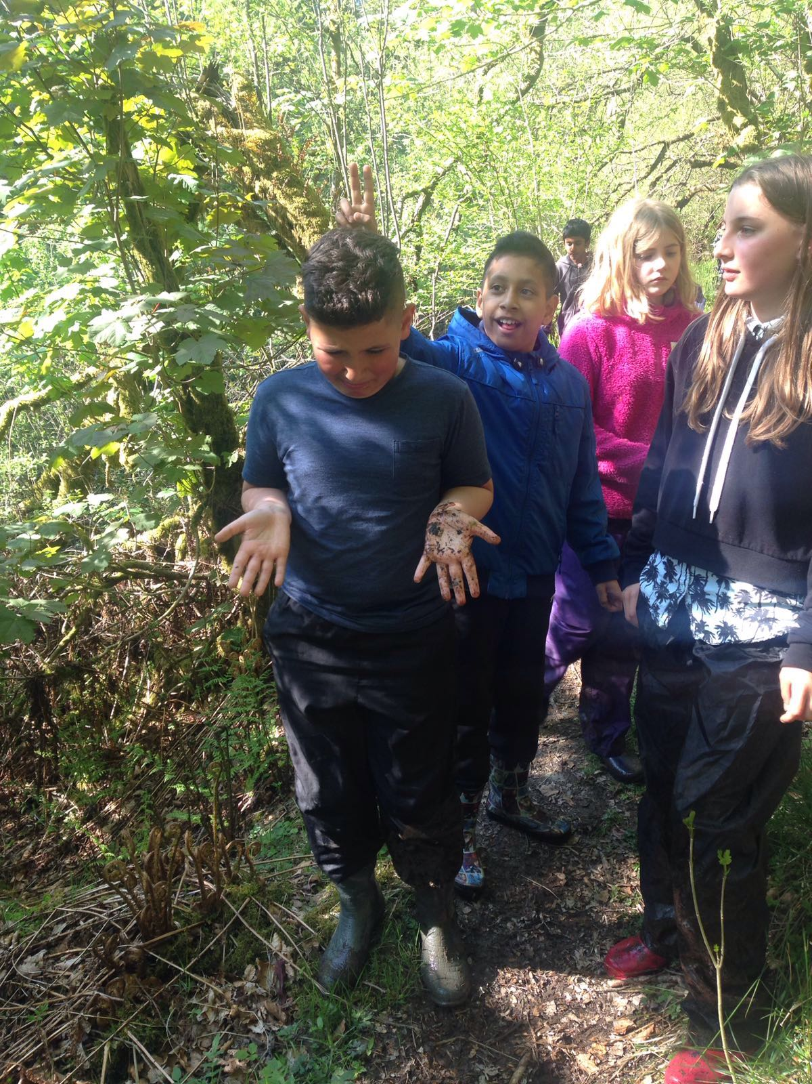

Slide 40
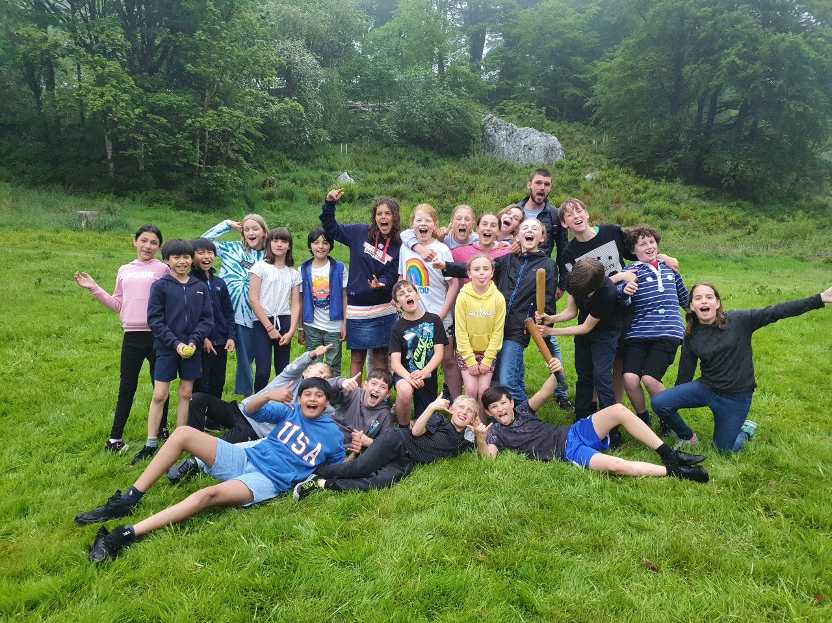

Slide 41
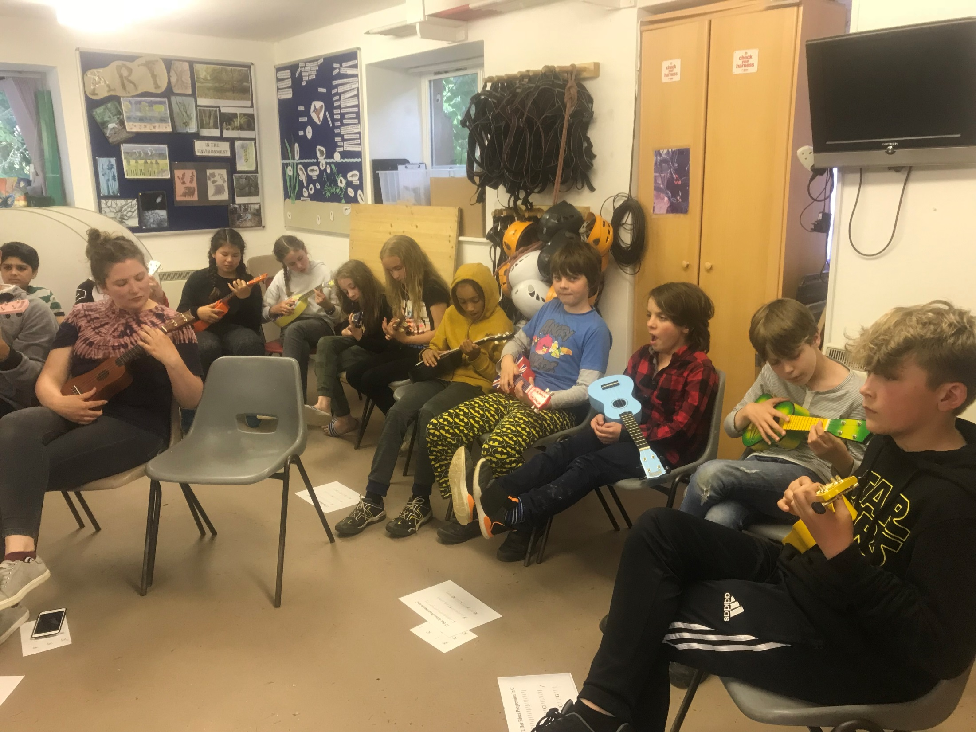

Slide 42
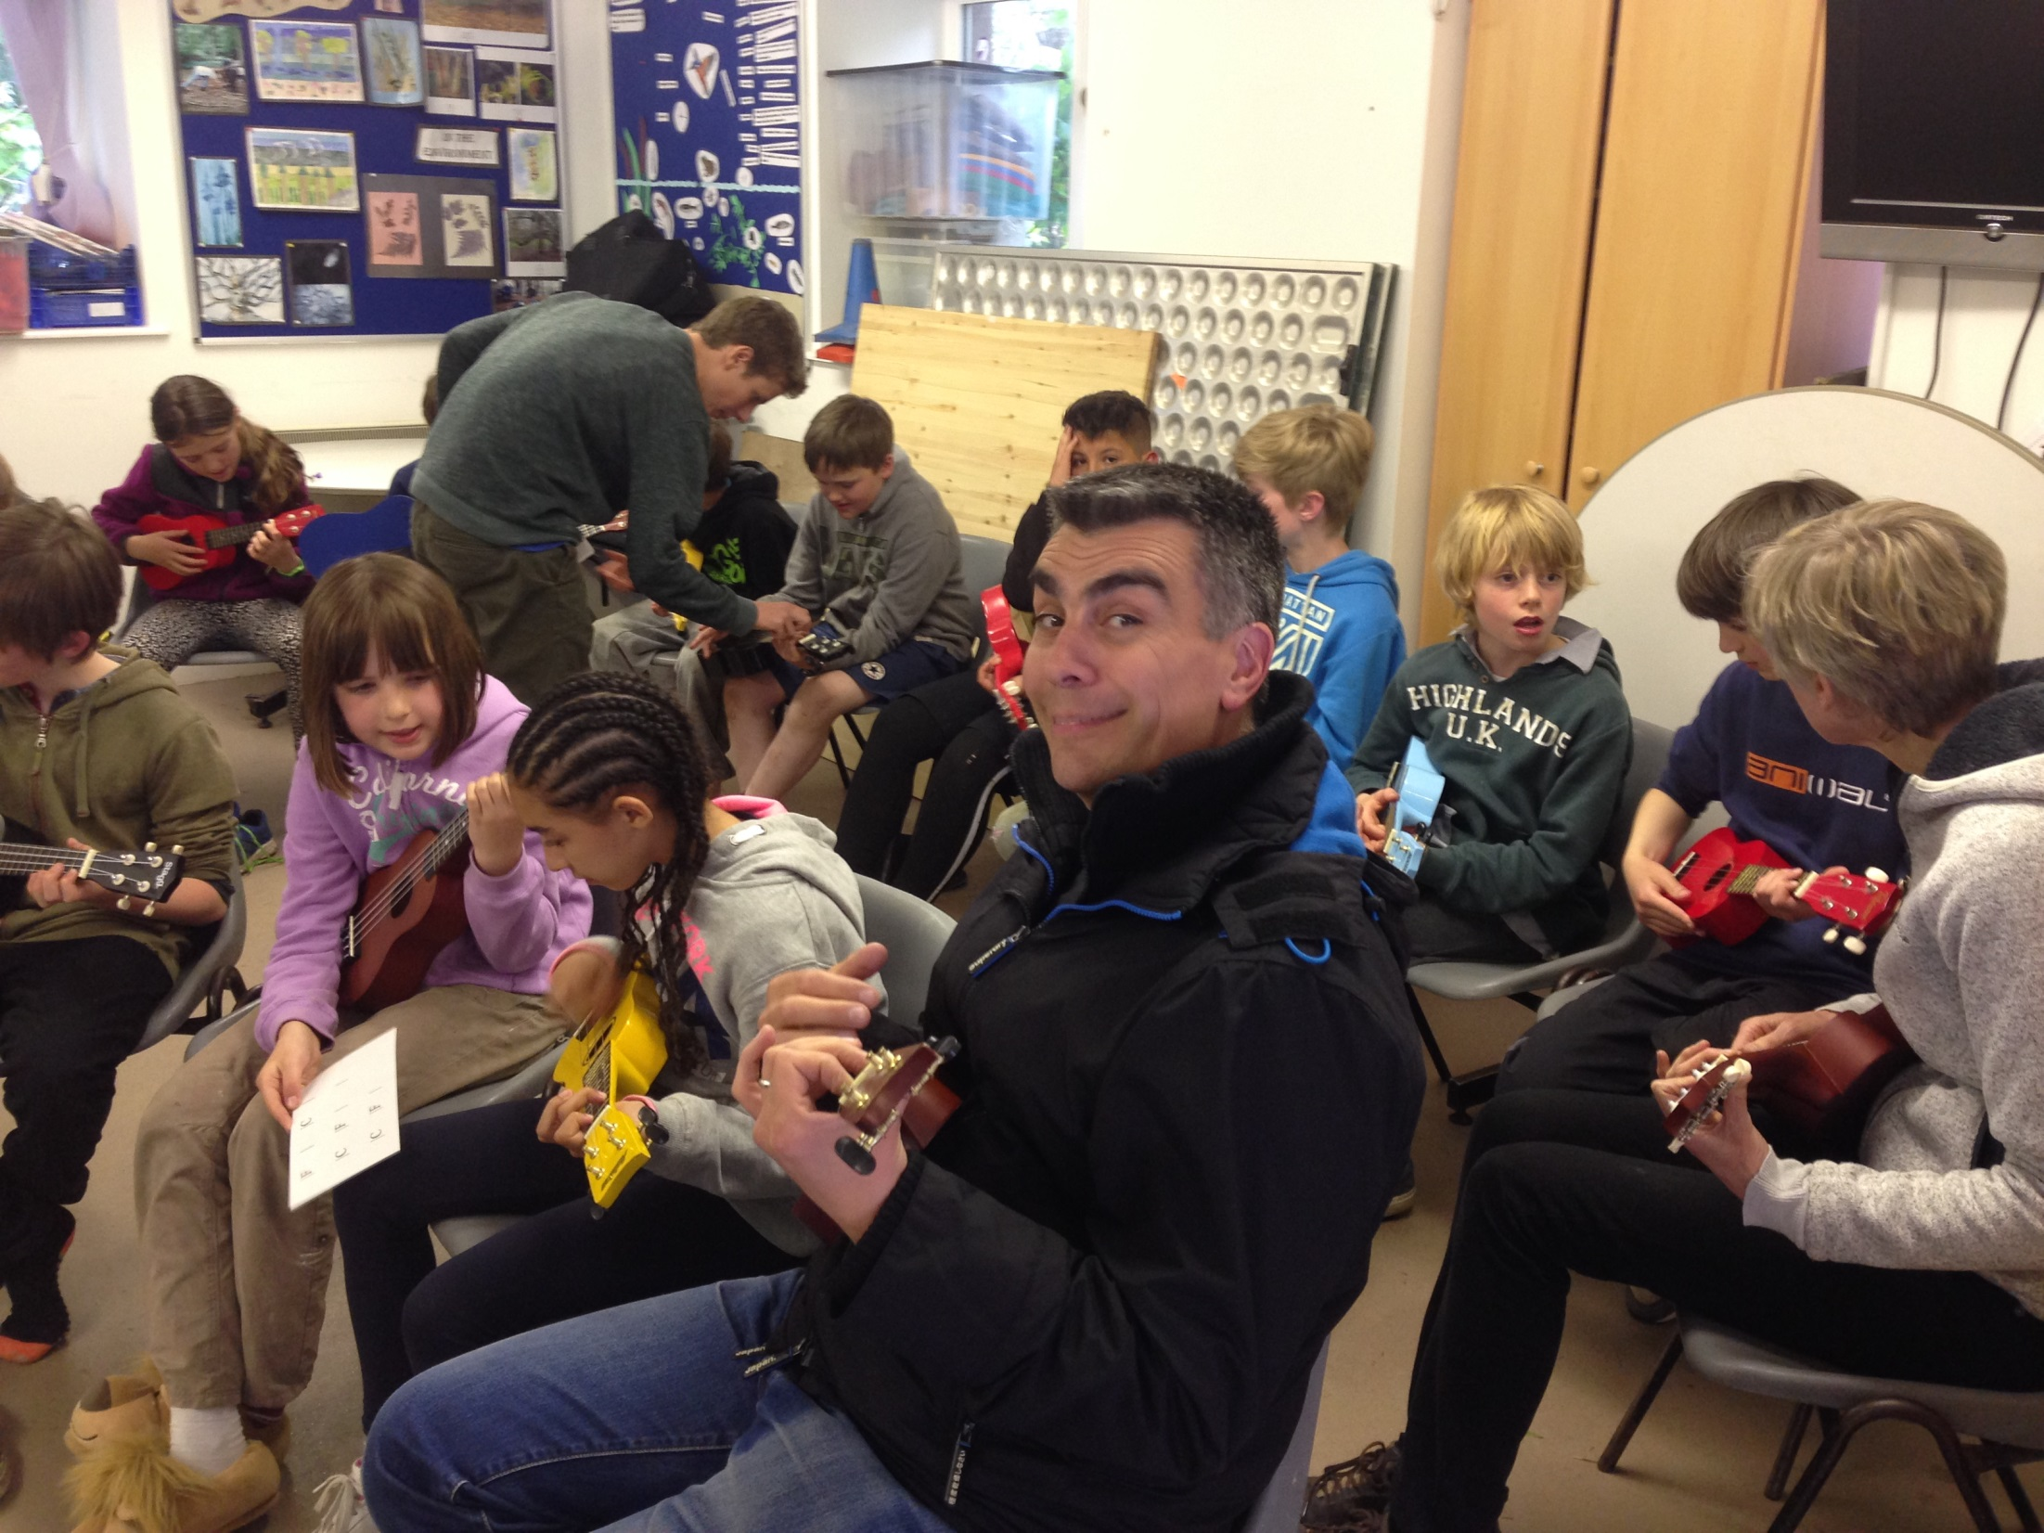

Slide 43
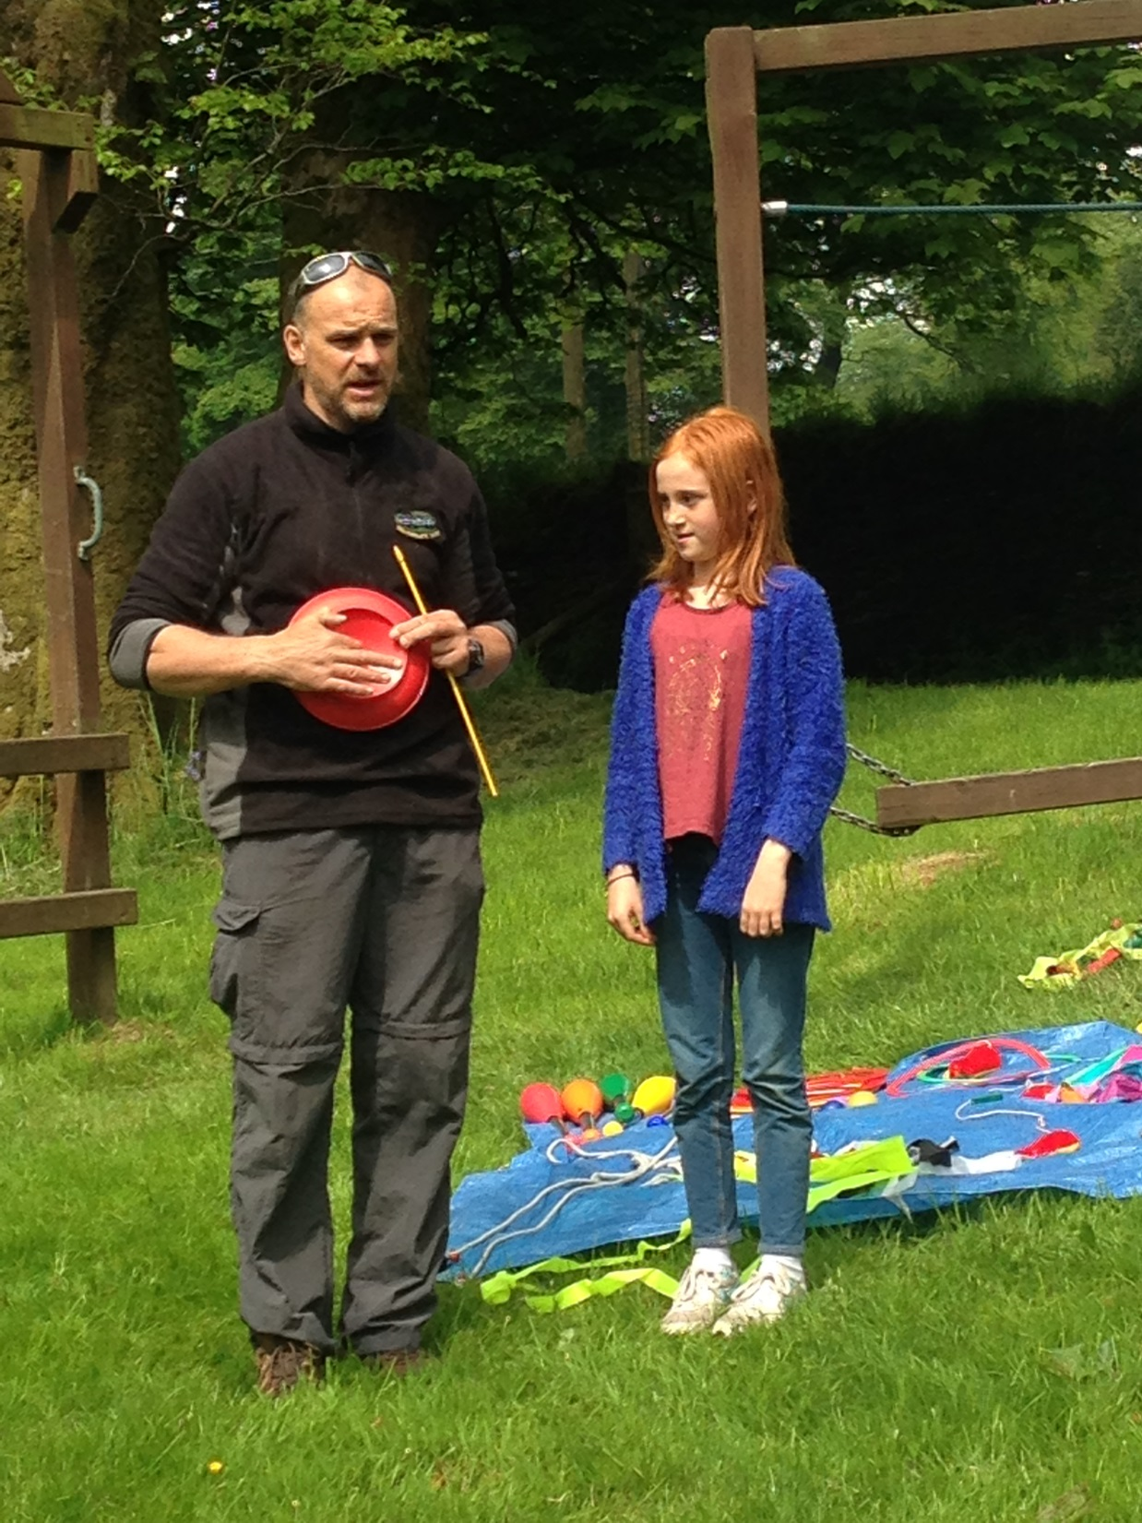

Slide 44
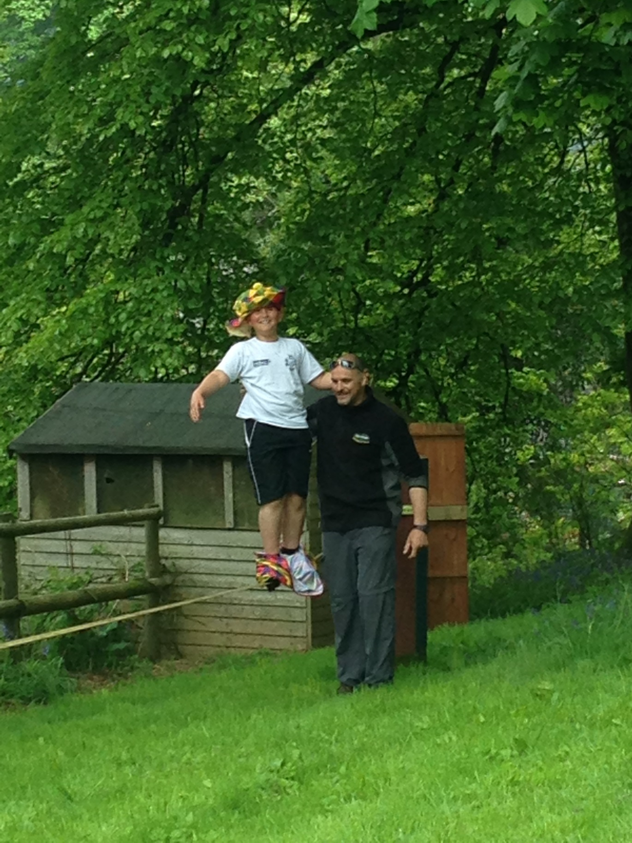

Slide 45
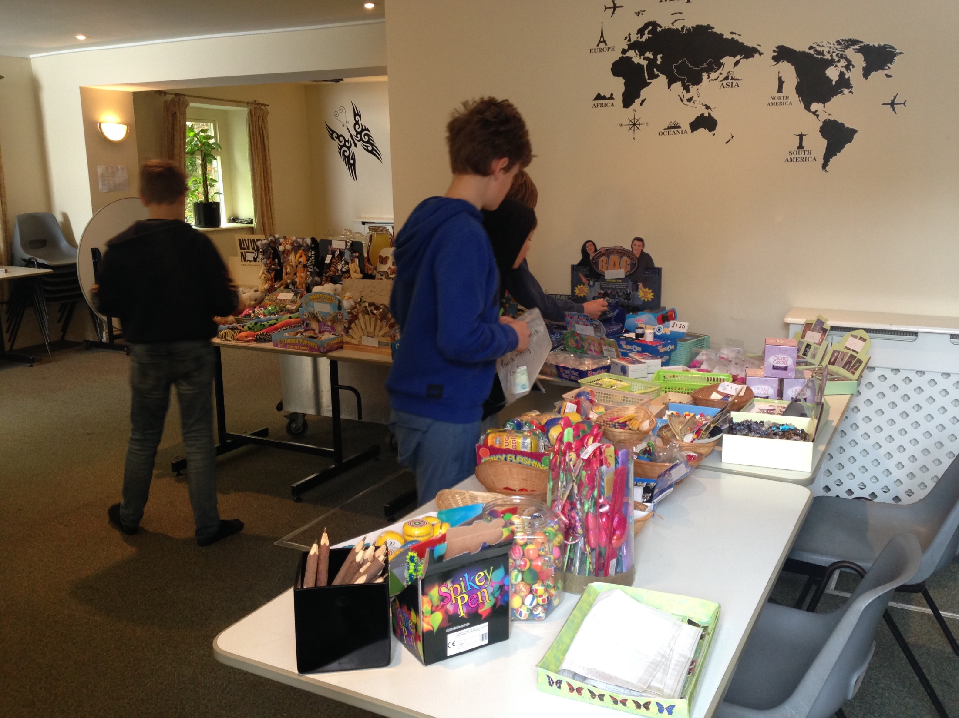

Slide 46
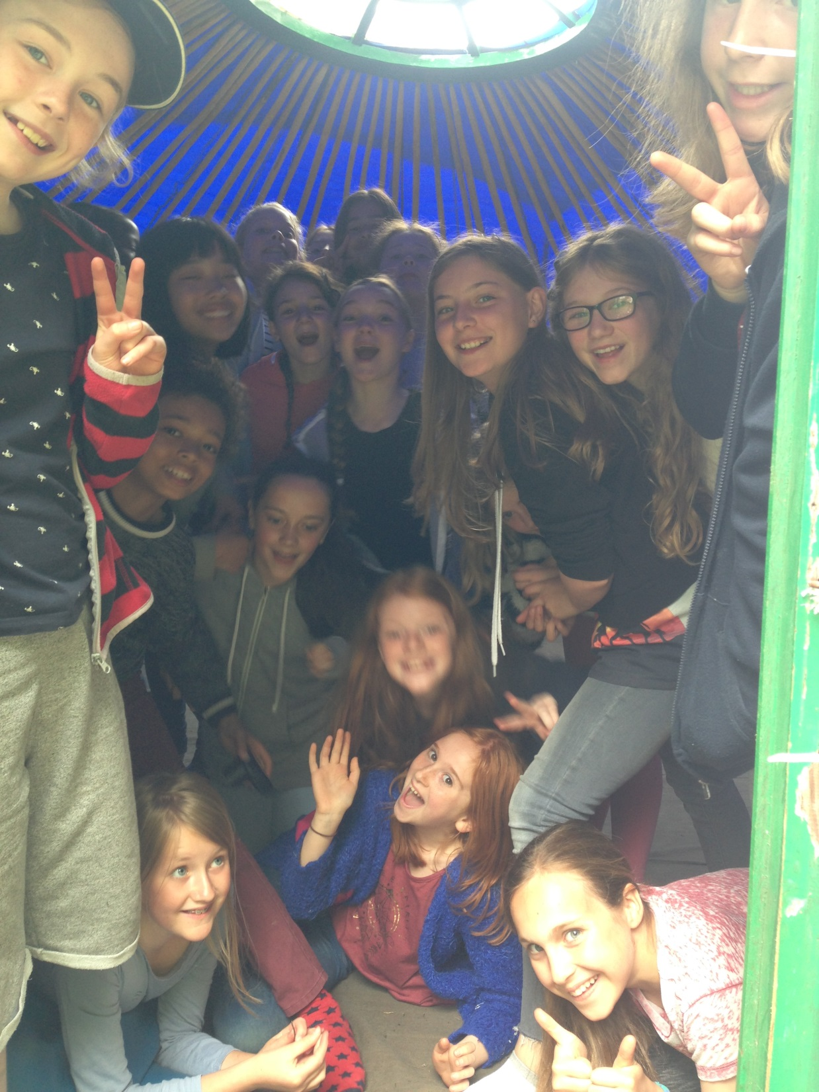

Slide 47
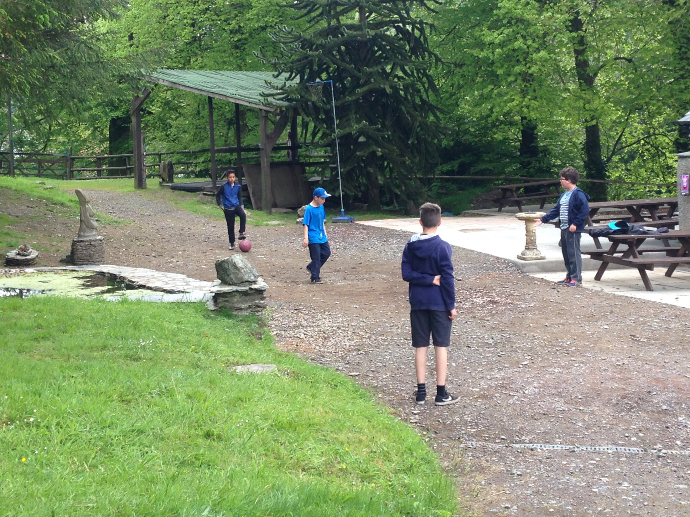

Slide 48
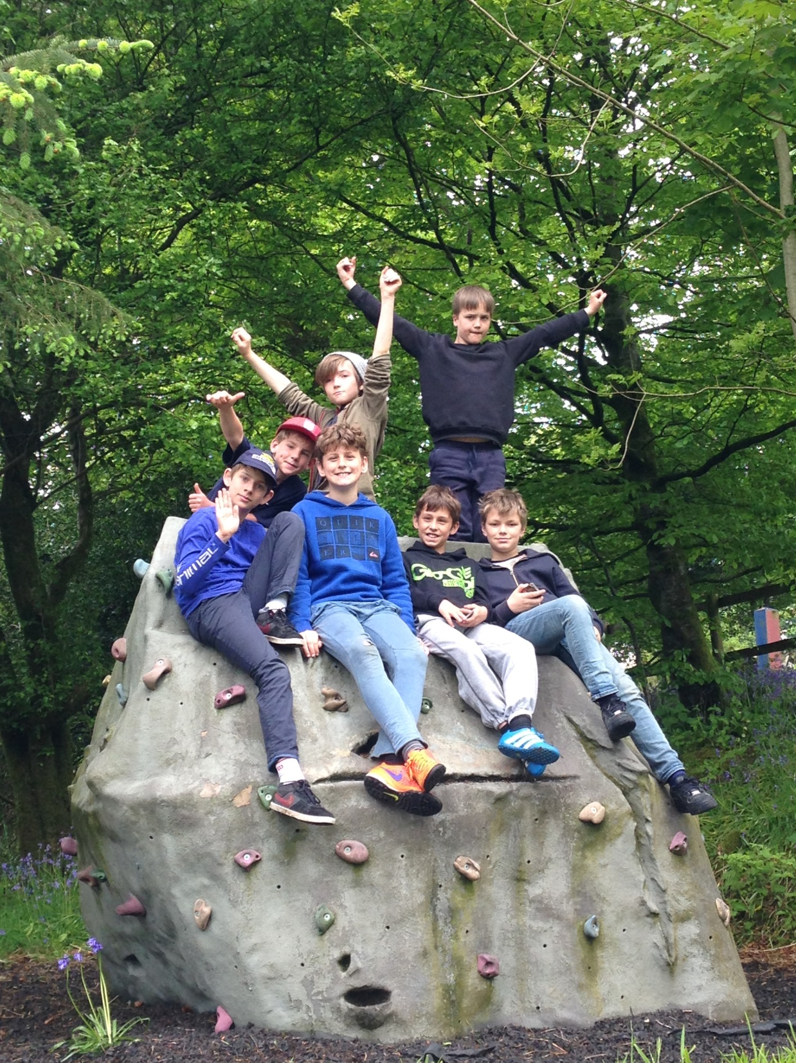

Slide 49
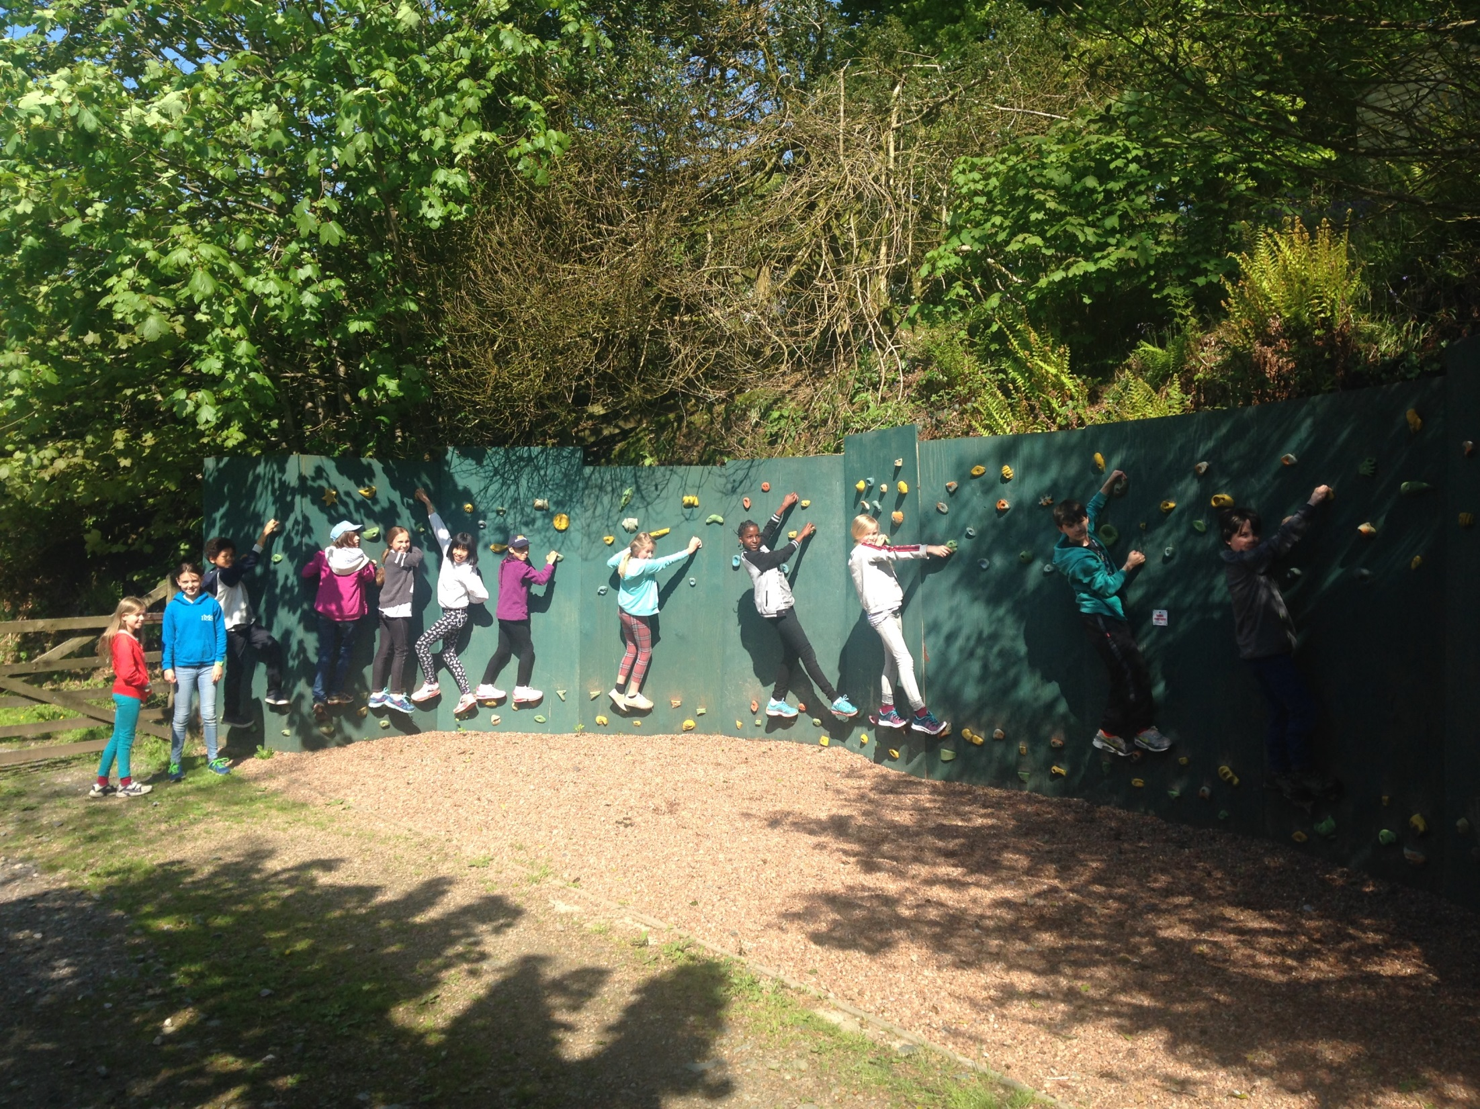

Slide 50
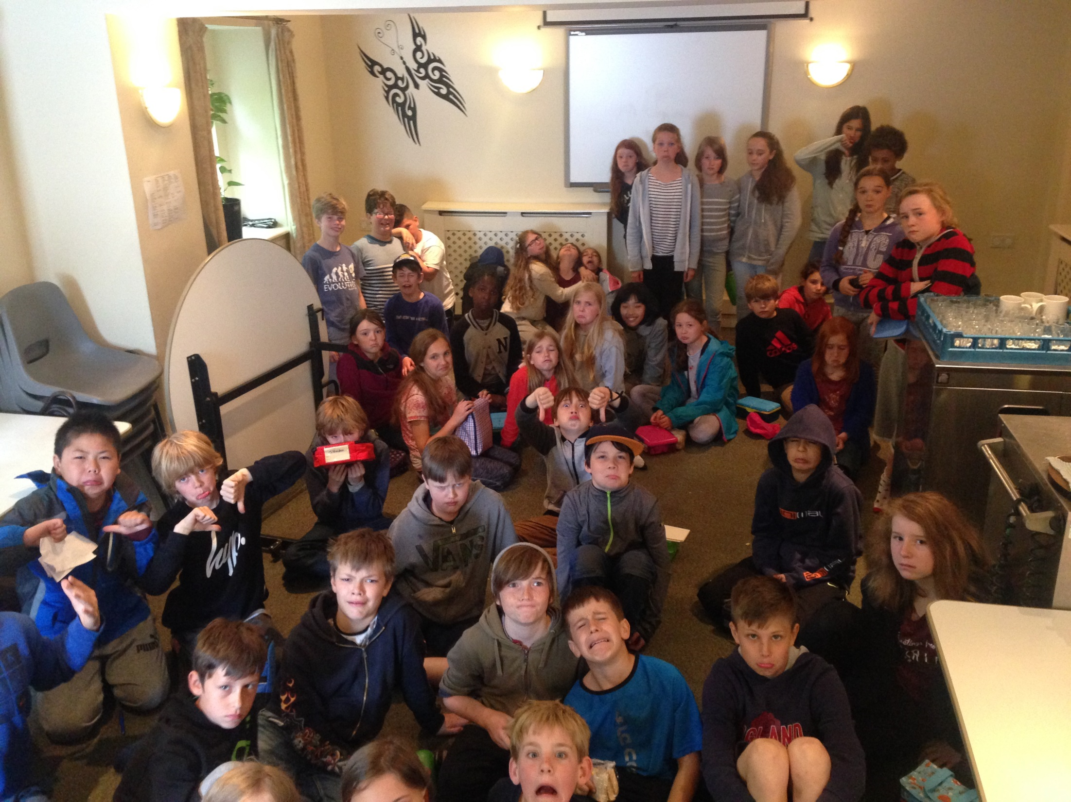

Slide 51
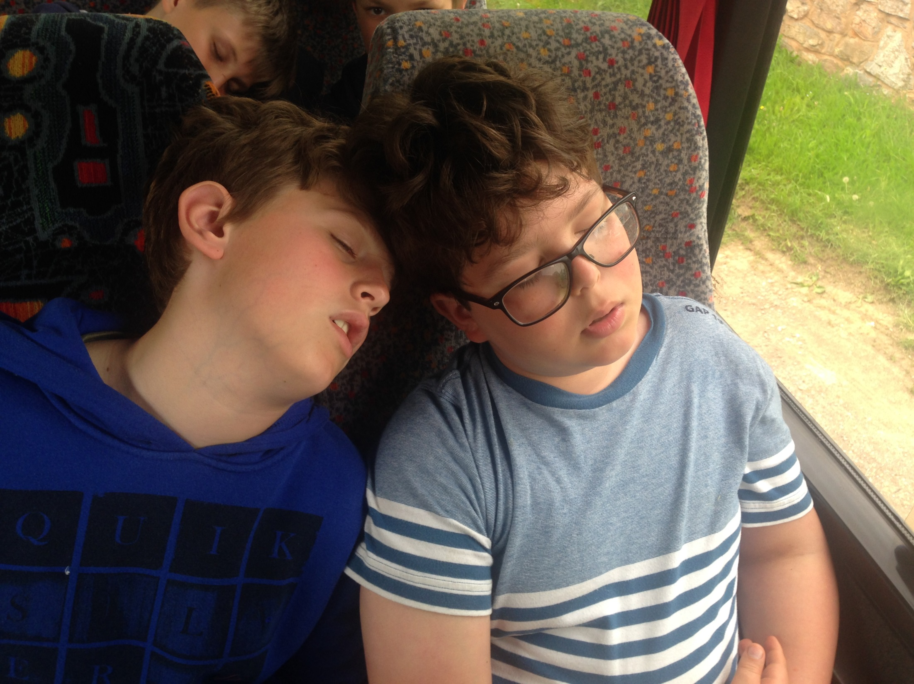

Slide 52
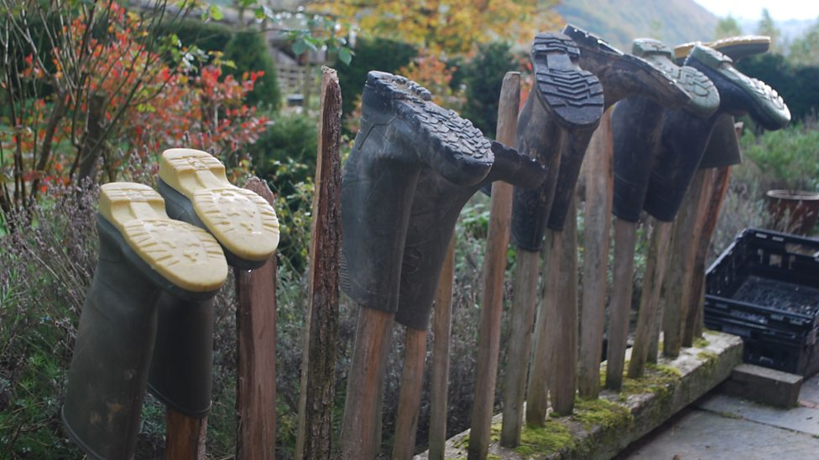
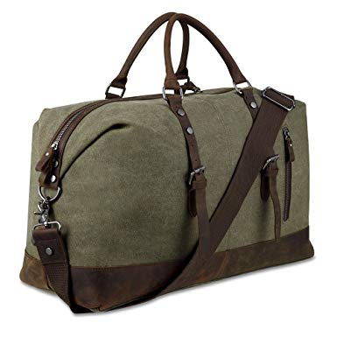

Slide 56
Questions…

