Slide 1
Online safety talk to parents and carers
26th April 2023
Notes:
Welcome. Thank you for coming to our online safety meeting.

Slide 2
The Internet
Notes:
The online world can be positive and exciting – like being able to create your own content, play games or watch videos. They can access resources on the other side of the world with just a click of a button. It is though important to manage and minimise the associated risks. The internet is changing quickly - PLAY
How you feel about the internet probably has a lot to do with the type of job you do as well as your age. I heard a quote from Douglas Adams which I would like to share with you …
“I've come up with a set of rules that describe our reactions to technologies:
1. Anything that is in the world when you’re born is normal and ordinary and is just a natural part of the way the world works.
2. Anything that's invented between when you’re fifteen and thirty-five is new and exciting and revolutionary and you can probably get a career in it.
3. Anything invented after you're thirty-five is against the natural order of things.”
― Douglas Adams, The Salmon of Doubt

Slide 3
Outcomes for the session
The aims for the session are to:
Give you a better understanding of online and cyber risks
Help you mitigate threats at home through technical and non-technical methods
Support you in being more cyber aware

Slide 4
What areas should we focus on:
Sharing
Viewing
Chatting
Friending
Notes:
Each one of these could be talked about for an hour on their own! Here we will touch on each area and the issues around them.
Viewing - firstly, is it age appropriate for your child. During this meeting we will help guide you on how you can make those decisions. Secondly, what you can put in place to help you restrict what they can see but also what you need to put in place for when your child can use the internet outside of your home. what to do when your child sees something they should not have seen. Plus how much time are they spending viewing?
Sharing - this is two-fold : what are they sharing on a platform? Also, what are they sharing with the provider as they sign up for different apps, games etc
Friending - Who are they friending? Are you able to restrict it? And with this Lastly, who can they chat to? Equally, who are they listening to?

Slide 5
Age -ratings
What are they viewing/playing?
Notes:
The PEGi system is based on six age catergorises - the one you can’t see here is ‘parental Guidence recommended’ and 8 content descriptors. Essentially, the PEGI rating on a game confirms that it contains content suitable for a certain age group and above. So a 7-rated game is suitable for everyone who is seven or older, It is not, however, a measure of who will enjoy the game or how difficult that game is.

Slide 6
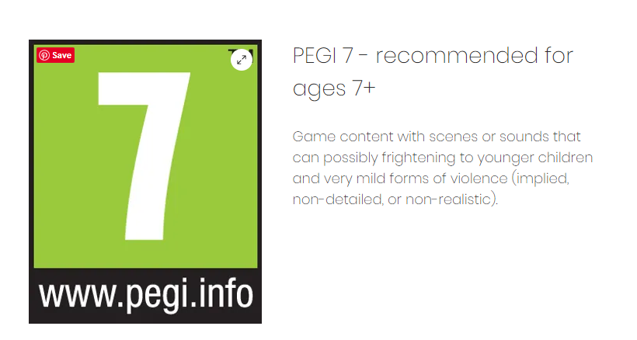
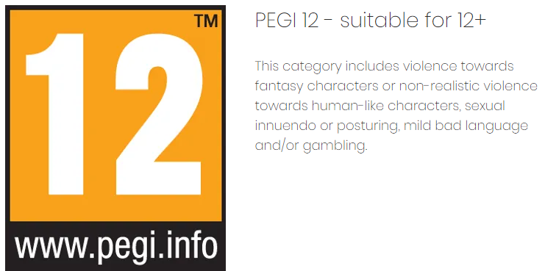
PEGI ratings
Notes:
Read screen

Slide 7
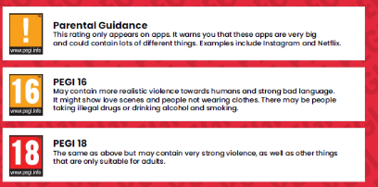
PEGI ratings cont.
Notes:
Quick look at age ratings above - read screen

Slide 8
What apps/games are okay?
Notes:
What apps? That is a hard question to answer. I could give you a list of educational apps but the likelihood is they won’t be the ones your child wants especially as they get older and more opinionated ! You also cannot possibility download and spend time looking at and playing each app. Luckily there is a website that has done this for you (Common Sense Media) - see link.
Talk to your child about why they want a particular app. What do they think they can do? What is it for? Sometimes what they think something does is not what they thought. Download apps together so you can notice any parent notifications and help set up the restrictions etc
Internetmatters.org - Amazing games guide for families -Playing games with your child and understanding how to make use of safety controls on apps and games consoles will help them develop good gaming habits, but there’s nothing as powerful as introducing them to a wide range of activities online.
Just like encouraging them to read books on different topics and themes, enabling them to explore a broader range of games beyond the most popular ones contributes to positive gaming.

Slide 9
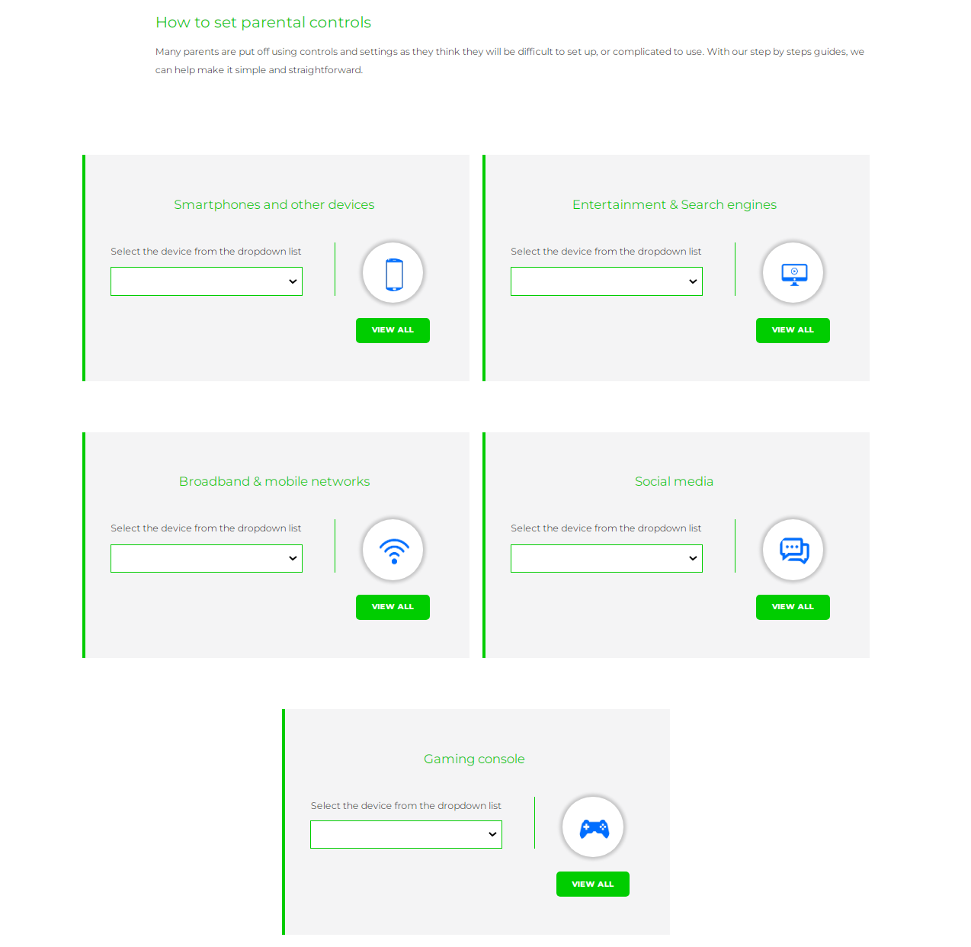
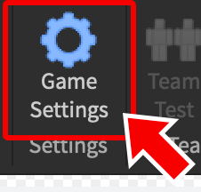
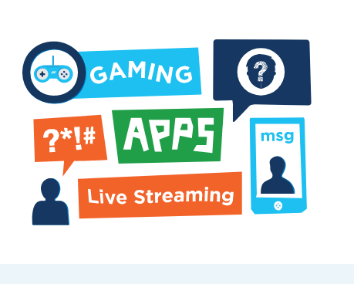
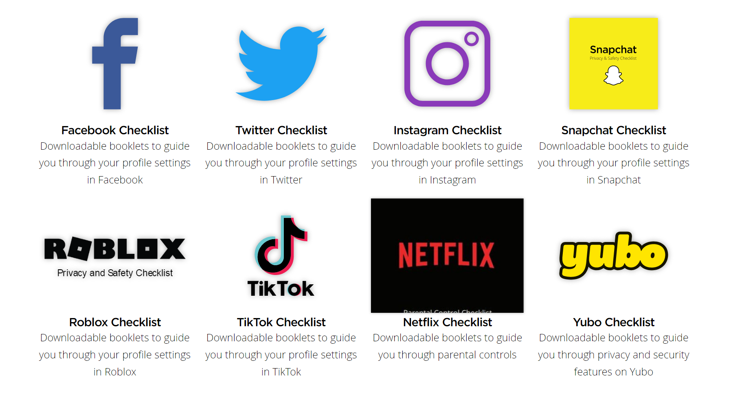
Filters and settings
Online safety guidance for parents
Notes:
In general you should go into your devices at home and use the parental controls to make them safer. Internet Matters. Org as seen here is a great site (link is on our website) as you can use the drop down menus to select your device and get instructions to guide you through the settings. We also have available tonight a number of leaflets to help you with specific and popular games and apps such as, Facebook, instragram, snapchat and a few others. Unfortunately we could not get Roblox and Tiktok as they were out of stock but we have popped links so you can download the guides from our website. We also have a general ‘Online Safety Guide for parents and carers’ for you to take as well.

Slide 10
App Top Tip
Notes:
A key thing to mention is that it is best to put a gift card on your child’s device or devices that they use, rather than your credit card details as, if they accidentally make inapt purchases, there is a limit to how much they can spend. CLICK
Newspaper headline December 2020

Slide 11
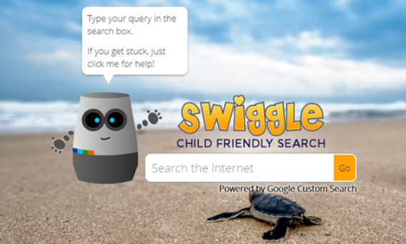
Notes:
So you have made sure you have all the settings and filtering sorted. You have gone through the settings with your child about the apps you have downloaded together and they know what to do if something goes wrong on them. You have a safe search engine so the chance of them spotting something they shouldn’t is reduced. So you can sit back and relax but unfortunately not. Things can still go wrong. So make sure your child knows they can come to you when it does and that you won’t be cross. It could be as innocent as typing in ‘string’ to a google image search and getting some eye opening results or going on a friends phone and accessing things you have already said no too. Your reaction is important because you want to make sure that they’ll come to you in the future. If they are upset by something that they have seen they will need a lot of reassurance and depending how traumatized they are please do come to us as a school to see what support we can offer.

Slide 12
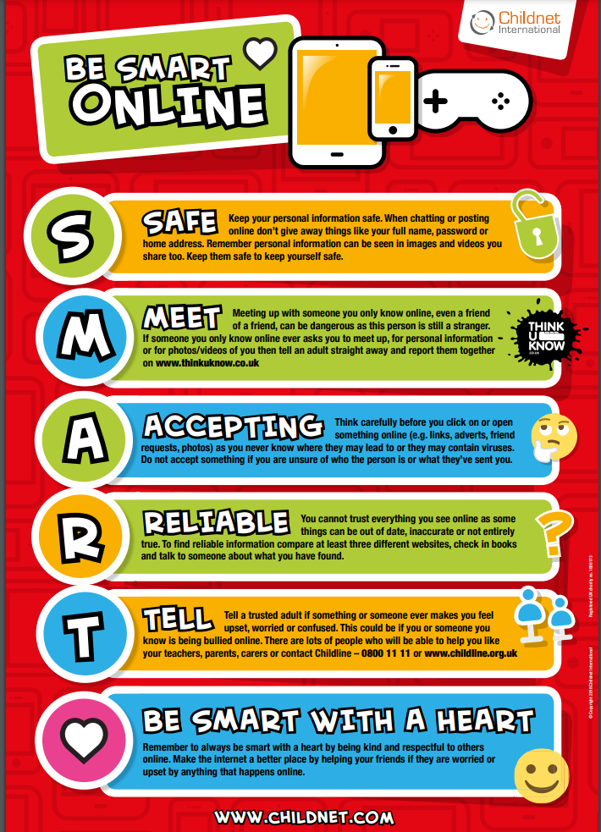
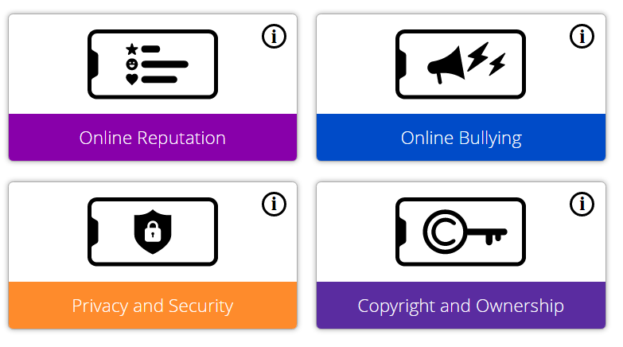
Online safety Lessons
Notes:
At St Johns we teach Online safety through ‘Project Evolve’, we also teach it through our computing lessons to ensure they children know how to stay safe when they are on devices and also through circle times when issues arise from outside of school or crop up through conversations in class.

Slide 13
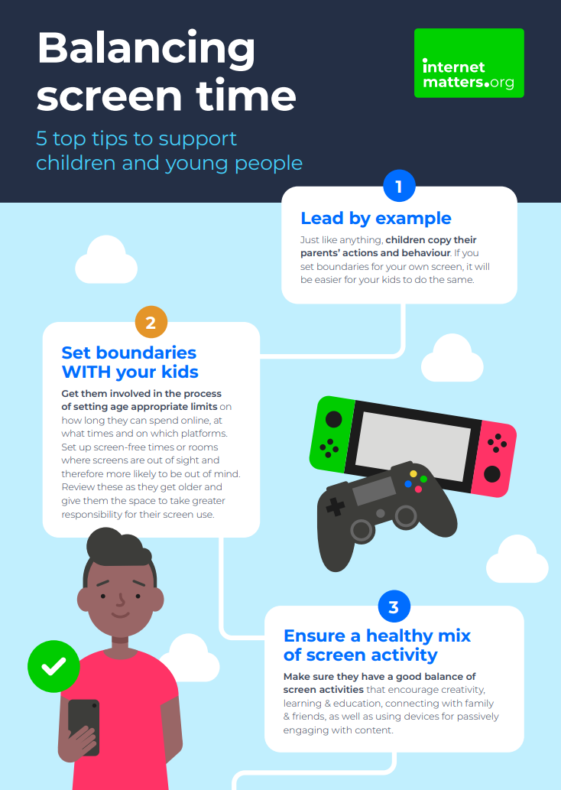
Screen time - is there a magic number?
Notes:
When it comes to using technology and the internet it all comes down to quality and not quantity, meaning that we should focus on making our use purposeful, and strike a healthy balance between online and offline experiences.(Childnet wellbeing) Screen time can offer children opportunities to learn and develop new skills at a touch of a button but like anything, too much of it can have a negative effect on their wellbeing.

Slide 14
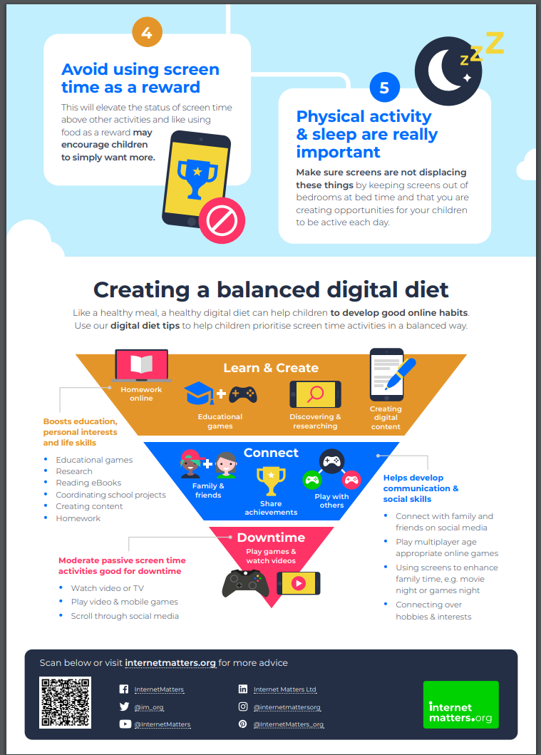

Slide 15
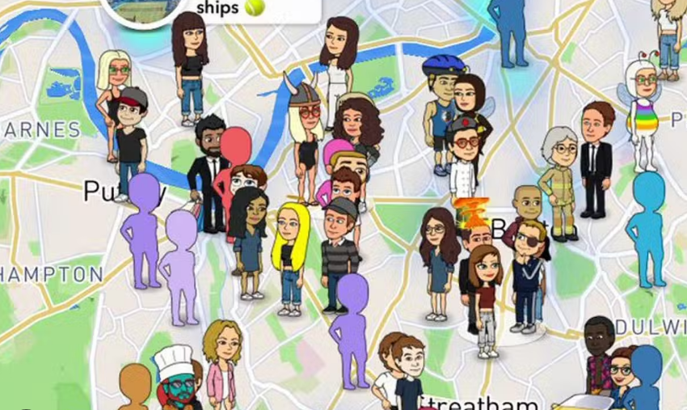
Sharing
Notes:
Sharing - as I said at the beginning this is two-fold. What are the children sharing when they are communicating with others but also what are they sharing when they sign up with a provider.
Firstly, what are they sharing. I’ve popped this slide up again. We go through a number of rules about what should not be shared and this is all about our personal information. Nickname and Avatar. This is taught from EYFS all the way through to Y6 as it is such an important lesson. As the children get older we talk to them about how much they give away without meaning to and there are lessons around reading messages or a script of talk and the children are surprised about how much information has been shared A key thing to note for those with older children and about to go to secondary school - do remind them not to make videos of themselves in their school uniform as this is the easiest way for someone to find out where they are. Just have regular check in’s with your children
So signing up to apps and games and sharing data with the provider - like me you have probably opened up a data agreement and having been scrolling through for over a minute you end up tapping accept without having completed reading it. In theory, anything for a child under the age of 12 the providers are not allowed to keep the data let alone pass it on or sell it. I think it is definitely worth ensuring that all contact information is yours and not your child’s and is a good idea to set up a family email account just to use as an email address for apps and games.
Whilst talking of sharing it is definitely worth mentioning Snapchat - If children use this app - you should be 13+ to have it and we Definitely do not recommend it. They should have their app in ghost mode so that
others cannot see where they are or where they were when they took photos. It even tells you how long it will take you to get to someone. Also check other social media apps to ensure they don’t share location when in the app.
SO to recap - remind children not to share personal information. Lock down social media apps so location is not on or only on so you the parents can see where they are. Then check what data is being shared when you done you download apps and use a family email address, your own phone number so spam is not going to your child

Slide 16
Watch this:
https://www.youtube.com/watch?v=K5IqSYSi1kE

Slide 17
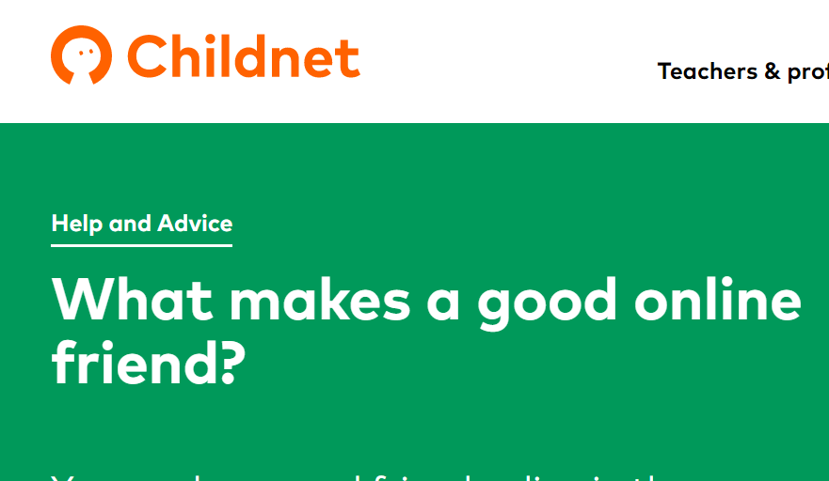
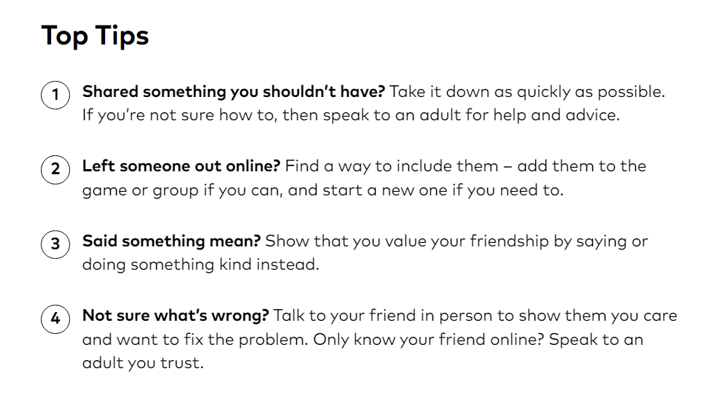
Friending - who is a friend and friendship issues
Notes:
We teach children that the same rules apply for how we treat people in real life to how we treat them online. That if we make a mistake we need to own up to it and apologise just like we do in the playground. Talking of playground issues - issues such as being left out of games is replicated online when children are left out of Whats app groups for example. CLICK
We talk to the children a lot about empathy - how would you feel if…. As parents and carers you will need to support this step into socialising online with friends they know in the real world. Are their messages appropriate? How might someone interpret your message if you wrote it all in capital letters etc Children need to be aware of the impact of their online activity can have onboth themselves and others, and how people might perceive them because of what they say and do online.
So children will start off by talking and messaging people they know in real life but then will start communication with people they do not know. It can be amazing that they have this opportunity to connect with people from across the world but it can be scary as well. We need to keep reminding children not to share personal information, if someone is making them feel uncomfortable then something is not right and trust their instincts. Equally it is easy for children to feel anonymous online and feel they can say things that they would never say to a person face -to- face. It is important that we teach children that they should only behave as they would in a person to person chat. Children also should think about who can view what they post and that it can shared including information, photo’s, videos and messages that they have posted. It is important children realise that new friends online may not be who they say they are and once they are added to an online account you may be sharing personal information with them. PLAY CLIP If you have concerns that your child is, or has been, the subject of inappropriate sexual contact or had requests for images and videos - it is importnat you report it to the police via the Child Exploitation and Online Protection centre. The link can be found on our website.
Do not say an outright no to meeting someone in real life as they may go behind your back and do it and that is a lot more dangerous.Be clear that if they are who they say they are then they will be happy for you to go with them and you would expect them to have their parents with them as well.
We must also mention here Online Bullying - any bullying whether through devices or face to face is unacceptable. If you are concerned about messages your child is receiving or equally sending then do take screen shots and come in to speak to us about it or the police. Do use online tools to report and block the perpetrator. Do not take the device away from your child as they will not share a problem with you in the future.
If you find a photo that has a photo of a person under 18 partially nude or is a sexually explicit image or video YOU MUST NOT screen shot it or share it. You can talk to the police as this would be a safeguarding issue and they are not looking to criminalise young people but do have a duty of care to investigate. Very young children may take a ‘funny’ photo - need to make clear that private parts need to stay private and it is not for sharing. Delete the image and if it has been sent ask others to delete it also. Do seek advice from us or the police if you want further support.

Slide 18
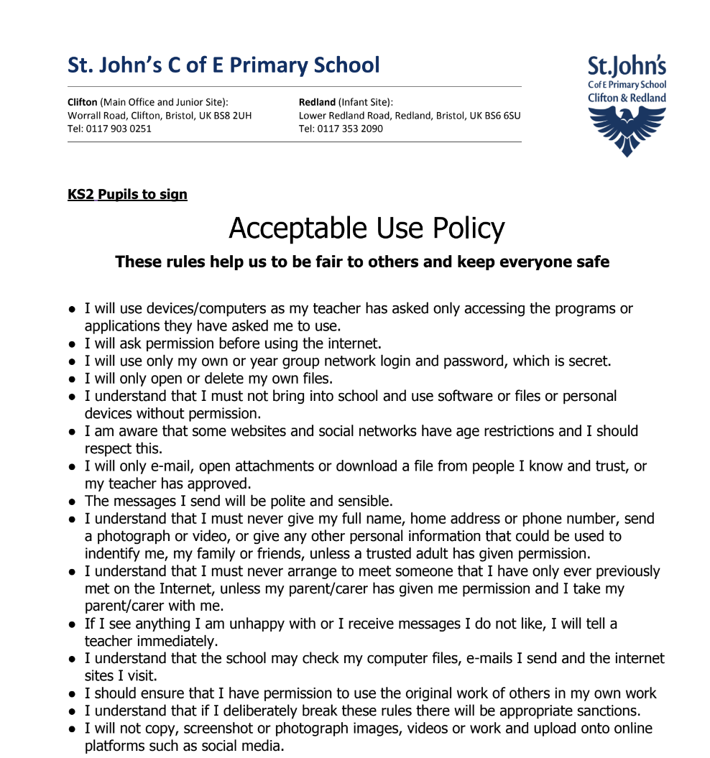
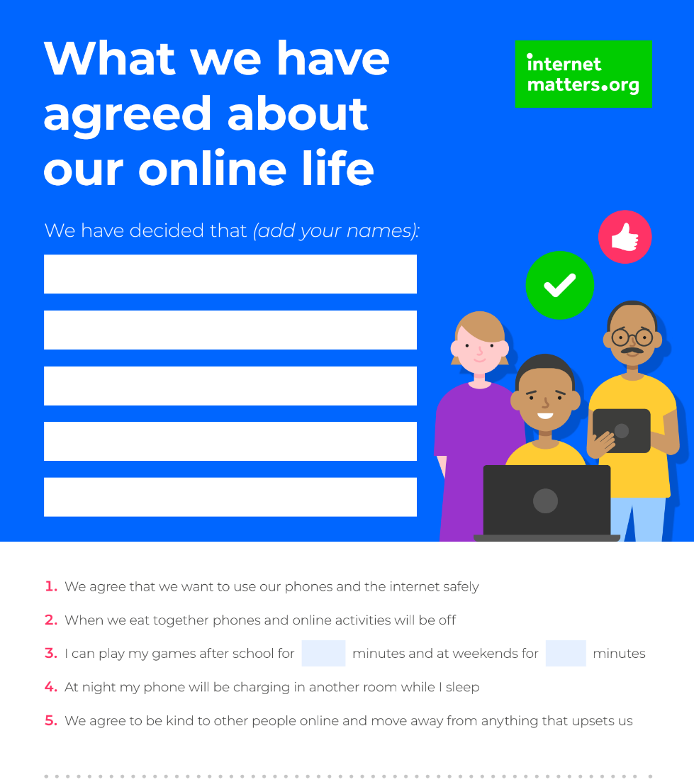
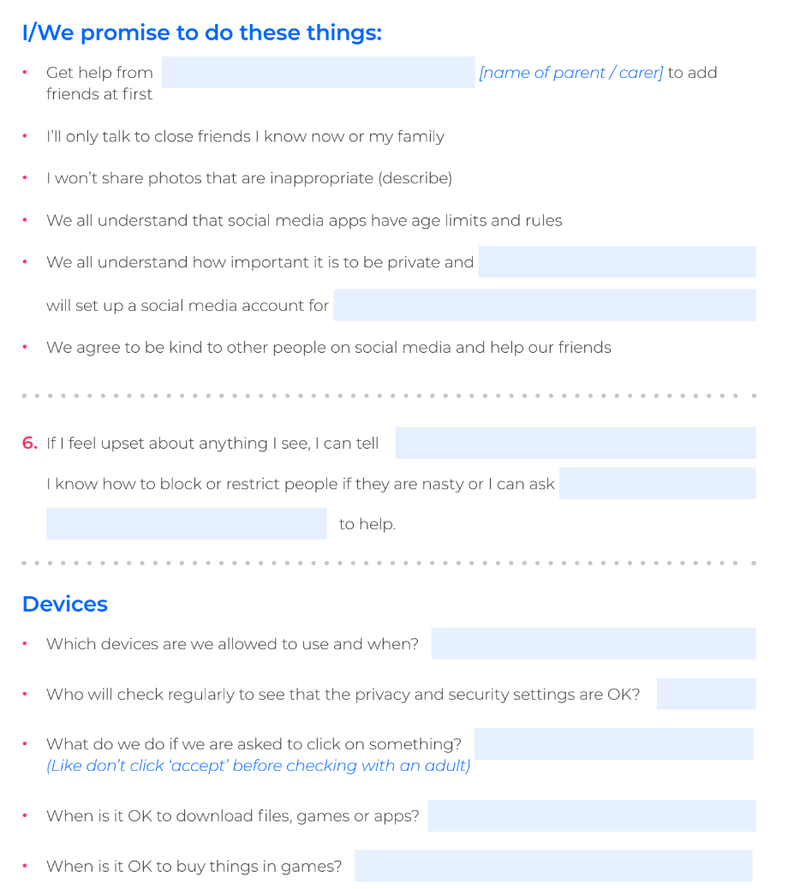
Agreements
Notes:
So contracts or agreements about how we behave online. You could adopt the school Acceptable use policy as a guide to your rules or have a specific one for home that goes so far as saying, for example. How long they are allowed on their devices. Make sure you have it part of your phone agreement that you are able to check in on their phone to check they are okay and to support them. Having a phone is not a right. You have chosen that you feel they are responsible enough for one but the key word there was responsible - having a phone or any device comes with responsibilities. Ensure children know that the agreement is up for discussion as they get older and are showing correct online behaviours.

Slide 19
Notes:
I understand that it is annoying to hear the sound of a game playing especially with repeating music or sounds but so crucial to be hearing what your child is doing. Believe me your sixth sense will be alerted when something is not going right. This brings me to my second point - (click). Always online in a shared family space. Whether you child is 4 or 14 they should only be online in these shared spaces so that they do not become isolated and in their own little bubble. Something that definitely happens when they have a headset on also.
Headsets _ there are more than one type of head set now. Stay clear of an Oculus Headset - it is operated through the headset and has VR chats - your child will be in their own little bubble and you will not know what is going on or who they are chatting with - Avon and Somerset police warning. 14 year olds in chat room and being threatened with rape. See the content - use it yourself
Here you will hear who they are friending, whether talk is appropriate or not. Also you can hear what talk they are listening to. I have heard the talk on some of these games and then am shocked to hear a young child’s voice know ing they have heard all the bad and aggressive language.

Slide 20
Apps to be aware of
Notes:
Finally, in order to help you be more internet savvy here are a few things you should know about. These look so innocent and yet unfortunately they are not. Monkey - Parents need to know that Monkey randomly connects teens with other Snapchat users for a 10-second video chat. They can add more time or add the person on Snapchat to continue the connection. Before connecting, teens will see the age and gender of the potential friend, and they can accept the video chat or not. The terms of service allow users ages 13 and older, but there's no verification of age.
Other important thing to mention about snapchat is there have been reports of money muling through the site. The target children aged 15- 18 with messages saying “you can make £200 for 10 minutes of your time”. They ask for bank details and you’ll receive £2000 into account and told to keep £200 and pass the £1800 into another account. It contributes to money laundering, drug cartals and human trafficking. Long term consequences are being on the fraud database, have difficulty opening an account, 14 years in prison as an adult. Police are running a campaign called ‘Don’t be Fooled’
The calculator symbol you see on the left is actually not real. It is a fake icon that actually can be used to store photos and videos you do not want others to see.

Slide 21
Notes:
You Tube Kids - just be aware that if a friend shares a you tube link then it goes to the main site not the kids one.
What’s app: Now rated 16 in the UK. The reason for this is that you can be added to groups even if you only know one person in that group as they are friends of friends. They can then save your number. We know this is popular for children to use so if you are allowing it please check regularly the groups and the type of chat. Have supportive not banning conversations as your child will hide things from you.
Discord: People can send direct messages to each other, chat, and talk or listen in larger group chats. Using a feature that scans for people you know when adding friends (with location features turned on) lets you find users who are near you. Although chat should be monitored for those 13 + if a child has lied about their age then they will be hearing talk that is not appropriate.
Skype and Facetime - ensure setting are use to contacts and that children are using in a family space. Lastly Omegle - Well the catch phrase ‘talk to strangers’ says it all’ Users are supposed to be 18 or older, but you just need to check a box to indicate your age. Though both parties are initially anonymous, either could ask for and share personal information or make inappropriate/sexual comments, which opens the door to kids interacting with potential predators or groomers. Language is uncensored. You can have video chat and the police reported that people can find themselves in a video link with someone masterbating.

Slide 22
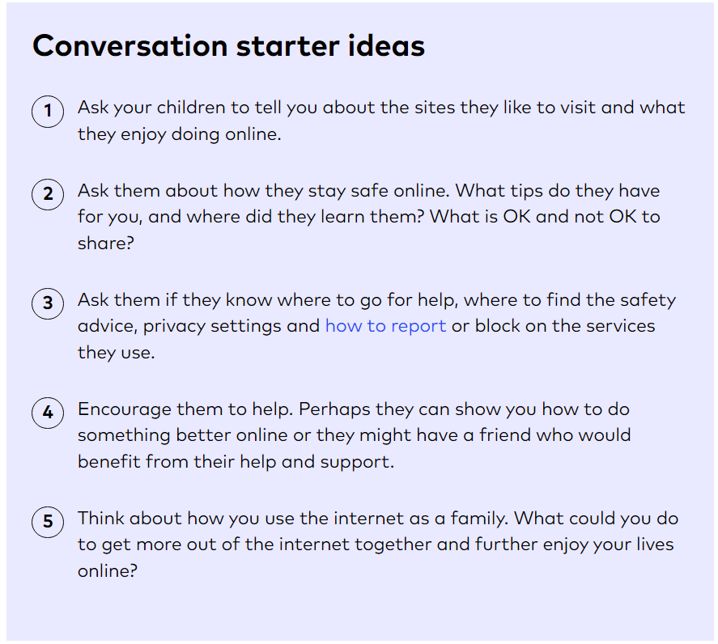
Mitigating the risk
Notes:
The key messages here are that devices should be used in family spaces. You should have a family agreement about how you will all use the devices and have regular conversations about what you are each doing and enjoying online. You should talk openly and honestly about mistakes you have made online and encourage your child to do the same. Ask questions like “How does the internet make you feel? Do different apps/games make you feel differently?
Playing games together helps build an understanding of what they enjoy and you can support them by modeling good online behaviour and help them in finding other appropriate activities. Remember that it is as important not to use going online as a reward as it is not to ban it if they have made a mistake.

Slide 23
Outcomes for the session
Give you a better understanding of online and cyber risks
Help you mitigate threats at home through technical and non-technical methods
Support you in being more cyber aware

