Slide 1
Positive Parenting
Wednesday 26th April 2023

Slide 2
Be respectful
Personal Information stays here
Supportive environment
Be kind to yourself parenting tough
Everyone struggles from time to time
We all get things right and wrong
We are aiming to do more of the right things more of the time

Slide 3
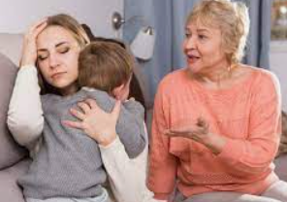
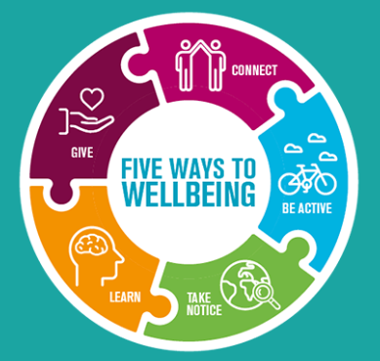
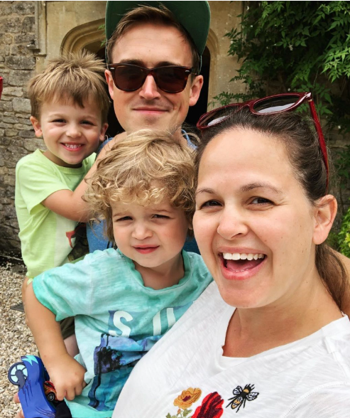
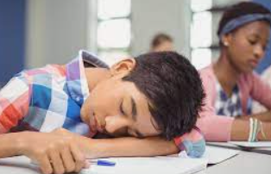
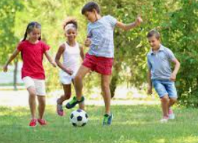
Context
Notes:
Lots of change, pressure. Lots of theories. Modern life. Over diagnosis. Mental health. Technology…..

Slide 4
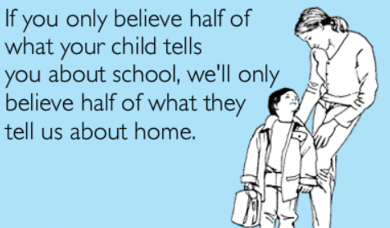
Partnership and the role of parents MR HOYE
Your role:
Establish a trusting relationship
Keep communication open
Provide boundaries
Remember to parent not befriend
You’ll need this later with …..
TEENAGERS!
‘I blame the other child.’
‘It can’t be my child.’
Instead try …
working in partnership with school, have an honest chat with us.

Slide 5
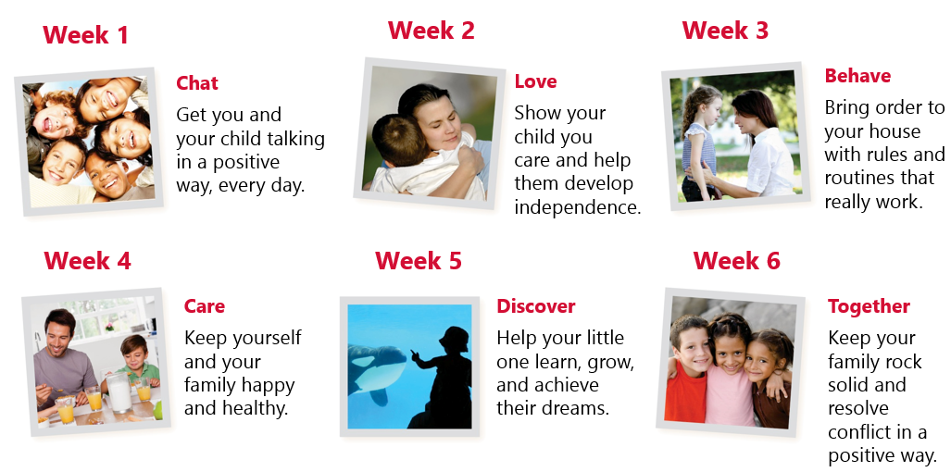
The Model
Notes:
Chat, Love and Behave are essential before developing further with Care, Discover and Together.

Slide 6
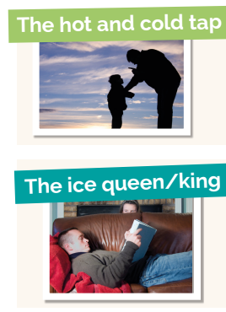
A self reflection

Slide 7
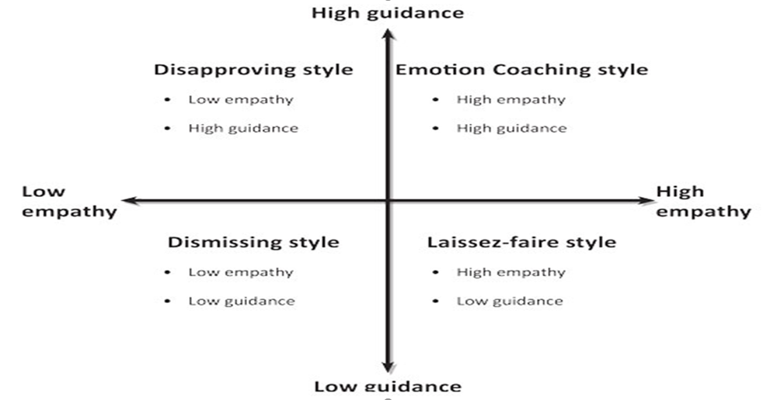
Style of parenting….

Slide 8
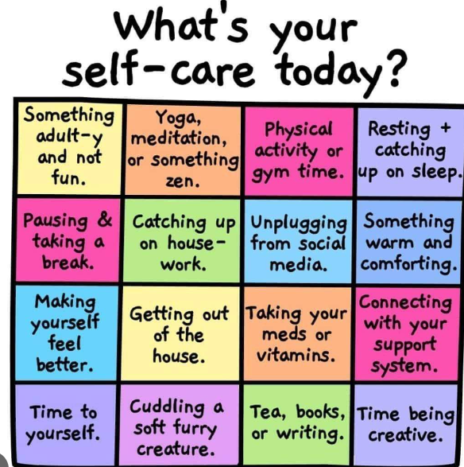
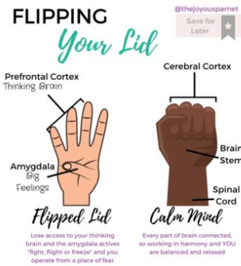
Must manage ourselves first!

Slide 9
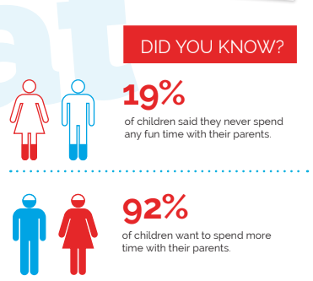
Importance of communicating with children (chat)

Slide 10
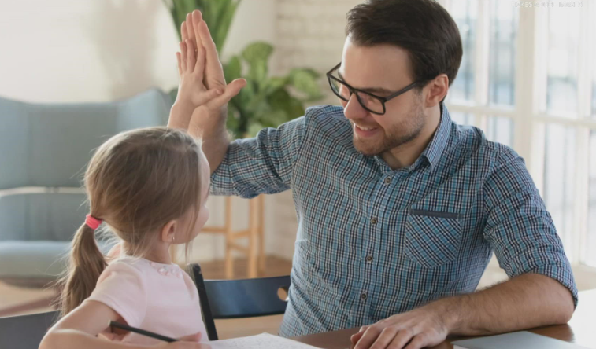
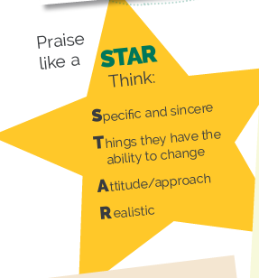
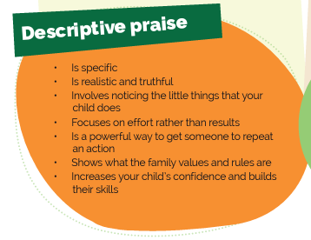
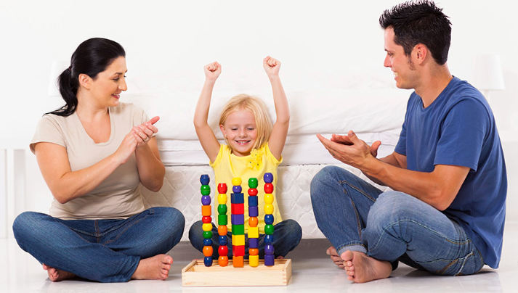
Chat Activity: DESCRIPTIVE PRAISE
It’s a literally a SUPERPOWER and it’s FREE!

Slide 11
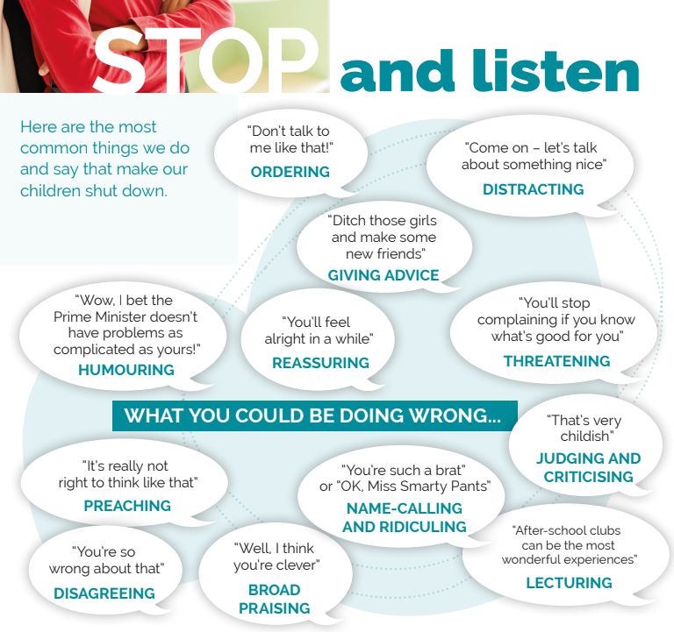
They just want us to listen ….

Slide 12
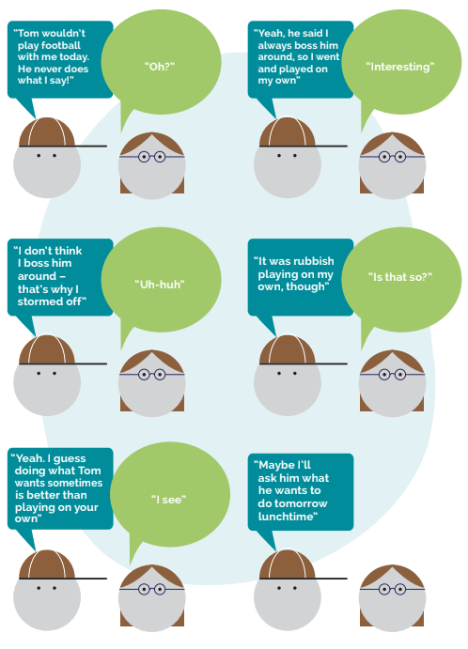

Slide 13
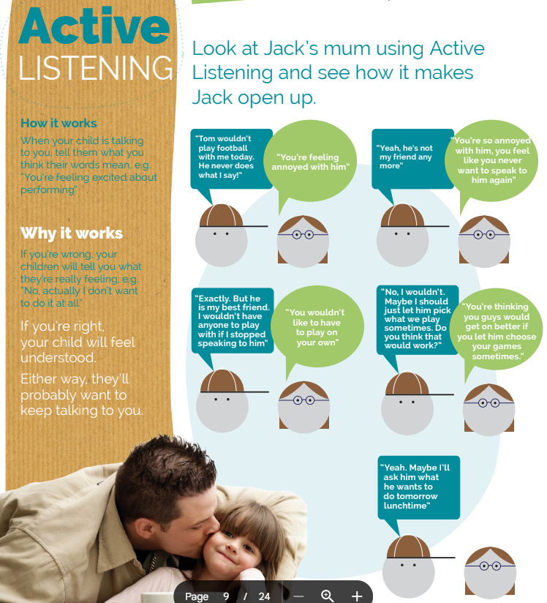

Slide 14
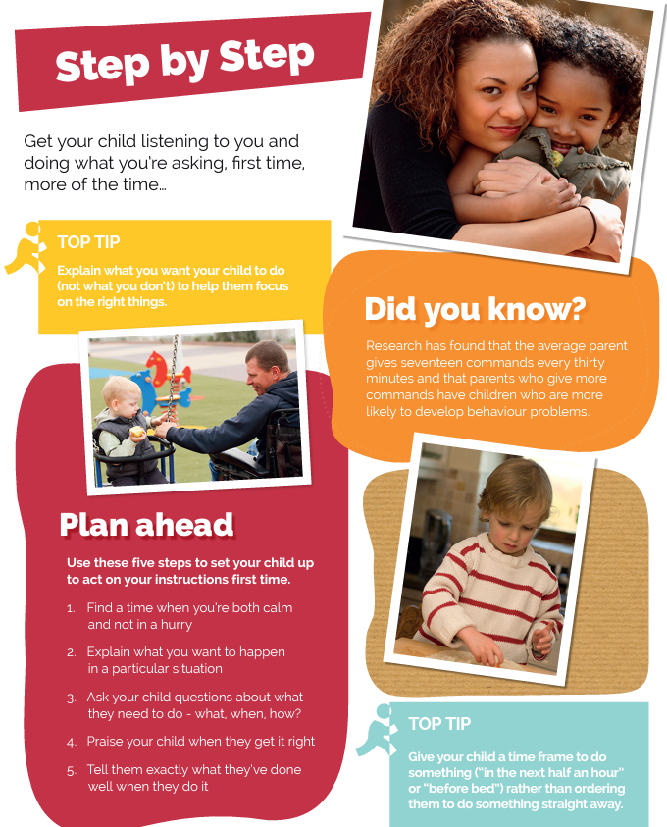
Chat Activity:

Slide 15
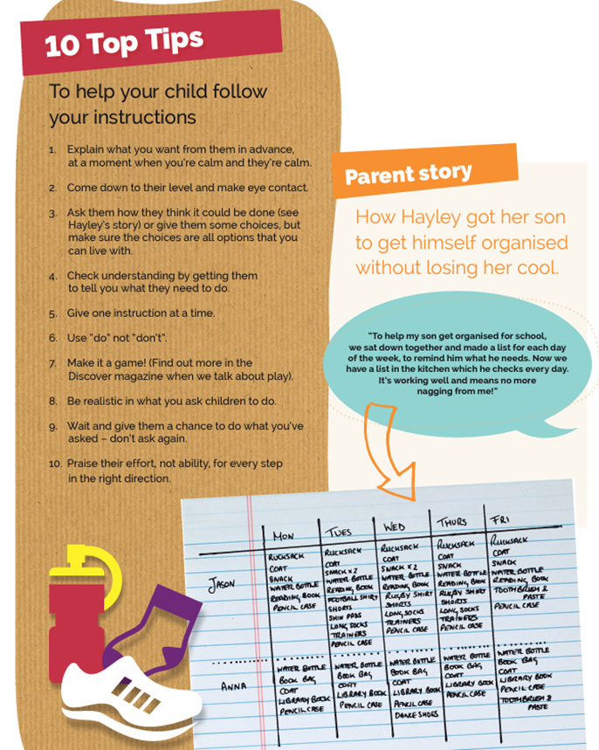

Slide 16
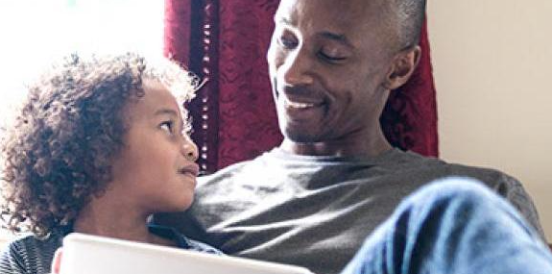
Chat – developing relationships
Reflect on your Talking/ Parenting style
Prioritise spending quality chat time with your child – plan the time – mornings, over dinner, at bedtime.
Descriptive Praise
Active Listening and Super Silence….
Keep communication open avoid jumping in, they won’t tell you next time!
Give yourself thinking time to respond
Listen to friendship, learning and worries
Give simple, timely instructions, allow take up time.
Plan fun days or activities to do

Slide 17
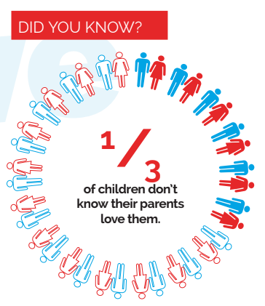
Love:

Slide 18
Love Activity: Parenting
No freedom ……….. Anchor ………… Too much freedom
Notes:
How were you parented? Too tight no freedom. Anchored with love and some independence. Too free without much time or care.
How do you parent now?

Slide 19
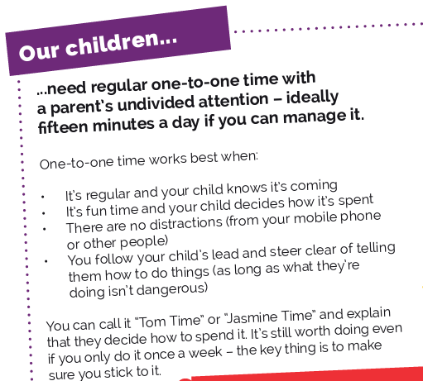
Love Activity: One to one time and LOVE BOMBING

Slide 20
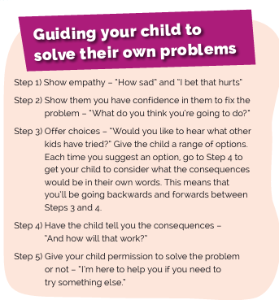
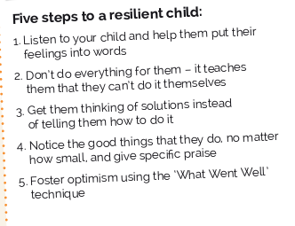
Love – Solving own problems and develop bounce back
Also…
Be optimistic yourself
Develop talents/ interests

Slide 21
Love – show it -recap
One to one time
Love Bombing
99 ways
Script for solving own problems
Developing independence
Develop a growth mindset (optimism)
Asking what went well today?
Tell them everything you do is coming from a ‘place of love.’

Slide 22
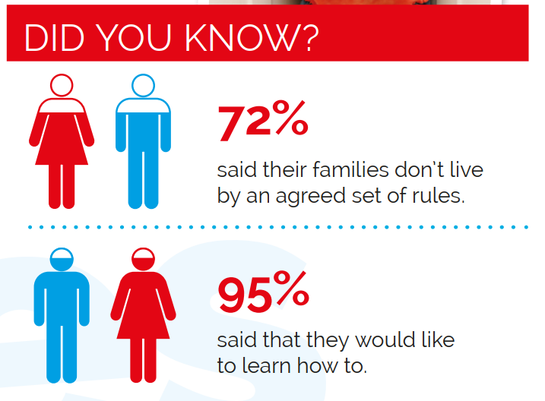
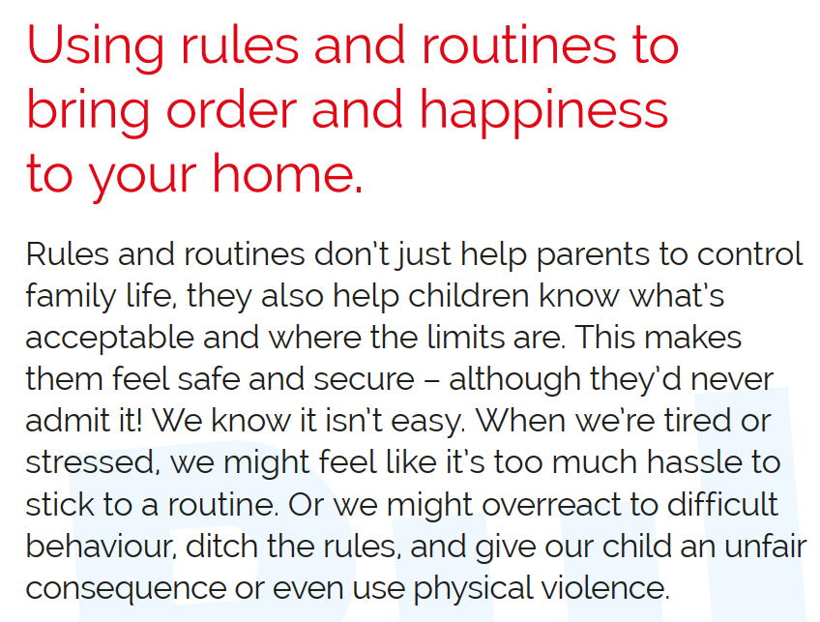
Behave
Notes:
Routines. Bedtimes. Timings try to stick to. Rewards help encourage key behaviour.

Slide 23
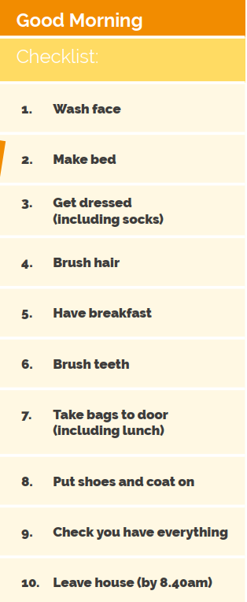
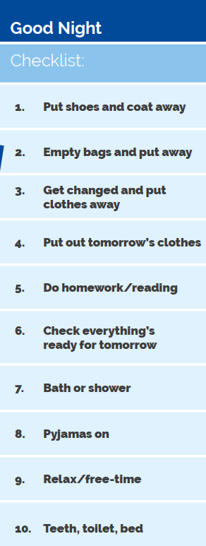
Routines
Notes:
Co- parenting e.g. Will a rule ever be ‘flexed’? (e.g. on a weekend, for good behaviour, if it’s be a difficult day…)

Slide 24
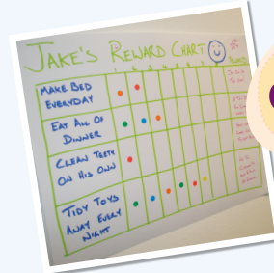
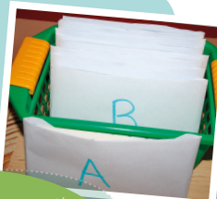
Rewards
Notes:
Rewards are important to change key behaviour and encourage what we want to see. Do this together. Plan it.

Slide 25
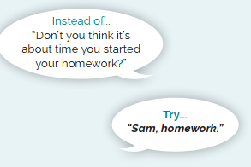
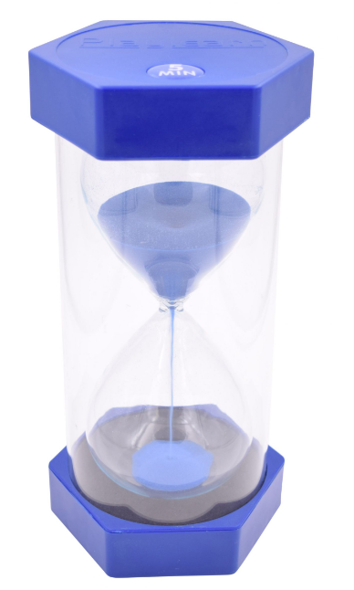
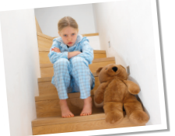
Strategies
Notes:
Co- parenting e.g. Will a rule ever be ‘flexed’? (e.g. on a weekend, for good behaviour, if it’s be a difficult day…)

Slide 26
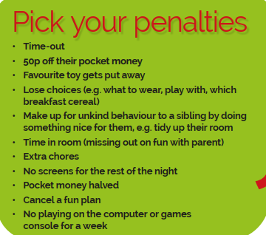
Behave
Notes:
Change of Face. Important to keep cool or you lose authority and poss. Relationship (avoid blame/ secondary chat…)
Stick to guns – consistency. Plan sanctions – make them small – so you don’t over react.

Slide 27
Behaviour reminders:
It’s ok to say no
You are their parent (a guide) not their friend
Boundaries (rules), routines and consistency all help.
Co-parent together
decision made together, check in with each other first.
Avoid partner v partner
Back each other up.
Discuss (or disagree) away from children.
Reflect and learn about what works well / doesn’t.
Was it the responses of you as a parent or the child or both that helped or hindered?
Notes:
Co- parenting e.g. Will a rule ever be ‘flexed’? (e.g. on a weekend, for good behaviour, if it’s be a difficult day…)

Slide 28
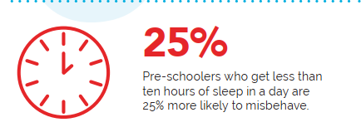
Care
Self Care
Be kind to yourself
No one is perfect … we all lose our temper
Remember it’s about doing more of the right things more of the time
Do self care (when you can) sleep, eat, exercise, hobbies/ mindfulness etc
Children:
Sleep for school aged children – 9 -11 hours. Routine is key. Provide a wind down, reward, exercise and sun in the day helps. No screens in hour before bed. Filter on devices. Set a bedtime.
Food – keep it balanced and healthy
Exercise - playing, gardening, walking, sport all count

Slide 29
Discover
Homework – environment, routine, rewards, little and often
Screen time
Play
Story time

Slide 30
Together
Conflict resolution - Stopping it spiralling
Co-parenting (learn & reflect together)
Family meeting:
parents in charge but done with children
Establish time and a buy in.
Changes everyone want to make (two way)
Keep it simple
Mention why???
Dream Team (siblings)
Connecting with others

Slide 31
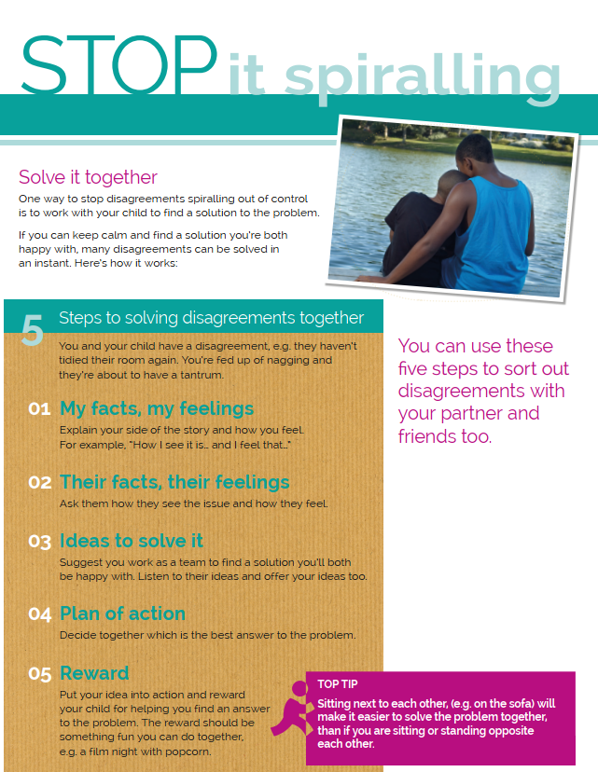

Slide 32
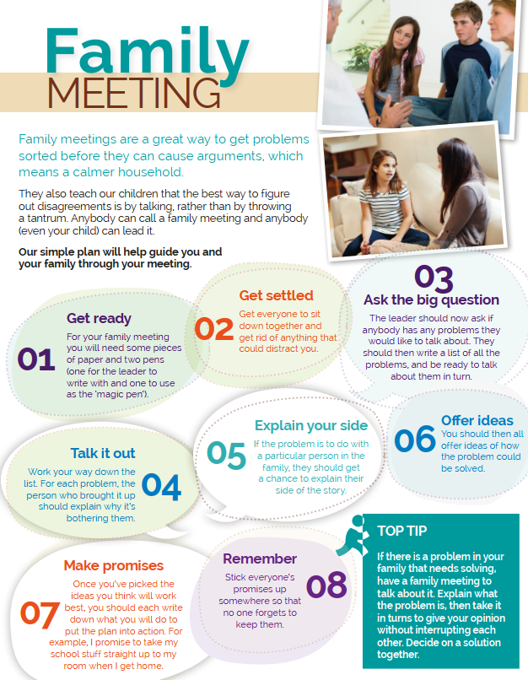

Slide 33
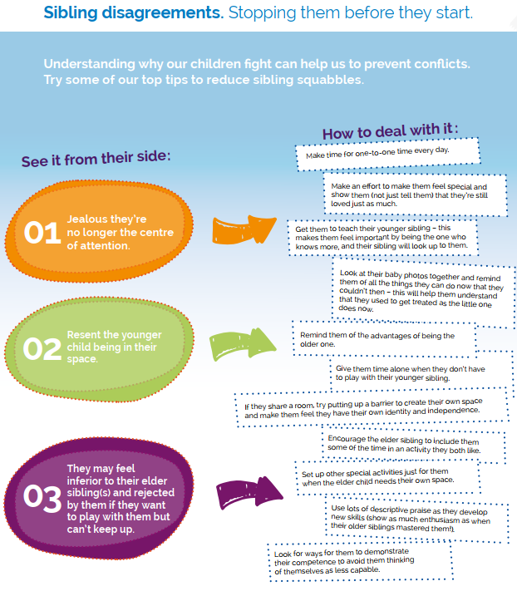

Slide 34
Parenting Help….
Family Lives
www.familylives.org.uk/how-we-can-help/online-parenting-courses
Net mums www.netmums.com/support/netmums-parenting-course-welcome
Bristol https://www.bristol.gov.uk/residents/social-care-and-health/children-and-families/support-for-parents-and-carers/parenting-courses-currently-running-in-bristol
Place2Be https://www.place2be.org.uk/our-services/parents-and-carers/support-for-families-in-place2be-schools/parenting-smart-online-course/#:~:text=Book%20now-,Overview,young%20people%2C%20and%20their%20families.
Parent Gym – offering an online 5 week complete course through he school. https://parentgym.com/

