Slide 1
Welcome to Year 1&2

Slide 2
Meet the Team
Notes:
All introduce

Slide 3
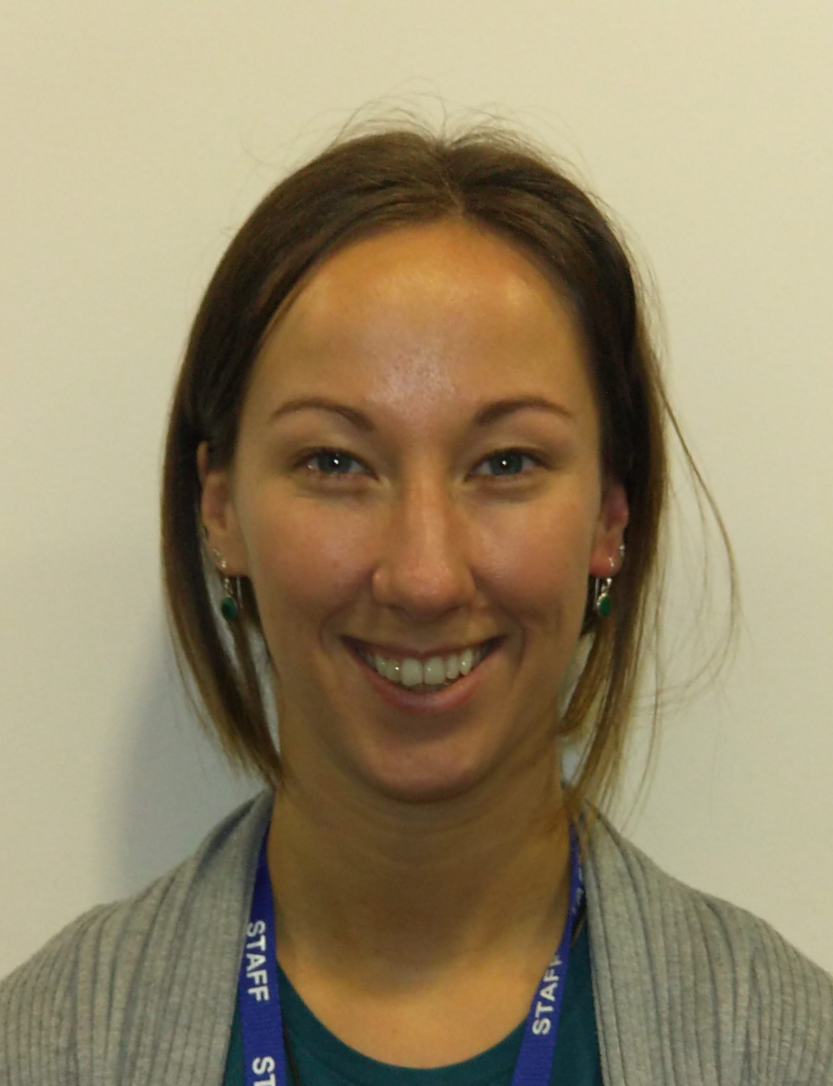
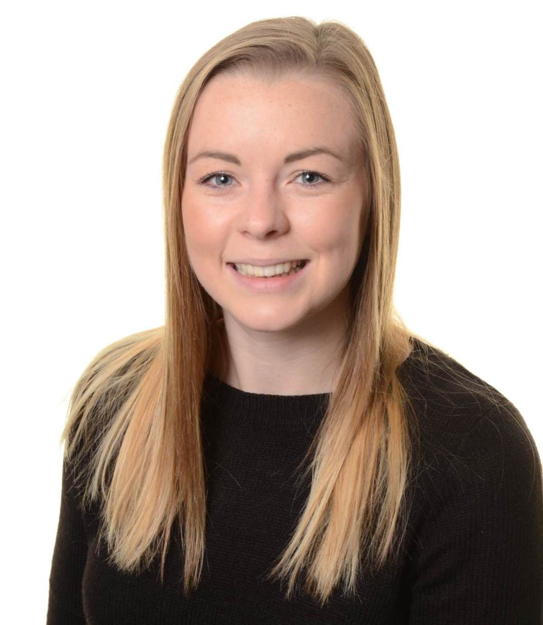
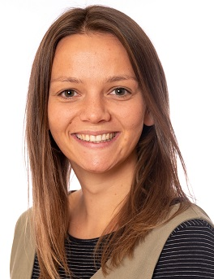
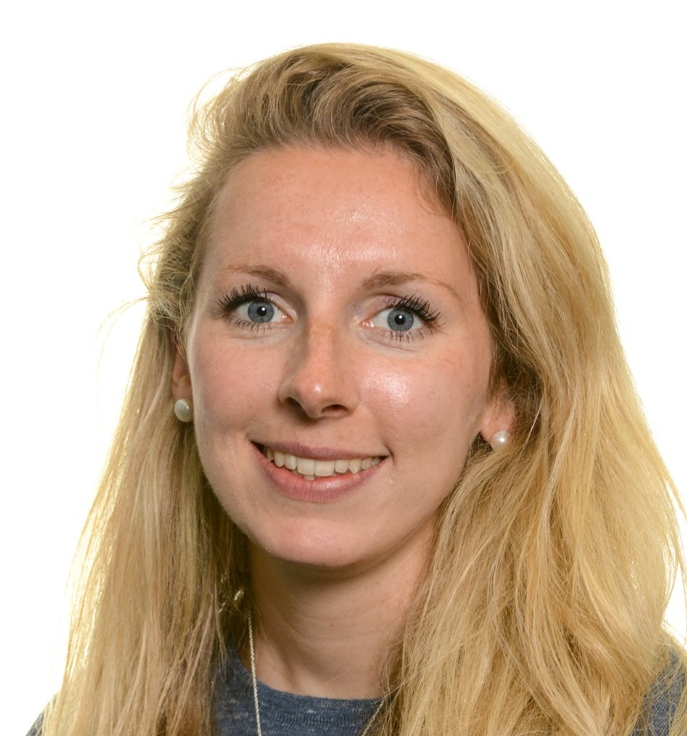
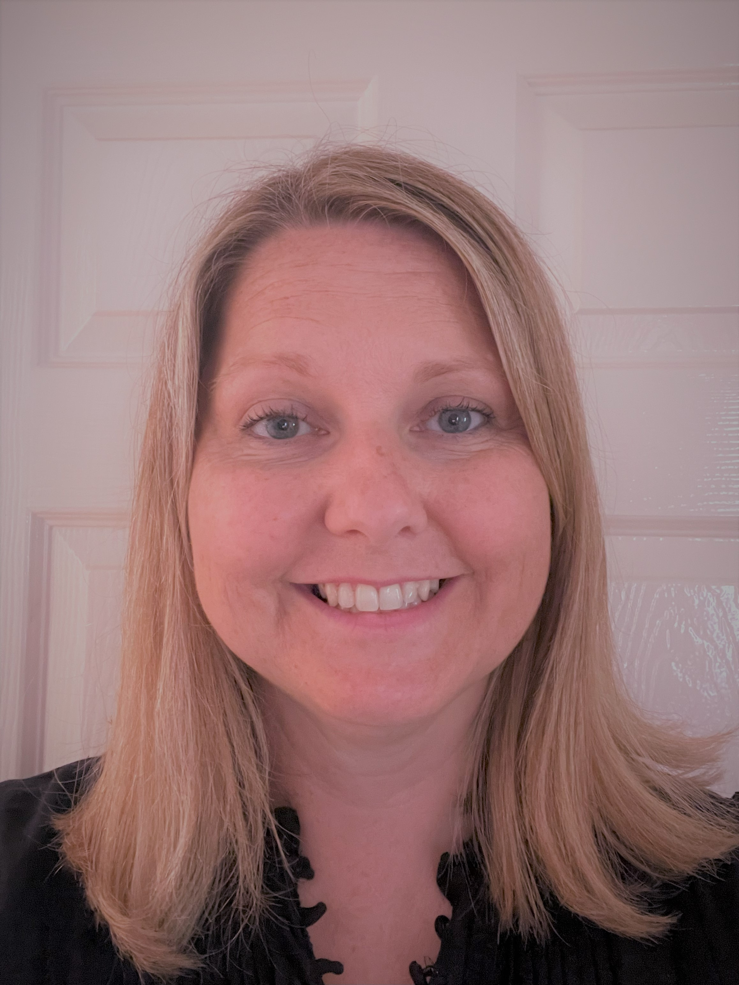
Class Teachers
Mrs Pickles Y1 Hawks Class (M,T,W)
Miss McCreery Y1 Kestrels Class
Mrs West Y1
Hawks Class (T2 W,T,F)
Miss Pearson
Harriers Class Y2
Miss Lugg
Falcons Class Y1&2
Miss Ricketts
Owls Class Y2

Slide 4
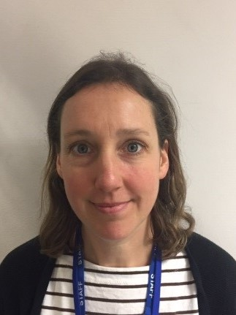
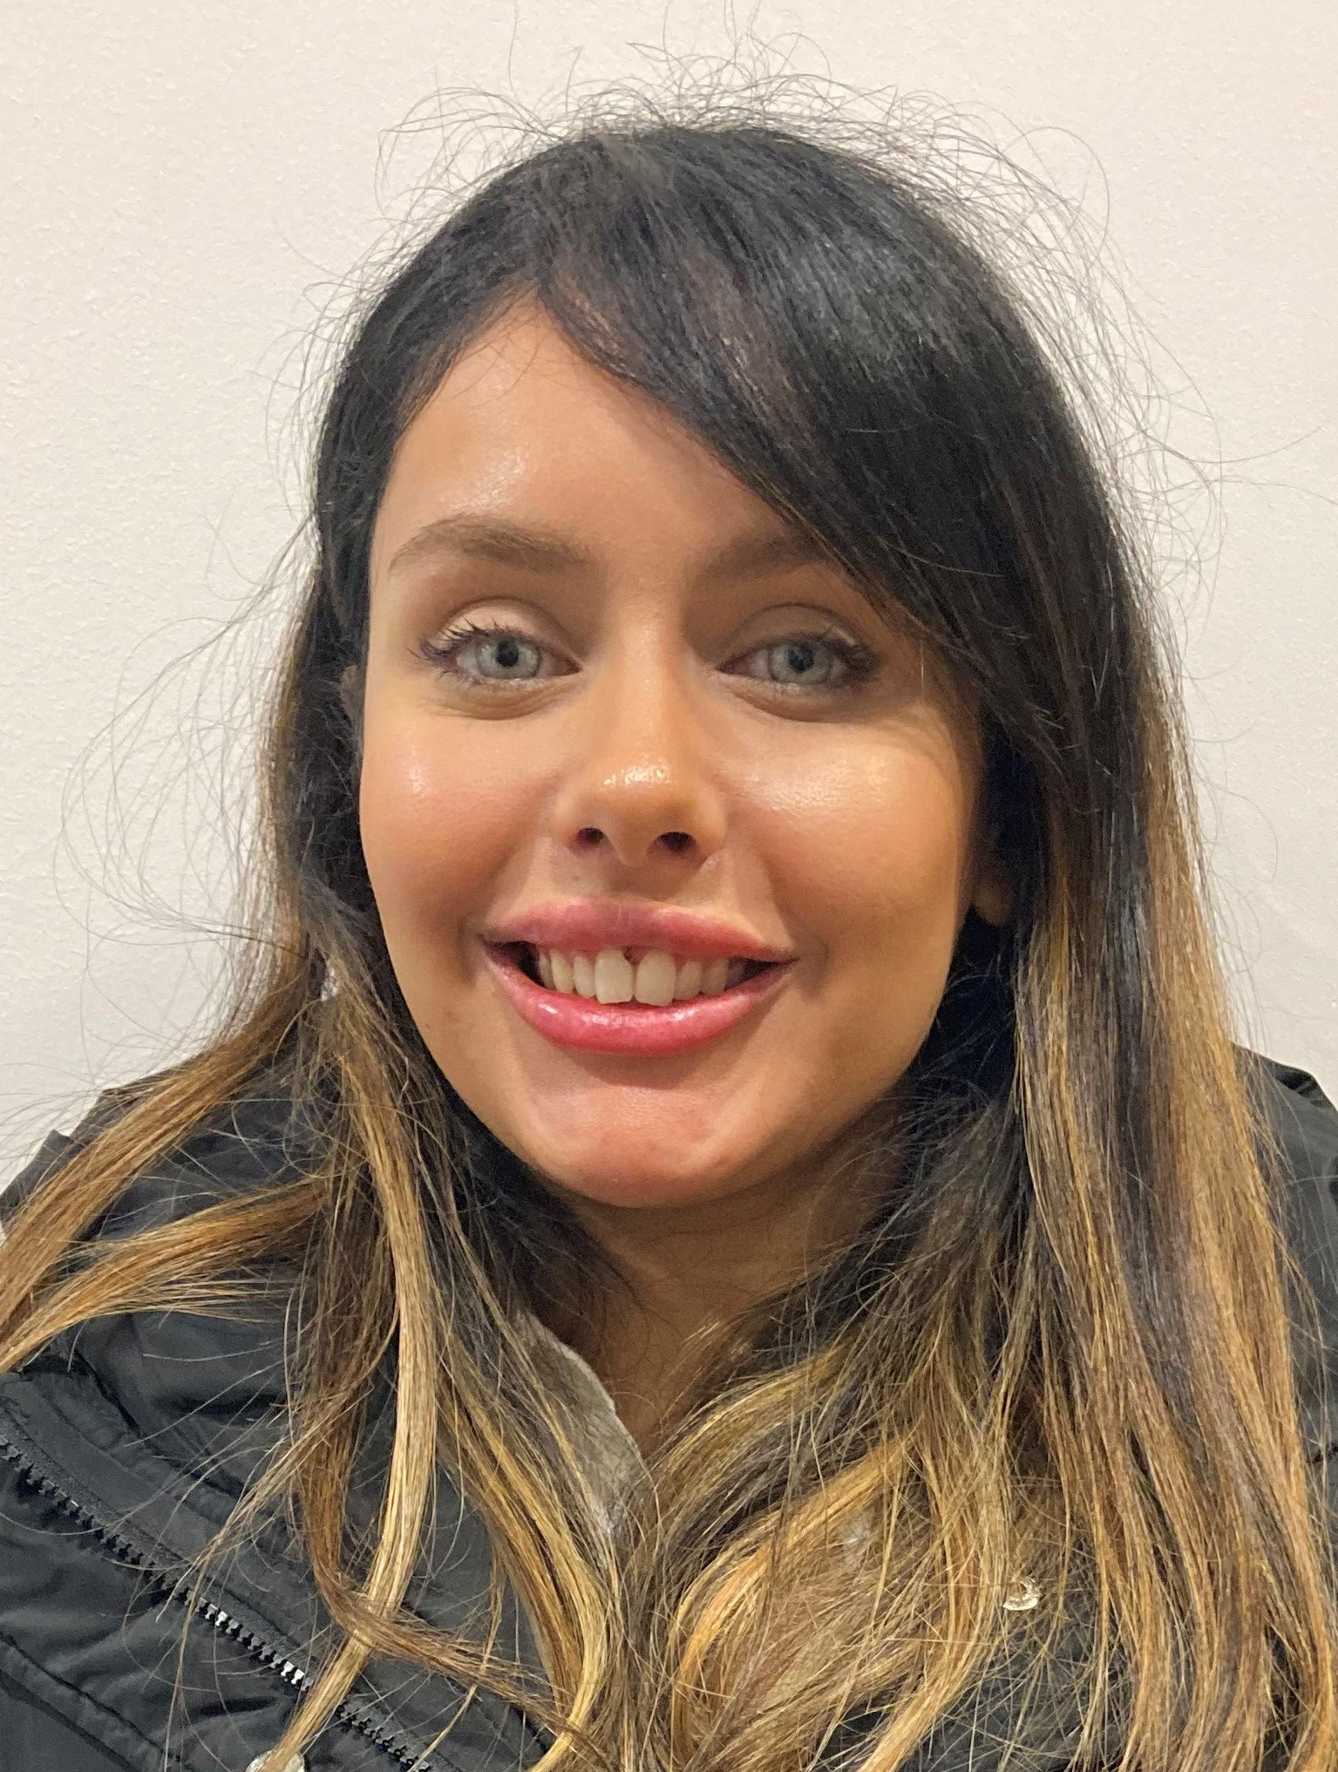
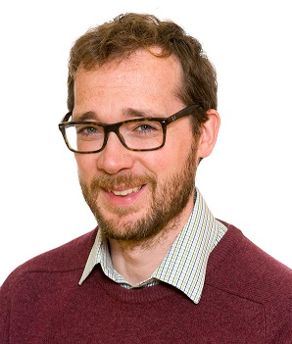
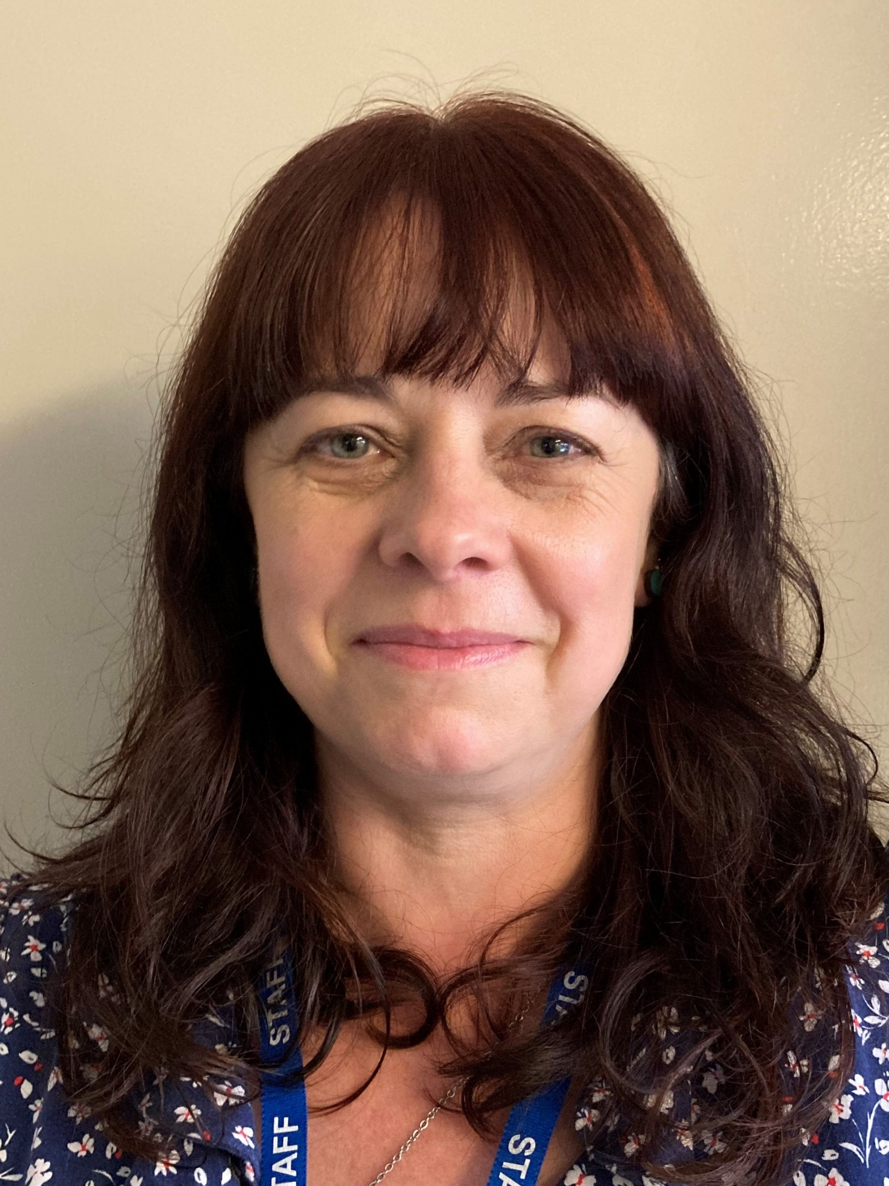
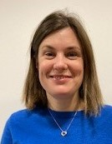
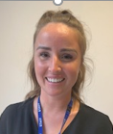
Other adults who work in Year 1&2
Mrs Garment
Learning Support Assistant
Mrs Igartua
Learning Support Assistant
Miss Rohani
Learning Support Assistant
Mr Travis
Learning Support Assistant and
Hawks class teacher Thursday and Friday
Mrs Crocker
Learning Support Assistant
Mrs Pickles
Hawks Class Teacher (Monday and Tuesday
Mrs Bennett
Learning Support Assistant
Miss Bracken
Learning Support Assistant
Mr Poole
Learning Support Assistant
Notes:
CS

Slide 5
Daily Routines
Prompt start, children to come in independently from 8.50. Bell will ring at 9am to indicate all children to make their way to their classroom.
Owls/Harriers/ Falcons through glass door on the playground.
Hawks and Kestrels enter through the classroom side doors.
Morning challenge for all.
In the mornings say goodbye at the door.
End of day: Prompt pick up 3.30pm. We will ensure a Safe handover.
Notes:
CS

Slide 6
What does Learning Look like in Y1&2
Due to the success of Continuous Provision last year we are continuing to use this as a structure to our teaching and learning in Y1&2.
This allows us to incorporate the demands of the Y1&2 curriculum, as well as provide children with the opportunity to continue to develop their own resilience, independence and key learning characteristics through purposeful play. This also allows us to provide the children with a smoother transition into their new year group.
As part of this project we are significantly developing our inside and outside classroom environments. If any parents have any old milk crates, wooden pallets, tyres, sturdy boxes, stones, pebbles etc that they would be able to donate to our new outside area then please contact your child’s class teacher.
Notes:
CS

Slide 7
Communication
Class emails (class name)@stjohnsprimary.org.uk
Weekly emails and bulletin.
Always available to discuss issues or concerns, please make an appointment. This will be via phone or face to face.
Before school for brief handover message to teacher/ LSA.
Please use the school website.
Notes:
CS

Slide 8
Uniform etc
Book bags not rucksacks.
All shoes should be black. This includes trainers.
Please can all uniform including tights be named!
All water bottles to be named.
No Nail varnish/Jewellery/ Tattoos to be worn by children. Sensible hairbands please.
Lost property inside lobby off the playground.
Please talk through school menu choice at home.
Notes:
ET

Slide 9
P.E.
As we are an active school, we try to encourage movement within all areas of the curriculum. If your child wears school shoes every day (other than P.E. days) then please have a pair of trainers in school every day.
PE kits to be worn to school on P.E days. The specific day/s will vary depending on your child’s class.
Owls: Wednesday and Thursday
Harriers: Wednesday and Thursday
Falcons: Monday and Wednesday
Kestrels: Monday and Wednesday
Hawks: Monday and Wednesday
Notes:
ET

Slide 10
Behaviour
We are a Rights Respecting School.
House points linked to values:
Respect, equality, collaboration, friendship, determination and positivity.
Rewards and certificates.
Sanctions.
Children to be monitored before and after school by parents.
Notes:
AP

Slide 11
Assessments
Regular checks on pupil progress.
Ongoing assessments across the curriculum.
Y2 SATS next May.
Y1 Phonics test next June.
Notes:
CS

Slide 12
How to help your child at home
Reading
Every day and record in yellow reading records. These records are checked on Friday.
Please send in reading records every day with reading book.
Reading books will be sent home in the next few weeks – see update on teaching phonics letter.
To encourage a joy of reading they can decorate their own reading record.
Notes:
CS

Slide 13
How to help your child at home
Maths
Mathletics log-ins will be in reading record.
Our curriculum focuses on developing a depth of knowledge rather than a breadth.
Focus on using ‘objects’ to help support the child’s understanding.
Notes:
RW

Slide 14
How to help your child at home
Spellings
There is a list of common exception words (red words) for each year group. This also includes spelling patterns for each year group.
Red word spellings are split into 6 termly word banks for both Year 1 and Year 2.
The spelling lists and a guide for parents including activities and games are all on our class page on the website.
We will be sending home any gaps in the children’s spelling knowledge so these can be learnt and practiced in conjunction with those learnt in school.
Spelling shed logins will come home in reading records.
Key Message:
Complete all these tasks regularly and this will really support your child’s learning. Keep it ‘little and often’ and ask for help from us if you need it.
Notes:
SM- phonic spelling as well as red words

Slide 15
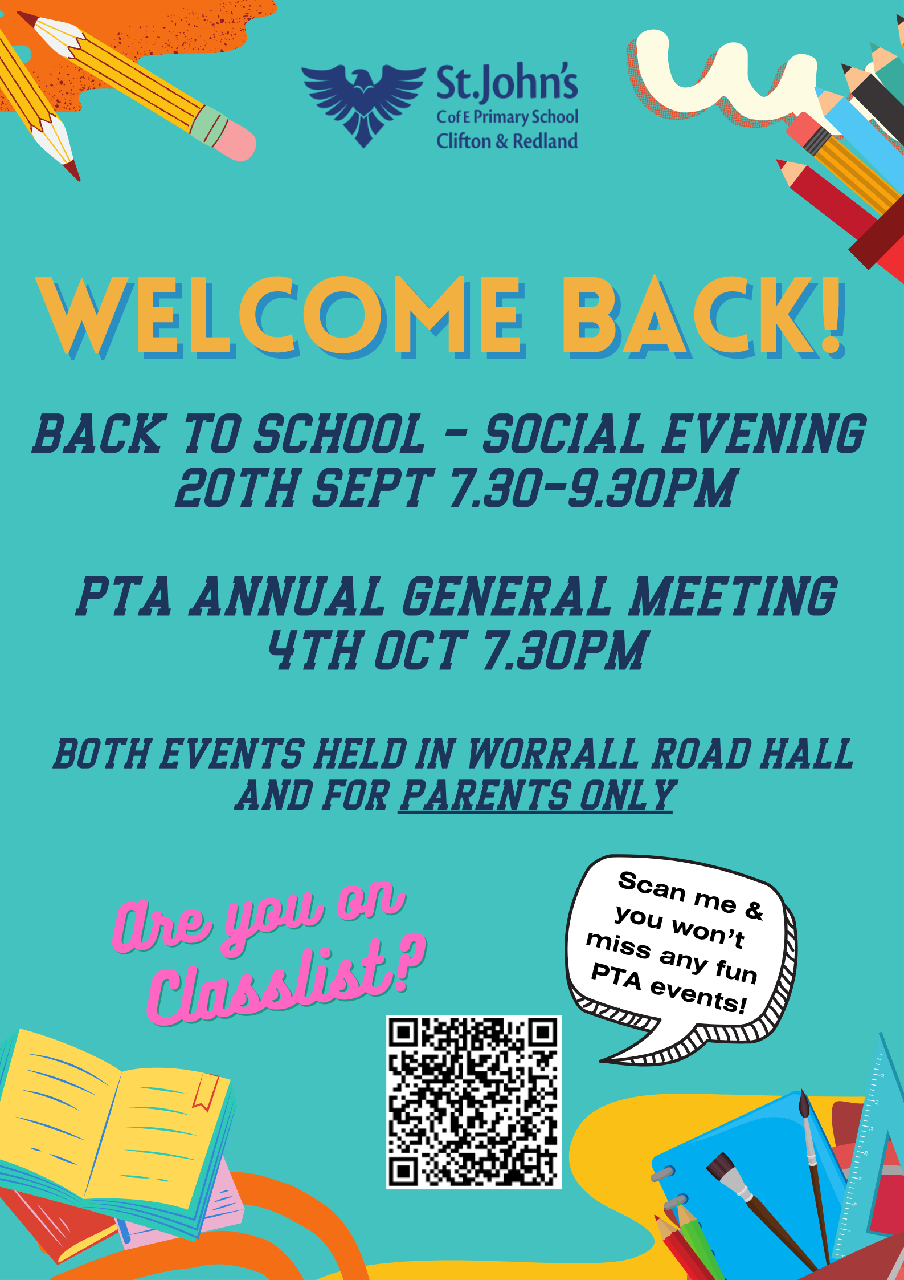

Slide 16
Questions?

